Slide 1
Survival Japanese
Helping you take your first steps in Japan
Module10 : Apartment Rubbish
Let’s have fun!

Slide 2
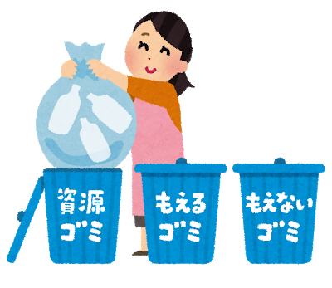
Why should I care?
Violations of social conventions, including garbage rules, were cited as the #2 reason why landlords don't want to rent to foreigners (link). It's also a major reason why some Japanese people don't want to live next to foreigners.
Apartment garbage is communal in Japan; by failing to follow the rules you are effectively annoying everyone else in your building. You may not think it's a big deal, but it is to your neighbors.
If you want any chance of making friends with the people around you, be a good neighbor by following the garbage rules carefully and immediately correcting any mistakes that you accidentally make.

Slide 3
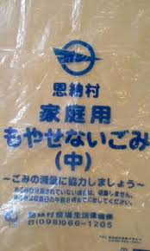
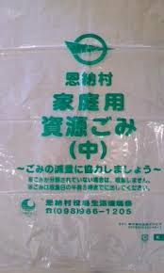
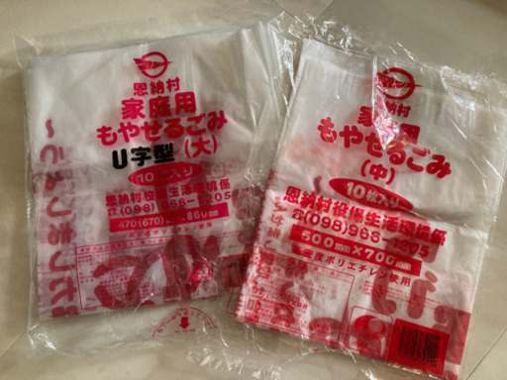
What bag should I buy?
Burnable trash
Non-burnable trash
Recyclables
You must buy the ones for the city you live in. These are for Onna-son (OIST).

Slide 4
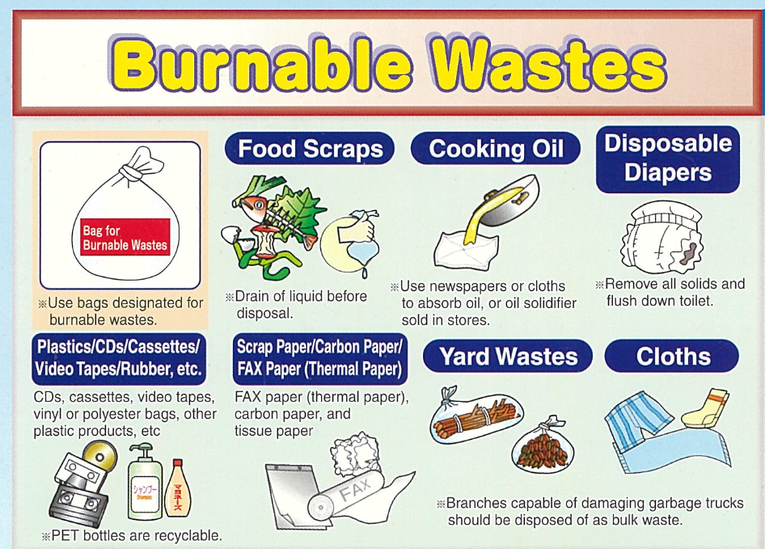
もやせるごみ Moyaseru gomi

Slide 5
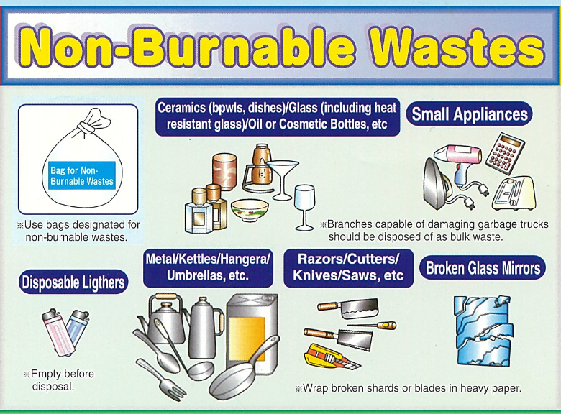
もやせないごみ Moyasenai gomi

Slide 6
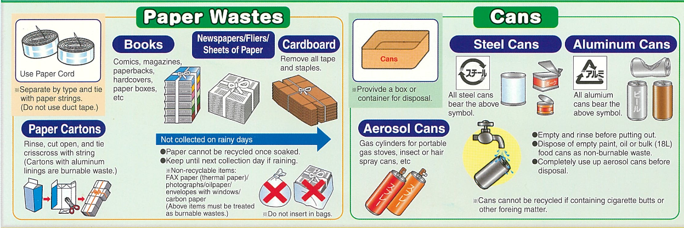
You have to use paper string or they won’t collect the recycling
資源ごみ Shigen gomi

Slide 7
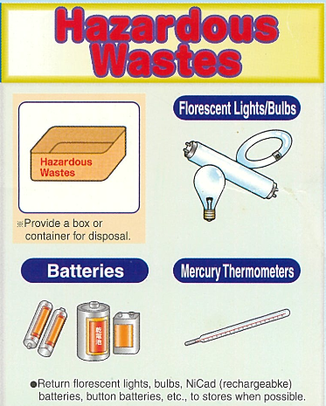
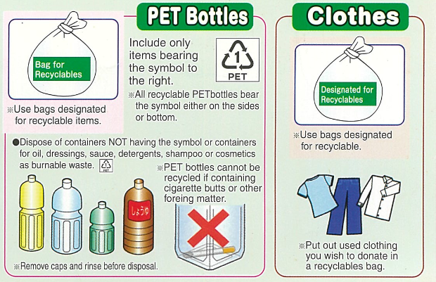
－
資源ごみ Shigen gomi
有害ごみ Ugai gomi
Be sure to take the labels off! Yes, this is a huge pain with imported food...

Slide 8
資源ごみ Shigen gomi
I’ve found that they’ll accept bottles and cans in recycle bags as well.

Slide 9
Bulk waste
Buy the ticket at your city hall. Don’t miss the reserved date, or the garbage may sit out for months!

Slide 10
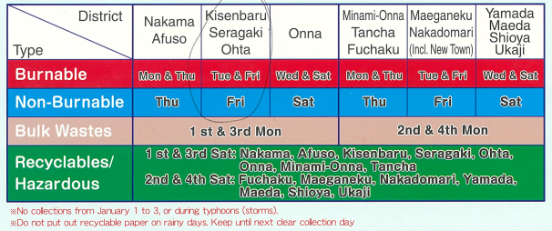
These are only for Onna-son. If you live in another village or town, yours will be different.

Slide 11
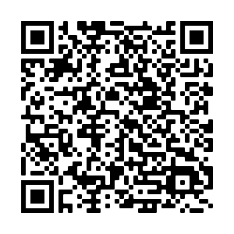
Survival Japanese
Helping you take your first steps in Japan
Office hours!
English and Japanese help
Free 30-min session
Otsukare sama desu!

