Slide 1
Where will science lead me in the future?

Slide 2
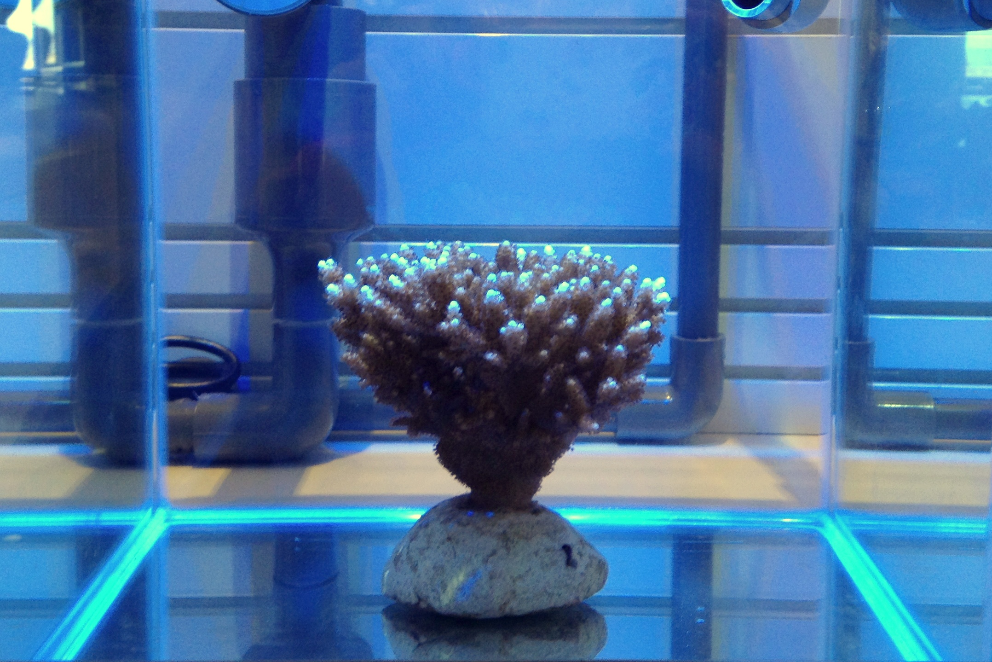
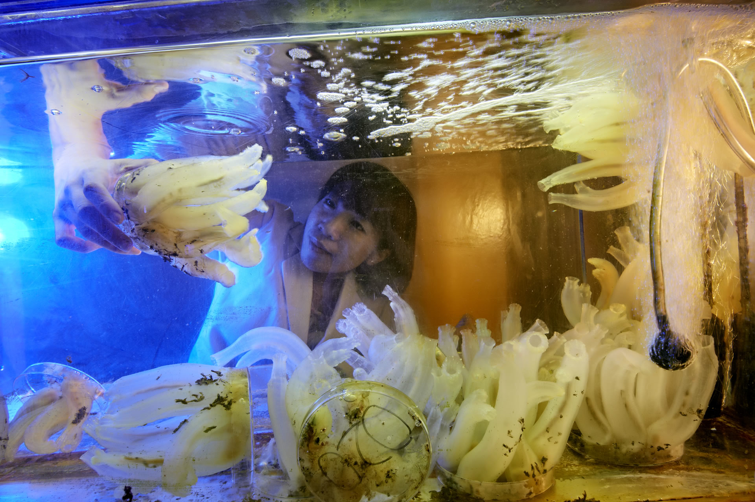
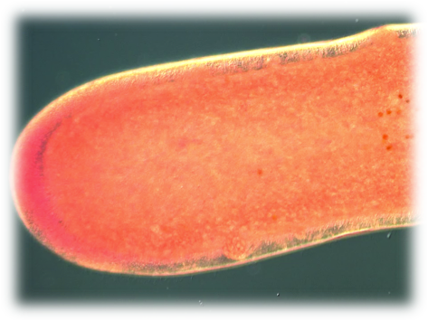
Great strides are being made in genetic sequencing.
The Marine Genomics Unit of
OIST has decoded the genome
of the Algae Symbiodinium
minutum. This is a major
advance in understanding the
complex ecology of coral reefs.
World’s first sequenced coral on
display
Sequencing genomes reveals the
relatedness of marine animals, as
well as their vulnerability to climate
change
Presentation Venue / Date & Time

Slide 3
In the future, this will lead to…

Slide 4
Diseases being treated with personalized treatment programs

Slide 5
The likelihood of contracting a disease will be determined so steps can be taken to lower risk through changes in lifestyle and/or environment.

Slide 6
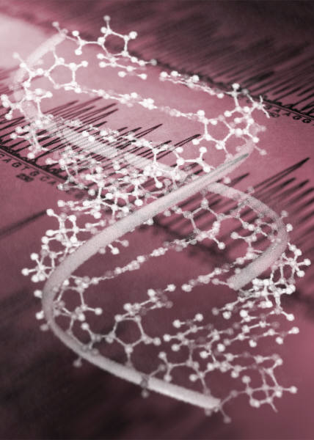
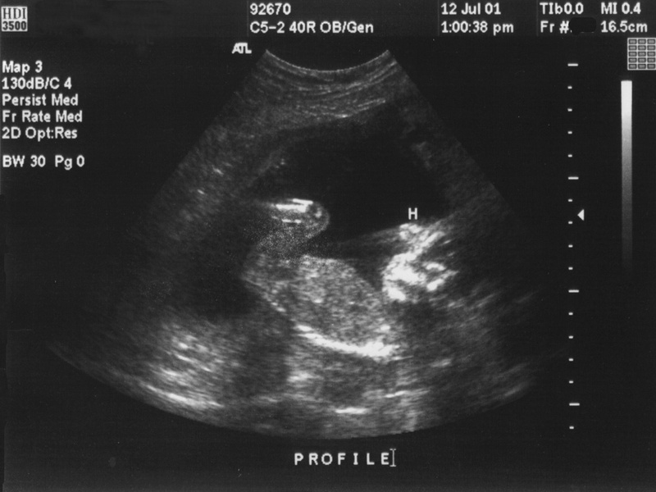
Learning whether individuals or couples are carriers of certain genetic diseases will indicate the chances of their children having the disease.

Slide 7
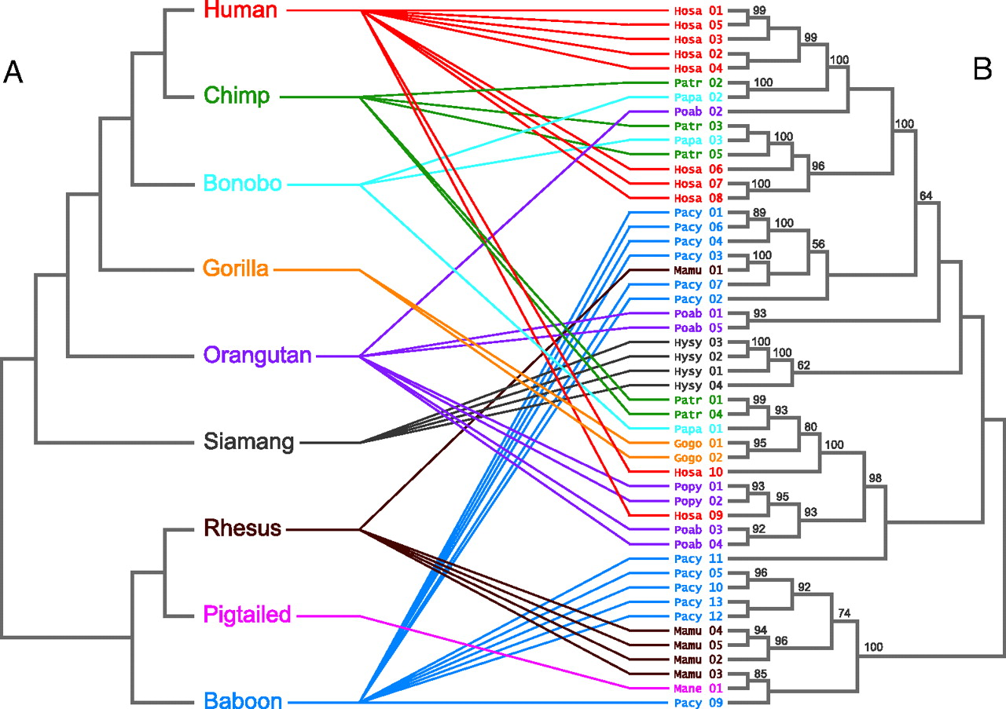
A better understanding of evolution and how all living things are related.
©2006 by National Academy of Sciences

Slide 8
In conclusion, science will take us to new and exciting innovations that will change the way we all live and perceive the world.
To the future…

