Slide 1
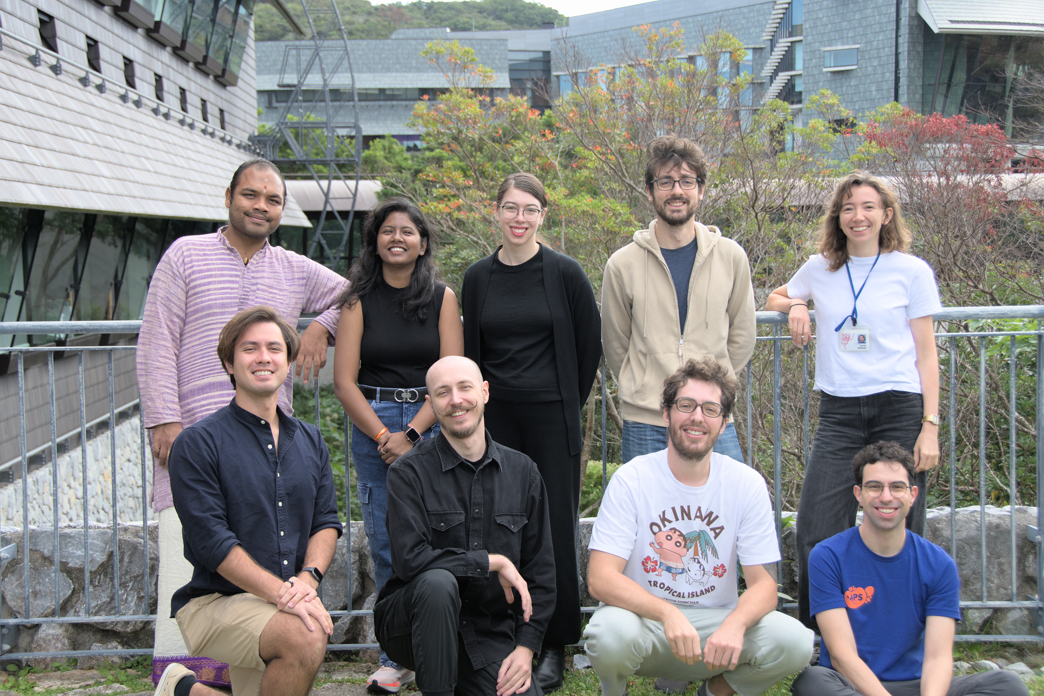
Student Council
We are a non-executive advisory body at the University that gathers information and advocates for students and interns.
Research Intern Orientation Summer 2024

Slide 2
Welfare
Officer
Academic
Officer
Chair
Secretary
Diversity Officer
Constitutional
Officer
Facult Assembly Representative
GEDI
IT Officer
studentcouncil@oist.jp

Slide 3
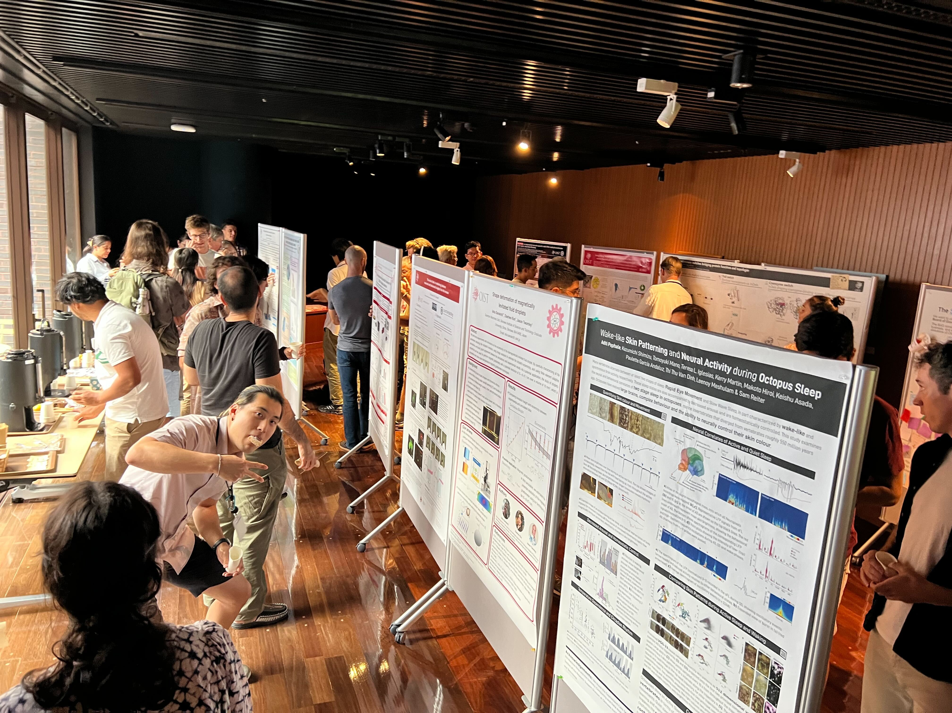
Some of the things we do...
Gather and communicate student/intern concerns to management and executives
Advise on student-related changes around campus
Communicate what leadership bodies at OIST are working on to the student assembly
Organize academic, extracurricular, and social events
Notes:
Our overarching aim is to convey and integrate the student perspective and insight into the policy-making processes by different sections to enhance student life and wellbeing.
Continued discussions with the respective sections, data collection and dissemination based on the principles of honesty, fairness and transparency.
Surveys
Open discussion sessions with invited representatives from GS, FC and BFM.
We also help organize and/or host events both social and academic!
Graduation Ball, Welcome BBQ
Information sessions, students' choice teaching awards etc.

Slide 4
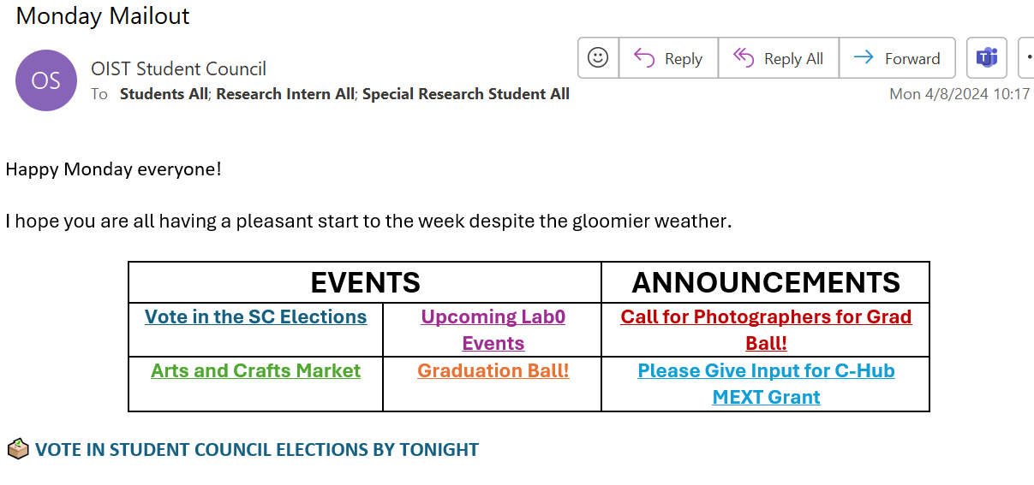
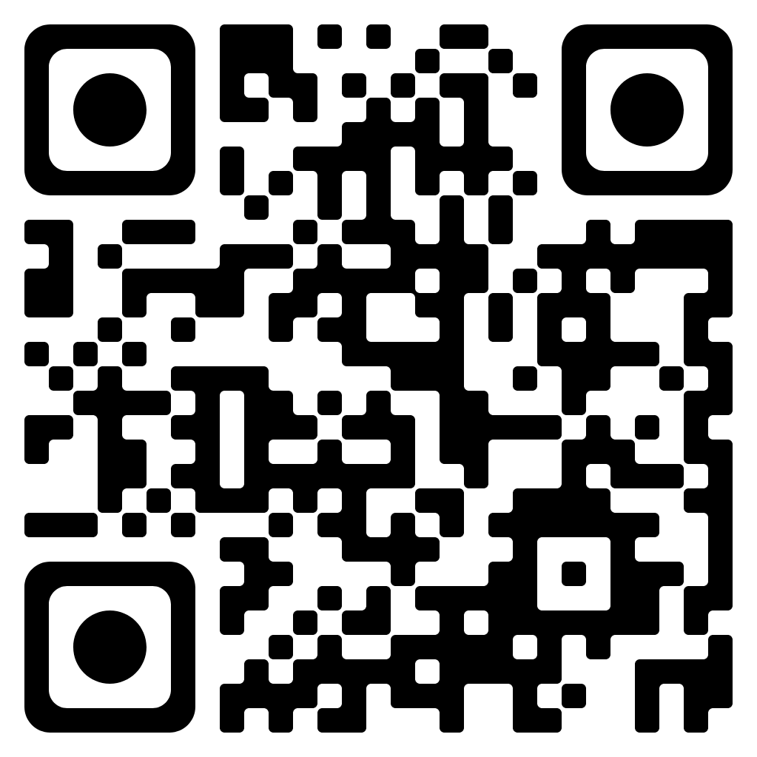
Communication Channels
Slack Channel
oiststudentassembly.slack.com
Instagram
@oiststudentcouncil
Monday Mailout
Includes weekly events, announcements, volunteer opportunities, etc.
Website
https://groups.oist.jp/sac
Email
studentcouncil@oist.jp
OIST Student Assembly Slack:

Slide 5
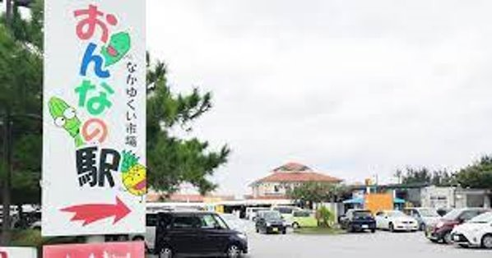
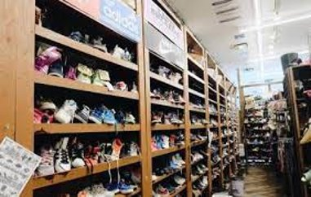
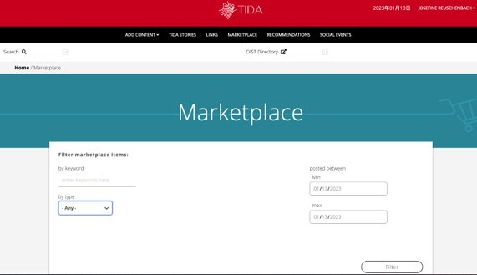
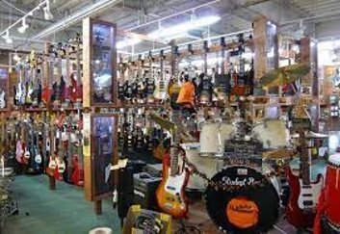
Sustainable Living
Onna no eki: local farmer's market
Bike Sharing Club (normal and electric)
Beach Cleaning Club
Eco Club
Power Club (Promotion of Okinawa's Welfare, Economy, and Resources)
Second hand shops: used items
Tida: OIST marketplace
https://groups.oist.jp/resource-center/green-okinawa

Slide 6
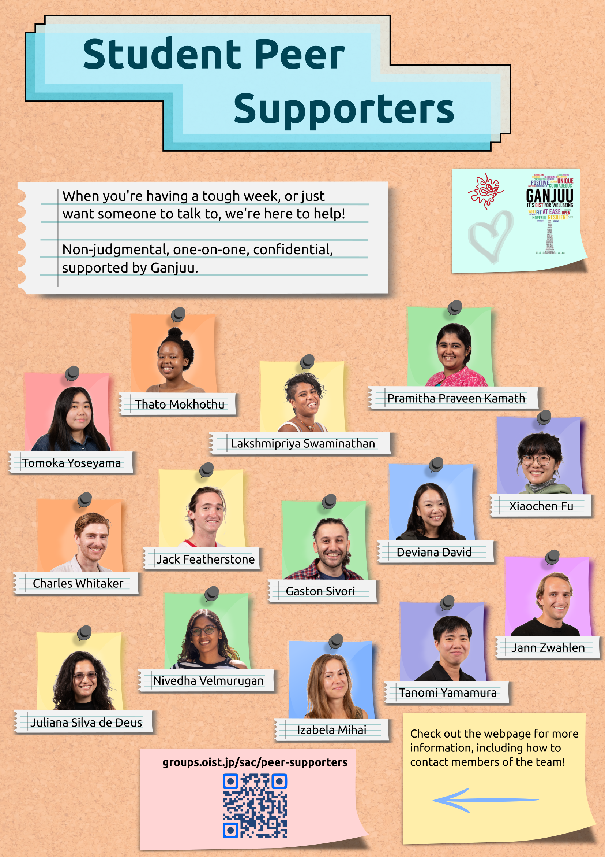
Peer Supporters
Need someone (confidential) to talk to?
Having trouble and want to talk to a peer about it?
https://groups.oist.jp/sac/peer-supporters

Slide 7
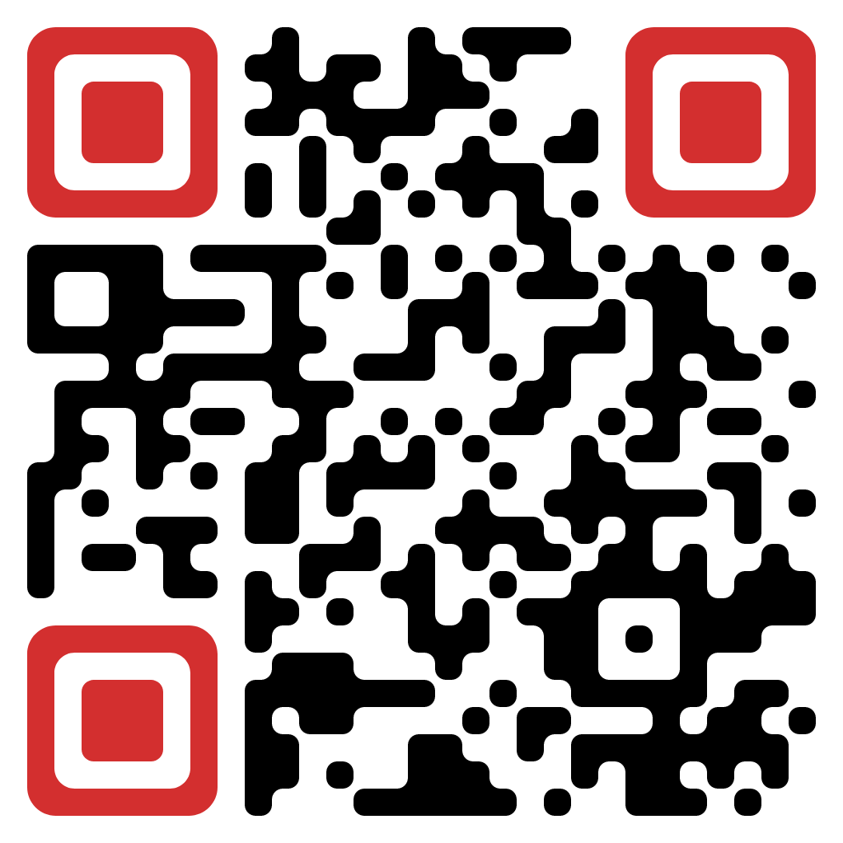
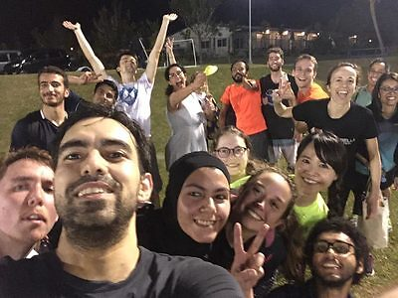
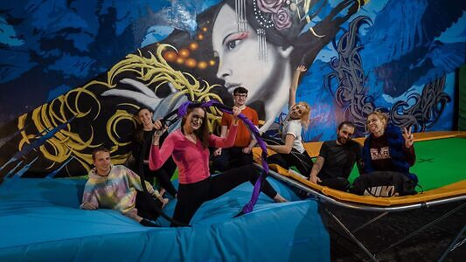
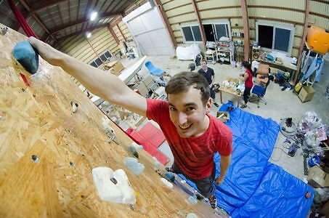
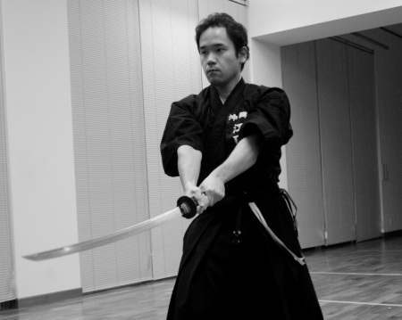
Clubs
https://groups.oist.jp/recreation/club-categories
Aerial Skills
Basketball
Climbing
Ultimate Frisbee
OIST Haarii Club
OIST Football Club
Tennis Club
Volleyball
Karate
Iaido
Kickboxing​
Akido​
Capoeira​
Orators Club​
LGBTQ and Allies​
ECO Club​
Gardening Club​
OIST Bike Share​
+ more

Slide 8
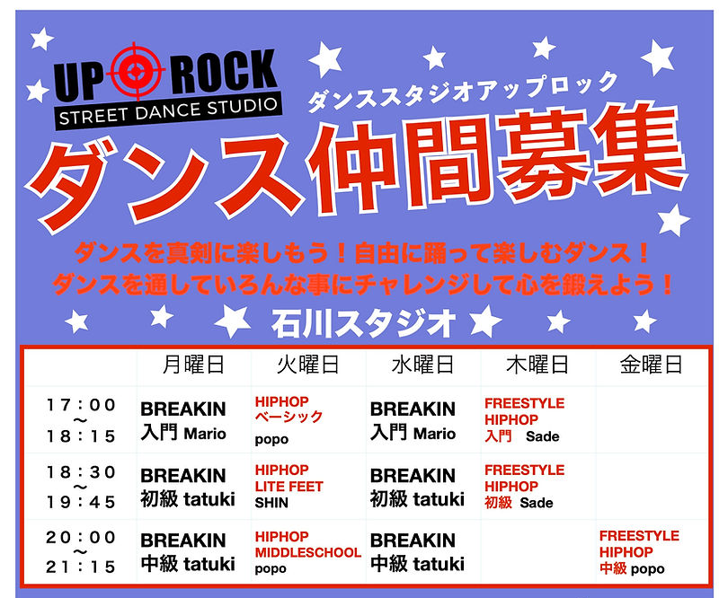
Events and activities
Uprock street dance studio (Ishikawa)
Weekly classes; free trial anytime!

Slide 9
Upcoming Events

