Slide 1


ＫＡＫＥＮＨＩ
What’s really going on…
Kotaro KODERA
Research Program Department
July 2015

Slide 2
Topics
・Overview of Kakenhi
・Application and review process
・FY2015 Budget for Kakenhi
・Management and appropriate use of Kakenhi
・Prevention of inappropriate use of research fund and research misconduct
・Publication and dissemination of research outcome

Slide 3
Overview of Kakenhi

Slide 4
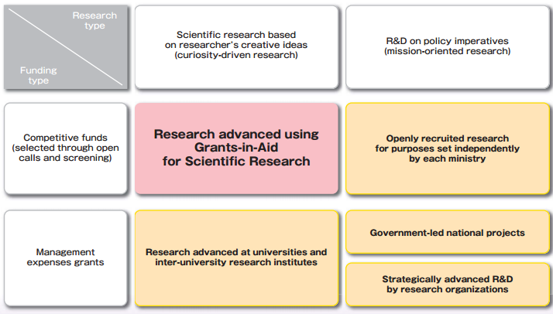
Kakenhi within Japan’s Science & Technology Research Policy Framework
Research
type
Scientific Research based on
researcher’s creative ideas
【curiosity-driven research】
政策課題対応型研究開発
【mission-oriented research】
Funding type
Competitive funds
（Open call）
Advancement of research
with Kakenhi
Open-call research
based on objectives
set by each ministry
Subsidies
Advancement of research
in universities and
research institutions
National research projects
led by the government
Strategic research and development by
National Research Development Agencies
*Kakenhi is awarded based on the rigorous screening of research plans submitted by researchers. This type of program is called “competitive funding”.
Kakenhi is the largest competitive fundin program in Japan, accounting for more than 50% of all competitive funding by the government, （FY2015 Budget: 22.73 billion yen)
Notes:
1National Research and Development Agency

Slide 5
Characteristics of Kakenhi
○ Supports unique, pioneering basic and applied “academic research (based on researcher’s creative ideas)”.
○ Wide spectrum of scientific fields, ranging from humanities and social sciences to natural sciences
○ Established fair and transparent screening system via process of peer review conducted by specialists in related areas of expertise.
○ Flexible use of funds as necessary to conduct the proposed research.
○ Research funds are administered by research institute to maintain its proper use.
○ Strict measures against improper use of funds and research misconduct, such as return of the spent fund and restriction of application.
Notes:
○Support both basic and applied research based on researchers’ creative ideas.
○Wide spectrum of scientific fields, ranging from the humanities and social sciences to the natural sciences
○Establishment of fair and transparent screening system via process of peer review conducted by specialists in related areas of expertise.
○Flexible use of funds as long as it is necessary to conduct the proposed research.
○Research funds are administered by research institute to maintain its proper use.
○Strict measures again improper use/act of research funds.

Slide 6
Type of Grants Programs (FY2015)
Type of research |  | Purposes and description of the research category | Agency
Grants-in-Aid for Scientific Research
 | Grants-in-Aid for Specially Promoted Research | Highly regarded research in the international arena conducted by one researcher or a relatively small group of researchers and is likely to yield highly acclaimed research achievements. (The period is three to five years. The upper limit of the total budget provided is generally set around 500 million yen per research project, though no exact budget range has been established.) | JSPS
 | Grants-in-Aid for Scientific Research on Innovative Areas | (Research in a proposed research area) New research areas proposed by a group of diverse researchers which, through efforts for collective research, scholarly training, shared use of equipment, etc., will develop and lead to the upgrading and enhancement of scientific research in Japan. (The period is five years. In principle, the budget is set at around 10 million to 300 million yen per fiscal year per field.) | MEXT(Evaluation) JSPS(Funding)
 | Grants-in-Aid for Scientific Research | (S): Creative/pioneering research conducted by one researcher or a relatively small group of researchers (The period is five years. The budget ranges from 50 to around 200 million yen per project.) (A), (B), (C): Creative/pioneering research done conducted by one researcher or jointly by multiple researchers (The period is three to five years.) Classification of A, B and C depends on the total budget (A) From 20 million to 50 million yen, (B) From 5 million yen to 20 million yen, (C) 5 million yen or less | JSPS
 | Grants-in-Aid for Challenging Exploratory Research | Early-stage research conducted by one or multiple researchers which, based on a unique idea, sets a high and challenging goal (The period is one to three years. The budget is up to 5 million yen per project.) ★ | JSPS
 | Grants-in-Aid for Young Scientists | (A), (B) : Research conducted by one researcher aged 39 or less (The period is two to four years.) Classification of A and B depend on the total budget (A) from 5 million yen to 30 million yen (B) 5 million yen or less | JSPS
 | Grants-in-Aid for Research Activity Start-up | Research conducted by one researcher who has just been employed by his/her research institution by one researcher who has returned from his/her childcare or other kinds of leave (The period is up to two years. The budget is up to 1.5 million per fiscal year.) | JSPS
 | Grants-in-Aid for Encouragement of Scientists | Research conducted by one person who is an employee of an educational/research institution, a company employee, or others (The period is up to one year. The budget is up to 1 million yen per project.) | JSPS
Grants-in-Aid for Special Purposes |  | Funding of urgent and important research projects. | MEXT(Evaluation) JSPS(Funding)
Grant-in-Aid for Publication of Scientific Research Results
 | Publication of Research Results | Funding for the publication and/or international dissemination of research achievements of high academic values made by academic associations and other organizations | JSPS
 | Enhancement of International Dissemination of Information | Funding for efforts of academic societies and other scholarly organizations to further enhance international dissemination of information for the purpose of international academic exchange. | JSPS
 | Scientific Periodicals | Funding for academic journals that are periodically published by an academic association or a cooperative group of academic associations for the purpose of international academic exchange | JSPS
 | Scientific Literature | Funding for academic publications authored by an individual or a group of researchers to publish academic research achievements | JSPS
 | Databases | Funding for databases created by an individual or a group of researchers for public use | JSPS
Grant-in-Aid for JSPS Fellows |  | Funding for research conducted by JSPS Fellows (including Foreign JSPS Fellows) (for a period of up to three years) | JSPS
International Collaboration Enhancement Fund |  | Enhancement of international collaborations and network making | MEXT(Call) JSPS(Evaluation and Funding)
*No new invitation for applications is conducted for “Scientific Periodicals”. *Among the research categories marked with the sign ★ (Scientific Research (C), Challenging Exploratory Research and Grant-in-Aid for Young Scientists (B)), research projects that are newly adopted in from FY2011 onward (hereinafter called “KAKENHI (Multi-year Fund)”) or later will be implemented using KAKENHI (Multi-year Fund). *Among the research categories marked with the sign ◎ (Scientific Research (B) and Grant-in-Aid for Young Scientists (A)), a part of the research projects that are from FY2012 onward (hereinafter called “KAKENHI (Partial Multi-year Fund)”) will be implemented using KAKENHI (Multi-year Fund) (up to 5 million yen out of the total research budget). *For Specially Promoted Research, Grants-in-Aid for Scientific Research based on Acts Incurring Liabilities on the Treasury will be granted.
Notes:
3

Slide 7
Kakenhi Research Categories
Notes:
7

Slide 8
Budget Transition
Budget
263.3 Billion
Budget
256.6 Billion
Budget
227.6 Billion
Only newly selected projects from FY 2011 are placed under the Multi-Year Fund . Some projects under Scientific Research (B) and Grant-in-Aid for Young Scientists (A) are covered by the Multi-Year Fund in FY2012.
Budget
227.3 Billion
Rolling Budget of Multi-Year
Fund :42.9 Billion
Budget
238.1 Billion
Rolling Budget of Multi-Year
Fund :52.9 Billion
Implementation of Indirect funds (FY2001)
Grant
231.8 Billion (+1.1 Billion)
Grant
231.8 Billion (-1.3 Billion)
Grant
230.7 Billion (+10.3 Billion)
Grant
230.5 Billion (-1.3 Billion)
Grant
220.4 Billion (+20.4 Billion)
3.4 Billion
First Basic Plan
Second Basic Plan
Third Basic Plan
Forth Basic Plan
（+49.5 Billion）
（+46.1 Billion）
（+1.2 Billion）
（+2.73 Billion）
※ Budget indicated is the initial one
※ Grant has been indicated separately since 2011FY as some projects started to be placed under Multi-Year Fund and research costs started to be included in the budget.
Notes:
8

Slide 9
Huge number of applications（Approx. 100 thousand new applications ）
Proposals submitted
(New+ Continuance)
Revision of application requirements
Proposals submitted
(New)
Proposal selected
(New+ Continuance)
Proposals selected
(New)
Selection ratio
(2014FY)
28.6%
FY

Slide 10
FY2014 KAKENHI Distribution Table （Newly selected）
Notes:
参考

Slide 11
State of distribution in fiscal year 2014
(By class of research organization) (New + continuing)
(Note 1) Of KAKENHI distributed in fiscal year 2014, that classified with regard to distribution of Grants-in-Aid for Specially Promoted Research, Grants-in-Aid for Scientific Research on Innovative Areas (research in proposed research areas), Grants-in-Aid for Scientific Research (S, A, B or C), Grants-in-Aid for Challenging Exploratory Research, Grants-in-Aid for Young Scientists (S, A or B) and Grants-in-Aid for Research Activity Start-up (new adoptions) (excludes Generative Research Fields and Promoted Research).
(Note 2) The total and breakdown figures may not match for reasons related to rounding off.
Notes:
参考

Slide 12
State of distribution in fiscal year 2014
(By research area) (New + continuing)
Other
735
1.0%
Infor-mation science
3,242.5
4.5%
Environmental science
1,344
1.9%
Other
800 million yen
0.5%
Infor-mation science
7.6 billion yen
4.6%
Environmental science
4.0 billion yen
2.5%
Composite areas
6,546
9.1%
Medicine, dentistry and pharmaceutical sciences
37.8 billion yen 23.1%
Composite areas
13.4 billion yen
8.2%
Medicine, dentistry and pharmaceutical sciences
21,259.5 29.4%
Other
735
1.0%
General category
11,132.5
15.4%
General humanities / social sciences
571.5 0.8%
Other
800 million yen
0.5%
General category
25.0 billion yen
15.2%
General humanities / social sciences
1.2 billion 0.7%
Humanities
7.7 billion 4.7%
Humanities
5,411 7.5%
Humanities / social sciences category
20.7 billion yen
12.6%
Social sciences
11.8 billion yen
7.2%
Biology category
30,346
42.0%
Total number of adoptions
72,262
Humanities / social sciences category
14,061
19.5%
Biology category
67.9 billion yen
41.4%
Total amount distributed
164 billion yen
Agricultural science
9.3 billion yen
5.7%
Social sciences
8,078.5
11.2%
General science and engineering
6.3 billion 3.8%
Agricultural science
3,943.5
5.5%
Science and engineering category
15,987.5
22.1%
Biology
12.9 billion yen
7.9%
Science and engineering category
49.6 billion yen
30.3%
General science and engineering
1,699.5 2.4%
Mathematical and physical sciences
14.5 billion 8.9%
Biology
3,036.5
4.2%
Mathematical and physical sciences
4,516 6.2%
General biology
7.8 billion yen
4.8%
General biology
2,106.5
2.9%
Chemistry
9.2 billion yen
5.6%
Engineering
7,097
9.8%
Chemistry
2,674.5
3.7%
Engineering
19.6 billion yen
11.9%
(Note 1) Of KAKENHI distributed in fiscal year 2014, that classified with regard to distribution of Grants-in-Aid for Specially Promoted Research, Grants-in-Aid for Scientific Research on Innovative Areas (research in proposed research areas), Grants-in-Aid for Scientific Research (S, A, B or C), Grants-in-Aid for Challenging Exploratory Research, Grants-in-Aid for Young Scientists (S, A or B) and Grants-in-Aid for Research Activity Start-up (new adoptions + continuing) (excludes Generative Research Fields and Promoted Research).
(Note 2) Number of cases and amount distributed aggregated on a pro rata basis for cases selecting two research fields as areas for proposed review in young scientist (B) adoption issues.
(Note 3) The total and breakdown figures may not match for reasons related to rounding off.
Notes:
参考

Slide 13
Recent Improvement of KAKENHI System
◎ Multi-year Funding
・FY2011：Scientific Research C, Challenging Exploratory Research,
and Young Scientist B
・FY2012：Scientific Research B and Young Scientist A
*Mixture of Single-year Grants and Multi-year Funding
◎ Adjustment Fund System for Single-year Grants (FY2013)
・Using the budget ahead of schedule is possible.
・ Using the budget in the next fiscal year is possible.
◎ Confirming multi-year funding for Specially Promoted Research
◎Allowing to add up several KAKENHI funds for purchasing shared equipment
Notes:
7
Recent revise of KAKENHI Policy (System?)
Improvement
Multi-year fund
FY2011: Scientific Research C, Challenging Exploratory Research, and Young Scientist B
FY2012: Scientific Research B & Young Scientist A
*Mixed fund: Single-year fund and Multi-year fund
Adjustment money for Single-year fund (from FY2013)
Move-up next FY’s fund to current FY
Carry-over unspent budget from current FY to next FY
Specially Promoted Research *国庫債務負担行為
Introduction of Multi-year fund
Confirming the issues of KAKENHI fund
Allowing to add up several KAKENHI funds for purchasing shared equipment

Slide 14
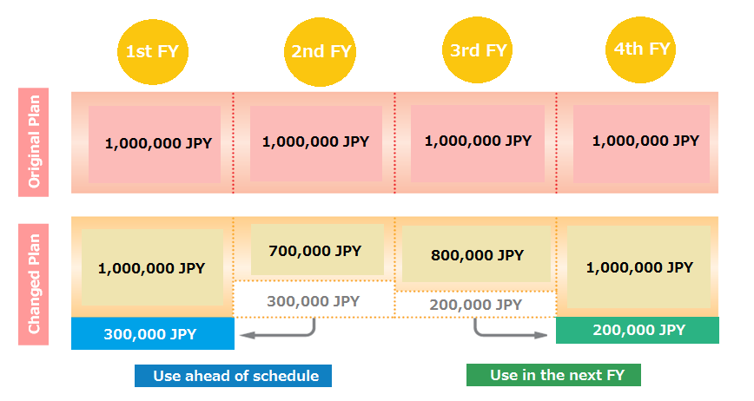
Introduction of Multi-year Fund
○ All amount of the budget for whole project period is approved at the beginning. Therefore, PIs can use their research grants flexibly.
◆ PIs can move up the next FY’s budget to current FY.
◆ PIs can carry over the unspent budget to the next FY (with no paperwork).
◆ Procurement of goods that extend past the approved fiscal year is possible.
PIs can request
1-year extension.
Notes:
参考
Introduction of multi-year fund
Flexible use of the budget
All amount of the budget for whole project period is approved at the beginning. Therefore, PIs can use their research budget flexibly.
PIs can…
Use the budget ahead of schedule
Carry over unspent fund to next FY with no paperwork
Purchase or travel without caring the end of the fiscal year
PIs can request 1 year extension.
Use the budget ahead of schedule
PIs can move up the next FY’s budget to the current FY.
PI can carry over the unspent budget to the next FY (with no paperwork)
Flexible purchase is possible
This is not limited to single fiscal year, so that PIs can
Procurement of goods that extend past the approved fiscal year is possible
OIST Procurement Website :
There are certain financial resources the uses of which are not limited to single fiscal year, including the fund portion of KAKENHI. Purchases made with these financial resources do not have to be accepted by the end of the current fiscal year (March 31), and may be delivered on or after April 1.

Slide 15
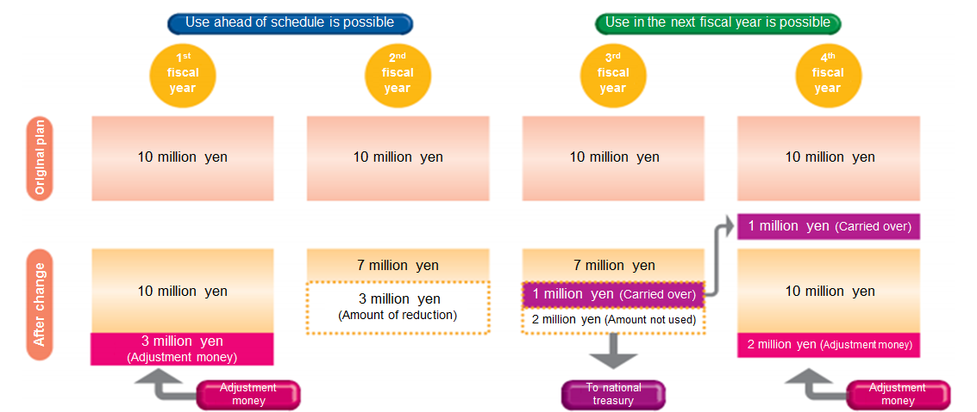
Adjustment Fund System for Single-year Grants
What is Adjustment Fund?
○Established in 2013 for flexible and efficient use of KAKENHI Single-year Grants.
○PI can request: 1) to use the budget ahead of schedule and
2) to use the budget in the next fiscal year
Use a head of Schedule
PIs can request extra budget for the current FY as “Adjustment Fund”.
(The amount of extra budget will be deducted from the next FY’s budget.
Use in the next FY
If there is unspent budget, PIs can request to use it in the next FY.
*This is different from “Carry over” system.
Notes:
参考
Adjustment Money for Single-year fund
Features:
Started from FY2013. introduced in FY2013
For flexible use of KAKENHI Single-year fund
PIs can move up the next FY’s fund to current FY
PIs can transfer unspent budget to the Next FY
*It is different system from “Carry-over”
PIs should consider to apply “Carry-over” system.
If the reason does not fits the “Carry-over” system, the PI can apply “Adjustment money” and transfer the unspent budget to next FY
Moving up a part of the next fiscal year’s budget to the current fiscal year.
Carrying over unspent budget to the next fiscal year.
Use ahead of schedule:
A PI can request extra budget as Adjustment Fund.
(the amount of extra budget will be reduced from next FY’s budget)
Use in the next FY:
If there is unspent budget, a PI can request to use it in the next FY.
This is a different system from “Requesting Carry-over”, a PI will refund it to National Treasury.
**From KAKENHI pamphlet**
In FY 2014, the “Adjustment Fund” system has been improved, enabling “Single-year Grants” to be used ahead of schedule or to be used in the next fiscal year, if certain conditions are met.

Slide 16
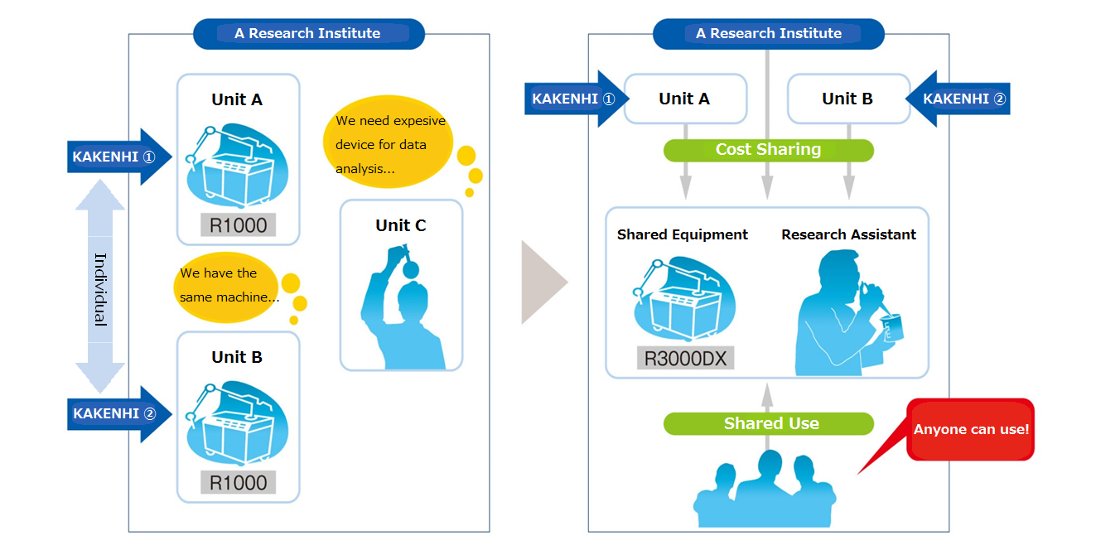
Adding up several KAKENHI funds
○ PIs can add up their KAKENHI funds for purchasing shared equipment (from FY2012).
○ This is for efficient and Flexible use of KAKENHI Grants and Funding.
Notes:
16
16
参考
Adding up several KAKENHI funds for purchasing shared equipment
PIs can add up their KAKENHI funds together and purchase shared equipment.
This is for efficient and flexible of KAKENHI use.
It allows PIs to buy expensive devices
This is for:
Flexible and Efficient Use of KAKENHI Grants and Funding
Promoting research project
**From KAKENHI pamphlet**
From FY 2012, the joint purchase of equipment/facilities for joint usage with a mixture of Grants-in-Aid or of Grants-in-Aid and other funding is authorized to achieve efficient use of research funds and to promote joint equipment/facility utilization.

Slide 17
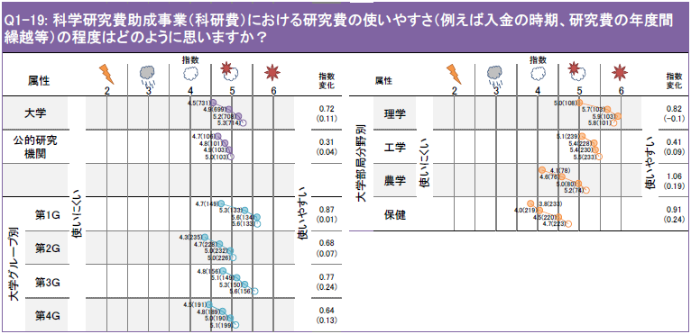
Evaluation of the KAKENHI system [1]
The KAKENHI system has obtained high evaluations from researchers and experts in the “NISTEP Expert Survey on Japanese S&T and Innovation System (2014 NISTEP TEITEN survey)” implemented by the National Institute of Science and Technology Policy.
(Q1-19, Ease of use of KAKENHI)
● Recognition that KAKENHI is easy to use increased further. The following are raised as reasons for increasing evaluations, “Carrying funds over between years has become smoother,”Ease of use has been improved by conversion to a fund” and “The system has become easier to use due to the reimbursement of expenses prior to issue system.”
● This is the question that had the biggest positive change in index from 2011 among all of the questions on the NISTEP TEITEN survey. (The positive change was big for universities in particular.)
Source: Analytical Report for “NISTEP Expert Survey on Japanese S&T and Innovation System (2014 NISTEP TEITEN survey)” ( http://www.nistep.go.jp/archives/20811 )
Notes:
参考

Slide 18
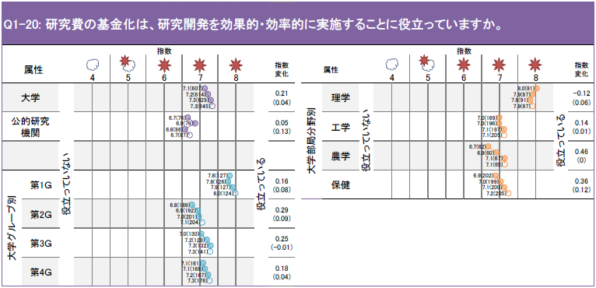
Evaluation of the KAKENHI system [2]
The KAKENHI system has obtained high evaluations from researchers and experts in the “NISTEP Expert Survey on Japanese S&T and Innovation System (2014 NISTEP TEITEN survey)” implemented by the National Institute of Science and Technology Policy.
(Q1-20, Conversion of KAKENHI to a fund)
● Recognition that the conversion of KAKENHI to a fund is useful for the effective and efficient implementation of research and development is shown in all attributes.
● The index figures are 7.3 points at universities and 6.7 points at public research institutions so this was the question with the highest value among the questions on the NISTEP TEITEN survey, continuing from the 2011 NISTEP TEITEN survey.
Source: Analytical Report for “NISTEP Expert Survey on Japanese S&T and Innovation System (2014 NISTEP TEITEN survey)” ( http://www.nistep.go.jp/archives/20811 )
Notes:
参考

Slide 19
Application and review process

Slide 20
Screening Process of KAKENHI
－Fair and Transparent Screening Process－
Peer Review by
Committee on
Grants-in-Aid for Scientific Research※１
・Decide screening policies
・Fair selection
of screening committee members
Large number of screening committee take part
Disclosure of Screening Results
Decide screening policies, etc.
（By Committee on
Grants-in-Aid for Scientific Research）
[For General Research Categories
(Such as Scientific Research)]
Initial Review
（document-based Review）
Second Review
（Panel Review）
Award Grants,
Notification of
Selection Results
Rules for Screening are disclosed.
Persons with conflicts of interest are excluded.
To unsuccessful applicants, the results are provided by electronic system(upon request)
Selection of Reviewers
（by the Research Center
for Science Systems）
[For Larger-Scale Research Categories]
Second Review
（Panel screening)
Interview
（Panel screening)
Approx. 6,000 reviewers are selected, carefully considering balance
Post-facto registration
of examiners’ names on the program’s webpage after selection process is completed
〔DEC～JAN〕
〔FEB～MAR〕
〔APR～MAY〕
※１ Peer Review： evaluation of work by one or more people of similar competence to the producers of the work
Notes:
8

Slide 21
Transfer of control of review and issue work to the Japan Society for the Promotion of Science
< Comparison of new adoptions in fiscal year 1999 and new adoptions in fiscal year 2015 with regard to reviews / issue >
 The transfer of control to the Japan Society for the Promotion of Science began from fiscal year 1999 and there have been big improvements such as the enhancement of the review system and the acceleration of informal announcements of grant issues due to the strengthening of functions as a fund-distributing organization.
Fiscal year 1999
Fiscal year 2015
 1st level review
 Number of review committee members 1,152 people
 Review period 31 days
 Number of reviews per person 183 on average (Maximum of 509)
 2nd level review
 Number of review committee members 123 people
 Number of review meetings
15 committee meetings
Enhancement of reviews
 1st level review
 Number of review committee members 5,500 people
 Review period 40 days
 Number of reviews per person About 70 on average (Maximum of 149)
 2nd level review
 Number of review committee members 606 people
 Number of review meetings 43 committee meetings
Reviews
Acceleration of informal announcement of grant issues
Issue
Date of informal announcement of grant issues
April 26
Date of informal announcement of grant issues
April 1
Computerization
 The computerization of application receipt started in fiscal year 2004 and the system was completely computerized in 2008.
 Reviews have been made more efficient and faster by the computerization of 1st level reviews (document reviews).
 The disclosure of notifications of 1st level review results was computerized in 2010.
 Issue application procedures were computerized in 2012 (subsidy and fund research classes)
 Result report procedures were computerized in 2013 (subsidy and fund research classes)
 Some fund research class issue application and result reports were computerized in 2014.
* The information given is for Grants-in-Aid for Scientific Research (A, B or C), Grants-in-Aid for Young Scientists (A or B) and Grants-in-Aid for Challenging Exploratory Research among the JSPS review classes in fiscal year 2015.
Notes:
9

Slide 22

Selection Process for Kakenhi (2015 FY)
※”Scientific research “・・・・・・”Scientific research （A・B・C）（General）”, “Challenging Exploratory Research”, “Grand-in -Aid for Young Scientists （A・B）”
The committee finalizes screening and evaluation guidelines (Beginning of Oct.)
November 10: Application Deadline
Beginning of Sept. 2016
Applications received
JSPS sends the application guideline to each institute
（Approx. 87,000 new proposals)
（Approx. 1,800 institutes）
Explanatory meetings regarding submission of applications
(8 areas, beginning of September ）
Middle of Nov.-Beginning of Dec.
Beginning of Dec.- Middle of Jan.
Application sorting
【Document review (1st stage)】
Individual document review by researchers according to their specialization.
（Approx. 5,000 researchers)
Middle of Jan.-Middle of Feb.
Middle of Feb.-Beginning of Mar.
Check the result of the 1st review
【Panel review (2nd stage)】
Panel review by organized committees based on the result of document review
(Approx. 600 researchers)
Middle of Mar.-end of Mar.
Confirmation of final results
April 1. 2015
JSPS informs final results to each institute

Slide 23
○ 1st level review (Document review)
4 or 6 review committee members implement reviews individually from expert viewpoints.
 Grants-in-Aid for Scientific Research (A or B), Grants-in-Aid for Young Scientists (A) . . . 6 people
 Grants-in-Aid for Scientific Research (C), Grants-in-Aid for Challenging Exploratory Research,
Grants-in-Aid for Young Scientists (B) . . . 4 people
○ 2nd level review (Conference review)
Based on the results of the 1st level review, a review is conducted by a conference on a sub-committee focused primarily on making the necessary adjustments comprehensively from a wide-ranging standpoint.
 The sub-committees for each expert area are composed of about 9 to 33 people.
 Multiple (3 to 9 people) review committee members in a discipline (research field for humanities
/ social sciences category) are assigned to a sub-committee.
* Other review methods
[1] Committees implement hearings. . . . Grants-in-Aid for Specially Promoted Research, Grants-in-Aid for Scientific Research on Innovative Areas (research in proposed research areas), Grants-in-Aid for Scientific Research (S)
[2] The same review committee members implement individual reviews and conference reviews.
. . . Grants-in-Aid for Specially Promoted Research, Grants-in-Aid for Scientific Research on Innovative Areas (research in proposed research areas), Grants-in-Aid for Scientific Research (A or B) (Overseas Scientific Research), Grants-in-Aid for Scientific Research
(B or C) (Generative Research Fields), Grants-in-Aid for Research Activity Start-up
Grants-in-Aid for Scientific Research 2nd level review system
The 1st level review results of 6 people or 4 people are aggregated.
-> 2nd level review materials are prepared.
・ Evaluations of each rating factor element (5 categories / 4 levels) -> Aggregation
・ Comprehensive evaluation (5 levels) -> Aggregation, T-score
・ Other evaluation items, review opinions -> Aggregation
* Image of results of aggregation of “Overall evaluation (& T-score)”
(* Case of Grants-in-Aid for Scientific Research (A) or (B))
Applicant A 5 5 4 5 4 3 4.3
4.07 3.98 3.42 3.88 3.55 3.11 3.67
Applicant B 3 3 2 2 4 3 2.8
3.14 3.02 2.68 2.64 3.55 3.11 3.02
Notes:
11

Slide 24
Examples of “Tips for preparing proposal” described
in Research Proposal Form
Purpose of the Research
The applicant shall indicate the general nature of the research and the specific purpose of the research, after succinctly summarizing and providing an outline at the beginning, citing academic literature if necessary. In particular, details shall be stated clearly, with a focus on the following points. [Refer to the rules concerning the screening and assessment of applications for Grants-in-Aid for Scientific Research. (cf. Application Procedures for Grants-in-Aid for Scientific Research)]
1) Scientific background of the research (e.g., domestic and overseas trends related to the research and positioning of the research; how the applicant developed the concept based on his or her achievements in past research work; and details of achievements of past research work, where the purpose is to attain a greater level of sophistication)
2) What will be elucidated and to what extent will it be pursued during the research period
3) Scientific characteristics, originality and expected achievements and significance of the research in the area
Research Plan and Methods
The applicant should provide details of the research plan and the methods for achieving the objectives of the research, referring to literature and explaining the points of focus specifically and clearly.
The plan and methods section should identify objectives, through a discussion from different angles, such as the actions to be taken, in the event that the research does not progress as originally planned. In addition, regarding the structure to conduct research, ----- the specific roles of the Principal Investigator and the Co-investigator(s) (kenkyu-buntansha) of the research team (using figures, tables and other visual aids) ------- the necessity and rationality of the research team and the relevancy to the research purpose also should be highlighted.
（Note）”Regulations regarding screening and evaluation in KAKENHI Grants in Aid” can be found at Hope Page of JSPS
（ http://www.jsps.go.jp/j-grantsinaid/index.html ）
Notes:
12

Slide 25
Evaluation criteria for document review (1st stage)
Evaluation criteria
Each criterion is assessed on a scale of one to four. (Absolute evaluation system)
※4 Scales: Excellent （４）, Good (3), a little inadequate (2), inadequate (1)
In case the applicants receive “a little inadequate” or “inadequate”, they can request information disclosure
(1) Academic significance and validity of the research topic
Academic significance of the research topic
Specific and clear indication of the research topic and the framework.
The significance of the research topic for the amount of the grant.
(2) Validity of the research plan and the method
・The plan is developed enough to achieve the research aim
・The plan is well developed from various points of view. i.e. Alternative plan in case the initial plan dose not proceed as it is originally planned.
・Reasonable duration of research
・Appropriate budget allocation
・In case the main researcher has another research project should be carried out, the relevance and the difference of the projects should be clearly indicated.
Note: The following research projects are not eligible
① Research projects which merely aim at purchasing ready-made research equipment. ② Research projects which aim at producing large-size research equipment and similar
things which should be funded by other budgets
③ Research projects which directly aim at developing and selling goods and services
(including market trend surveys on the development and sale of goods and services).
④ Funded research which is carried out as commercial business.

Slide 26
Evaluation criteria for document review (1st stage)
(3) Creativity and innovativeness of the research topic
・ Creativity and innovativeness should be found in the research object, the method and the achievement.
(4) Ripple effects and universality of the research topic
・Whether academic ripple effects can be expected by supporting the proposed research project. Ex) Significant developments in the research field, exploration of fields of study etc.
・ Whether positive impacts and contributions can be expected in various fields.
(5) Ability to accomplish the research project and adequate research environment
・ The researcher’s high ability to accomplish the proposed research project. (This will be assessed based on the researcher’s projects in the past)
・ In case the project is carried out by several researchers, the team should have high ability to accomplish the project and sufficient contribution from each researcher should be expected.
・ Adequate research facilities and materials to accomplish the project.
・ The way to disseminate the result of the research should be considered.
Overall assessment
Comparative evaluation with 5 scales (will be assessed by reference to the evaluation result of each criterion)
Comments by reviewers
Reviewers’ comments regarding strong and weak points of the project.

Slide 27
An example of reviewer’s opinion which is valuable for the second review
１．Example of reviewer’s opinion of which is valuable for he second review
（３）Example of reviewer’s opinion about demerits of proposed project
Aim of this research is understandable, however there are some vague points, as well. For instance, what kind of problems have occurred and inhibited ◯◯, because there was no appropriate verification method. Moreover, it is noted that versatile and practical verification methods are to be developed. However, what kind of relationship exists between the verification methods developed for this research and those currently conducted by researchers all over the world. Assuming that versatility・practicality are the objectives of this research, the number of ◯◯ to verify will be extremely large. What kind of standards will be set to decide the scope of research and what kind of phasing will be included? As there is no specific discussion of such points, it is difficult to evaluate the expected outcome and the follow-on consequences of and opportunities presented by this research proposal.
Aim of this research proposal is to develop ◯◯ for the purpose of practical ◯◯. As a specific object, ◯◯ is cited. However, as problems regarding each object have not been covered in depth academically, it is hard to understand the intention. Regarding ◯◯, the applicant has not demonstrated any originality, as it is merely stated that the method developed by ◯◯ will be applied. Further, the research plan and method are not adequately described. More practical and detailed description is required.
※ Picked from a guideline of the first review of KAKENHI for FY2015
（Note）guideline of the first review of KAKENHI can be found in JSPS KAKENHI HP
（ http://www.jsps.go.jp/j-grantsinaid/01_seido/03_shinsa/index.html ）
Notes:
15

Slide 28
KAKENHI review / evaluation improvement system
Holds jurisdiction over KAKENHI system
Responsible for the implementation of reviews and evaluations
Ministry of Education, Culture, Sports, Science and Technology
Japan Society for the Promotion of Science
Council for Science and Technology
Presentation of the
“basic way of thinking”
KAKENHI committee
Image of organization
○ Determines the “basic way of thinking about reviews” with regard to the following items, etc., each fiscal year
・ Implementation of the 2nd level review system
・ Implementation of research progress evaluations
・ Confirmation of unreasonable duplication / excessive concentration
etc.
○ Evaluates the state of reviews / evaluations implemented at the Japan Society for the Promotion of Science, etc.
Based on the “basic way
of thinking about reviews”
○ Implementation of reviews
and evaluations
○ Formulation of review and
evaluation rules
・ Review policy, review format
・ 1st level review evaluation standards
・ Research progress evaluation method, etc.
Review / evaluation 1st panel
(Grants-in-Aid for Specially Promoted Research)
Humanities / social sciences category sub-committee
Science and engineering category sub-committee
・・・
・ Management of review meetings
・ Improvements related to evaluation standards, etc.
Coope-
ration
The evaluation results are used in the determination of the basic way of thinking about reviews” for the next fiscal year
Reporting of improvement requests, etc.
Research Center for Science Systems
・ Selection of candidate review committee members
・ Verification of reviews
・ Investigates reviews and improvements of review systems / management and evaluation methods, etc., from a PO (researcher) standpoint
Notes:
16

Slide 29
○ 「The Research Center for Science Systems 」established in July, 2003 with advice of Council for Science, Technology,
Program Officers who have experience as researchers are assigned
○ Program Officer
123 「Senior Program Officers」、「Program Officers」 who are equivalent to university professors, are assigned (for terms of three years)
Organized into nine committees for each field
○ Senior Program Officers have two meetings/month、Program officers have one meeting/month
・Meeting of Senior Program Officers・・・・・Discuss various kinds of subjects in JSPS to provide advice and suggestions
・Meeting of Program Officers・・・・・Implementing practical procedure regarding JSPS program review and evaluation, based on the needs and perspectives of researchers
○ Working Group・・・・・Work on subjects which are important and which require continuous discussion.
Currently two working groups exist for KAKENHI and Fellowship programs（Meetings are held once/month）
The Research Center for Science Systems
Notes:
17

Slide 30
Main Role of the Research Center
for Science Systems for KAKENHI
Researchers in the Center
are not involved
in screening and selecting
［JUL～AUG］
Selecting and nominating candidates as first and second reviewers, names drawn from “Reviewers Database”(Approx. 6,000 reviewers)
［APR～JUL］
SEP
Appoint reviewers, considering screening process and application procedures
NOV
Publishing Application Procedures
Selecting a writer of [recent outcome of research in [KAKENHI NEWS] （throughout the year）
Accepting Research Proposal
Appointing Reviewers
Initial Screening
Notification of Selection Results
Second Screening
APR
DEC～JAN
［APR～JUN］
FEB～MAR
Verification of screening results of the first and
second screening
・Reviewers who perform inappropriate
reviews will not be asked to participate in
future reviews
・Selecting and recognizing reviewers who
rendered valuable opinions in reviewing
(170 reviewers are recognized in 2014).
Leading Screening Committee, explaining information etc.
（Involves running the second screening）
Notes:
18

Slide 31
・In compiling a list of candidates
The verification of the results of the last year’s review is reflected appropriately
*The verification and analysis are conducted comparing the results of the initial reviews (360,000 cases) with the results of the second reviews.
・Reviewer who performed inappropriate reviews will not be appointed for the next fiscal year.
・Selecting and recognizing reviewers who rendered valuable opinions in reviewing (49 reviewers in 2011, 115 reviewers in 2012, 124 reviewers in 2014 and 170 reviewers were recognized in 2014).
How to select reviewers
〔Until 2004〕
Selected from the candidates recommended by JSPS Science Council of Japan
〔After 2005〕
Program Officers in the Research Center for Science Systems select and nominate a list of candidates from “Database of Reviewers” compiled at JSPS by the “Committee for Selecting Reviewers of Applications for KAKENHI, Grants-in-Aid ”.
Notes:
19

Slide 32
The database of review committee member candidates
Overview of the database of review committee member candidates
○ Maintained since 2004 KAKENHI research representatives, etc., are registered each year
○ KAKENHI research representatives
. . . Sequential registration from research representatives of large research projects
Research representatives from prior to fiscal year 2003 were also registered in 2007
○ Researchers registered on the database
. . . Confirmation / upgrading of data by researchers themselves is requested once a year
* Confirmation / upgrading of data is very important for the selection of more appropriate review committee members (upgrading throughout the year is possible)
1. Trend in the number of registered people
2. Number of registered people by institution
Total number of registered people
Number of newly registered people each fiscal year
Of whom are female
Total 81,065 people
Of whom are female 12,431 people
(15.3%)
Notes:
20

Slide 33
Criteria for Selecting Reviewers and Consideration
Upon selecting reviewers, program officers of the Research Center for Science Systems work hard on carefully selecting appropriate reviewers, applying the following criteria. Further, Program Officers of the Research Center for Science Systems are not themselves involved in reviewing and selecting successful applications.
(1) Reviewers shall be persons with the ability to conduct fair and substantive evaluations, who understands the system of the KAKENHI, Grants-in-Aid Program and are familiar with the academic and research field.
(2) Reviewers shall be persons who have knowledge equivalent to a professor or assistant professor in a university. However, if a person is particularly distinguished in a particular field, a lecturer or associate professor can be selected.
(3) The age of a person does not matter, provided the person is dedicated to research activity. However, the selection of younger researchers shall be encouraged in considering the age profile of the reviewers.
(4) Consideration shall be given to the selection of a reasonable number of female researchers.
(5) Consideration shall be given to the selection of a balanced group of researches from public/private universities, independent administrative agencies and private enterprise, etc.
(6) Special attention shall be paid to the following points in selecting reviewers.
① Reviewers who review a particular research proposal shall not belong the the same research institute as the applicant submitting the proposal.
② The structure of each small reviewers committee shall not include more than 1/3 from the same research institute.
③ A single reviewer shall not be appointed to several research fields or small reviewer committees.
④ The balance of Related Research Field and key words of reviewers shall be appropriately kept.
⑤ As a general principle, reviewers whose terms have been expired shall not be selected for a successive term. However, in cases in which unavoidable issues arise, a person can be selected for a successive term.
⑥ Within each small reviewer committee, in cases two reviewers who review the same research proposal, the person who belong to the same institute with the former reviewers shall not be selected.
⑦ A person who is guilty of misconduct and/or a person who has performed an unfair review shall not be selected.
Notes:
21

Slide 34
Enhancement of the details of disclosure of 1st level review
(document review) results
Fiscal year 2009
Fiscal year 2012
Fiscal year 2016
Fiscal year 2018
Started disclosure of review results to non-adoptees
Enhanced details of disclosure
Enhanced details of disclosure
Enhanced details of disclosure
 Indicated in an easy-to-understand way the results of evaluation of the appropriateness of the research theme applied for and the reasonableness of research expenses
 Clearly stated the contact details for inquiries on the KAKENHI system overall
 Indicated the rough ranking based on the overall evaluation score of the 1st level review
A (Roughly equivalent to an adopted theme)
B (Themes within the middle rank)
C (Themes below the middle rank)
 Indicated the number of applications / adoptions at the class / division level
e.g.: Grants-in-Aid for Scientific Research (C)
Science 670 / 2,979
 Notification by postcard to the applicant
 Indicated the result of the 1st level review and the explanation of the ranking numerically
A ・・・ (Top 20%)
B ・・・ (Top 20% - 50%)
C ・・・ (Below 50%)
 Refined the disclosure of the number of applications and adoptions from the area level to research fields
e.g.:
Grants-in-Aid for Scientific Research (C)
Functional material chemistry 22 / 111
 Refined the evaluation elements of 1st level reviews
(2 items -> 5 items)
 Enhanced the results of evaluation of appropriateness of application research themes (observance of human rights protection and law, etc., allocation of shares)
Fiscal year 2020
Enhanced details of disclosure
Disclosure by electronic system
 Indicated items evaluated as insufficient in cases where 4-level evaluation elements of 1st level reviews were evaluated as “2 Slightly insufficient” or “1 Insufficient” (disclosure of typical findings)
Example items
・ Looked at scientifically, is this a research theme that should be promoted?
・ Has the research plan been refined sufficiently to achieve the research targets?
 Disclosed the average points for evaluation elements in the 1st level review results (2 items)
e.g.:
Research details 3.5
Research plan 3.8
 Disclosed evaluation results for “Appropriateness as a research class and review category” and “Suitability of application research expenses”
 Indicated the number of applications, the number of adoptions and the adoption rate for research classes, disciplines and research fields applied for
 Indicated the average points for each evaluation element of research themes adopted in detailed research fields applied for
Notes:
22

Slide 35
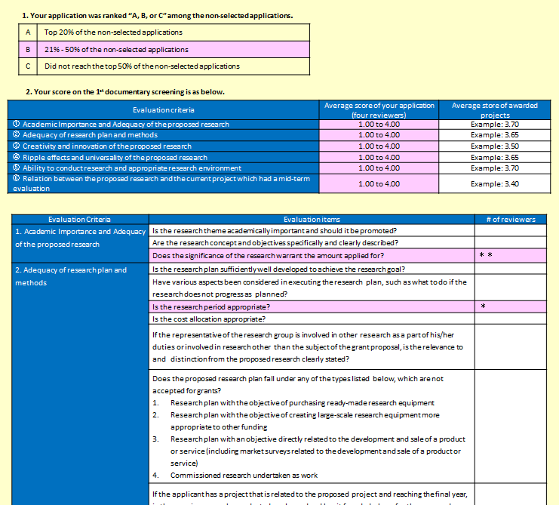
Screening Result (e-application system)
Notes:
23

Slide 36
Information Disclosure
・ The Scientific Research Grant Committee of JSPS, screening and assessment rules
The list of reviewers, screening and assessment rules are described in JSPS KAKENHI HP
http://www.jsps.go.jp/j-grantsinaid/01_seido/03_shinsa/index.html
・ Program Officers of the Research Center of Science Systems are described in JSPS the Research Center of Science Systems HP
http://www.jsps.go.jp/j-center/index.html
・ Disclosing Status of Application and Selection
Application and Selection Status is available at “KAKENHI Data” in JSPS KAKENHI HP
http://www.jsps.go.jp/j-grantsinaid/27_kdata/index.html
・ Disclosing Selected Research Projects
Selected Projects, Research Performance Report, Outcome of Research, etc. are available in the Database of Grants-in-Aid of Scientific Research（KAKEN）https://kaken.nii.ac.jp/
Notes:
24

Slide 37
FY2015 Budget for Kakenhi

Slide 38
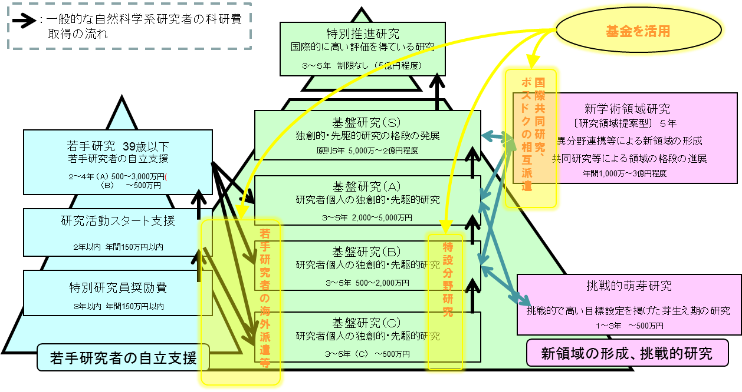
Grants-in-Aid for Scientific Research (KAKENHI)
Amount of grants in fiscal year 2015: 231,790 million yen (*)
(Amount of grants in fiscal year 2014: 230,451 million yen)
(Comparison with previous fiscal year: + 1,339 million yen)
Budget for fiscal year 2015: 227,289 million yen
(Budget for fiscal year 2014: 227,616 million yen)
- Enhancement of competitive funding that supports scientific research -
(Overview of the fiscal year 2015 budget)
KAKENHI supports a wide-range of so-called “scientific research” across all areas. In particular, we have started a drastic reform of KAKENHI in order to promote diverse, high quality scientific research and strengthen the ability to create excellent knowledge, such as the formation of international research networks centered on young researchers, etc.
< Issues in Japanese scientific research >
・ Sustained development of areas where Japan is competing for the global lead, such as physics, chemistry, material science, immunology, biology and biochemistry
・ Promotion of research in interdisciplinary / fusion areas where Japan has a low presence in comparison with the UK and Germany, for example
・ Increasing the diversity of Japanese scientific research, which is relatively low, from the perspective of participation in research areas that are attracting attention internationally
1) Promotion of international joint research and the formation of overseas networks in order to increase Japan’s presence in scientific research in international society
[1] We will strengthen international research that researchers adopted for KAKENHI carry out at overseas universities and research institutions for fixed periods
[2] We will establish an “International Activities Support Team” for Grants-in-Aid for Scientific Research on Innovative Areas, and promote international
joint research based on research areas that Japan is strong in
and the formation of overseas networks (invitations for overseas researchers
evaluated highly internationally, and mutual dispatch of post-doctoral
researchers, etc.)
[3] Reserved adoption of excellent Japanese researchers overseas:
“Calling back” of Japanese researchers overseas
2) Enhancement of the pioneering trial run of new review methods
(Generative Research Fields) that draws out area fusion-type
research not particular about detailed research fields
○ Special segregation of Generative Research Fields
 We will maximize the outcomes of research expenses by reviewing the subjects of grants from the Fund for Scientific Research Grants
・ We will use the fund to maximize investment effects with regard to international joint research and area fusion-type research, which increases the quality of KAKENHI, to hold onto expanding / fusing scientific research fields positively and establish an international presence
・ We will simplify the complex and cumbersome system by eliminating fund / grant composite classes (Grants-in-Aid for Scientific Research (B), Grants-in-Aid for Young Scientists (A)) and issuing grants in order to secure the research time of researchers and to secure the flexibility of research expenses
(* Supplementary note) Because research expenses used in the following fiscal year on are included in the budget amounts (fund portion) due to the introduction of conversion to a fund for some classes from fiscal year 2011, both the budget amount and the amount of grants that is the forecast amount granted to researchers
during the fiscal year in question are shown. The grant amount includes the portion of grants from the fund created up to the previous fiscal year.
Notes:
25

Slide 39
○Main Change for FY 2015
●Fund for Accelerating International Research Collaborations
・Strengthening International Research Collaboration……（Creating International Research Network for Young Researchers）
・Innovative Research Area（International activity supporting group）
……（Inviting foreign researchers who have a strong reputation internationally, etc.）
・Developing Research back in Japan…（”Inducing Japanese researchers abroad to come back to Japan)
●Multi-Year Fund categories are applied to:
・Scientific Research（Ｂ・Ｃ）（Special Field Research）
●Single-Year Fund is disbanded
・Simplifies the complicated system: Scientific Research（Ｂ）and Young Scientist（Ａ）
Notes:
39
26

Slide 40


○ Overview of the International Joint Research Acceleration Fund (Purpose / aim)
Japan currently has issues such as a declining birth rate and a growing proportion of elderly people, and a declining population, etc., and is also faced with global issues such as the energy problem, etc. Scientific research continues to focus on the modern elements of “challenge, integration, fusion and internationalism” while being required to exhibit to the utmost the essential roles of scientific research (Report of the Science Subcommittee, January 2015)
Meanwhile, the concern has been expressed that “Recently, the construction of international research networks has advanced around the world due to things like the invigoration of international intellectual circulation, etc., and Japan has been left behind from that great flow” (Science Subcommittee Research Expenses Panel, August 29, 2013), and measures are required to invigorate Japanese research activities.
Japan Society for the Promotion of Science
KAKENHI “International Joint Research Acceleration Fund”
400 people
Dispatch
Special overseas researchers
[1] “Strengthening of international joint research”
We will select professors and associate professors who will lead the relevant areas into the future to strengthen international joint research.
Leading overseas researchers
KAKENHI
International Joint Research Acceleration Fund
40 areas
[2] Grants-in-Aid for Scientific Research on Innovative Areas
Establishment of the “International Activities Support Team”
Acceleration of international joint research, etc., in research areas that Japan is strong in
Japanese researchers achieving success overseas
Top level of domestic researchers
About 70,000 people
20 people
International exchange programs
Support for the formation of international exchange bases
Support for international research meetings
Invitations for excellent foreign researchers
[3] “Research that advances returns to Japan” by Japanese researchers
“Calling back” of Japanese researchers overseas
About 10,000 people
Support to return home
Network vanguard
Notes:
27

Slide 41
International Joint Research Acceleration Fund [1] “Strengthening of international joint research”
○ We will strengthen international joint research that researchers adopted for KAKENHI carry out at overseas universities and research institutions for fixed periods (Fund amount 6.4 billion yen)
[Background]
In the current situation of Japanese scientific research, it is essential that Japanese researchers accumulate research experience overseas and take the opportunity of success overseas to create an international circulation of human resources so that research can be allowed to develop. Furthermore, in increasing the productivity of international joint papers of Japan overall, for example, for which a decline in international share is pointed out, it is thought that increasing the rate of international joint authorship of papers using KAKENHI will be effective. However, the strengthening of international joint research will also be essential as a precondition for that.
Consequently, we will develop research human resources with broad, international vision and form an international research circulation effectively as Japan overall through KAKENHI by strengthening international joint research centered on those researchers who have already been adopted for KAKENHI and are expected to lead Japanese scientific research as future front-line researchers to create an international exchange hub.
[Overview]
If excellent researchers (KAKENHI adoptees aged from 36 to 45) are resident overseas for a fixed period of time (in principle from 6 months to about 1 year) to carry out research, we will provide support bringing together “[1] travel expenses / living expenses,” “[2] research expenses” and “[3] expenses to secure replacement personnel” (up to 4 million yen each, total up to 12 million yen).
[Framework]
[Expected results]
Open recruitment
Reviews
Issue
○ Subjects
Research plans to be carried out at overseas universities or research institutions for a fixed period of time where the dramatic advancement of research plans currently adopted for KAKENHI is expected
○ Eligible applicants
Research representatives aged from 36 to 45 who have been adopted for “Grants-in-Aid for Scientific Research (excluding Overseas Scientific Research)” or “Grants-in-Aid for Young Scientists”
○ Total amount for application
No more than 12 million yen (no more than 4 million yen each for travel expenses / living expenses, research expenses and expenses to secure replacement personnel)
○ Research period
The research period will be up to the end of the 3rd fiscal year calculated from the fiscal year when the grant was determined (maximum of 3 years), but, in principle, the period overseas shall be from 6 months to about 1 year.
○ Research expenses
Grant issue of KAKENHI (Multi-year Fund)
○ Number of cases scheduled for adoption
About 400 (400 people (strictly selected)
○ Considerations
・ Do not place restrictions on duplication with research classes for which open recruitment is carried out in September.
・ Make unofficial announcements of issue conditional on starting the period overseas by the end of the next fiscal year to the fiscal year that adoption was determined because adjustment / preparation between the destination facility and the institute of affiliation will be required.
・ Carry out environmental preparations related to travel at the research institution by the time of the application for the grant.
○ Review system and method
・ 4 categories - humanities / social sciences, science / engineering, biology and general
・ Selection of senior researchers, etc., as review committee members
・ Comprehensive review format based on people who can judge the significance and appropriateness of travel plans from a broad perspective (do not seek expert area knowledge alone)
○ Points of focus in reviews
・ Suitability / effectiveness of the research plan (aim of travel / details of travel) (judge comprehensively factors including the state of preparation, the research environment at the destination, the possibility of forming an applicant network, compatibility with already-adopted research plans, the effects, degree of contribution to and details of returns to research plans, the possibility of leading the international scientific community in the future, and necessity or urgency as a research area, etc.)
* Because the system is for KAKENHI adoptees, subjects have already reached a high standard in their research results and research content.
○ Expenses
・ Along with “travel expenses / living expenses” and “research expenses” required for the period in question, we will also support “expenses to secure replacement personnel” (with regard to “expenses to secure replacement personnel,” it will be possible to have expenditure not only for the labor costs of the replacement personnel, but also for the expenses required to secure the replacement personnel.
In addition, it will also be possible to calculate and pay the labor costs of sharing the work among existing personnel without securing replacement personnel.
○ Conditions after issue
・ Along with advancing research activities by giving a name to the traveling researcher, participation in joint research with researchers in the country of travel or in international workshops, etc., in Japan or overseas is also a condition, and involvement in the management of workshops, etc., in addition to the main member is recommended. Results reports, etc., are required to have the details of international research activities and reports on the results of the holding of / participation in workshops, etc.
・ It will be obligatory to cooperate with the follow-up survey by the JSPS after returning to Japan (a survey of research activities and career formation results after returning to Japan is envisaged).
- We will form an international research environment based on researchers who promote diverse, high quality research in Japan accumulating research results at overseas universities and research institutions for fixed periods of time.
Because it will be possible to secure replacement personnel to enable people to return smoothly to their research activities after returning to Japan, it will be
possible for them to take on the challenge of research exchanges with overseas partners without hesitancy.
Notes:
28

Slide 42
Grant pattern image of the International Joint Research Acceleration Fund (strengthening of international joint research)
July
July
December
Open recruitment
Informal announcement of grant issues
* Support to the end of the 3rd fiscal year calculated
from the fiscal year grant issue was determined
Determination of travel
Determination of grant issue (About 1 month after application for grant issue)
Return to Japan
[Travel during implementation of research theme]
6 months
(Securement of replacement personnel)
Original theme
(2nd year)
(3rd year)
(4th year)
(5th year)
Implementation of joint research with researchers in the country of travel after returning home
Determination of travel
Determination of grant issue
Return to Japan
[Travel prior to completion of research theme]
1 year, 3 months
(Securement of replacement personnel)
Original theme
○ Measures to secure replacement personnel (e.g.)
・ Hiring of researcher or part-time lecturer
・ Enhancement of post-doctoral researchers
・ Securement of administrative personnel, TA and RA required when other teaching staff share the workload
・ Compensation for teaching staff who share the burden of education and research, etc.
(1st year)
(2nd year)
Determination of travel
Determination of grant issue
Return to Japan
[Travel after completion of research theme]
2 year, 6 months
(Securement of replacement personnel)
Original theme
(1st year)
(2nd year)
(3rd year)
Informal announcement of international KAKENHI adoption
1st year
2nd year
3rd year
4th year
5th year
Preparation possible period
Deadline for grant issue application (by the end of the 2nd fiscal year after informal announcement of grant issue)

Slide 43
Investigation of “Generative Research Fields”
○ This was newly established as a Grants-in-Aid for Scientific Research (B / C) review category from open recruitment in fiscal year 2014.
○ In setting the areas of “Generative Research Fields,” the JSPS Research Center for Science Systems investigates based on the latest research trends taking as its subjects areas where the generation of cross-sectoral research is expected, based on the “basic policy” presented by the KAKENHI Review Panel of the Science Subcommittee, Council for Science and Technology, MEXT.
○ It sets about 3 areas each fiscal year.
○ The characteristic efforts are as follows.
  ・ Avoid applications for research themes where appropriate research fields can be selected from the table of disciplines and research fields.
・ Do not place restrictions on duplicate applications with other research classes.
・ Implement the new review format in advance (document / conference reviews by the same review committee members)
・ Implement reviews based on the same review standards without categorizing Grants-in-Aid for Scientific Research (B) and Grants-in-Aid for Scientific Research (C).
・ Disclose the findings of review results for cases where it is judged to be necessary in particular among research themes that were not adopted.
・ Distribute with total fund from the new adoptions in fiscal year 2015 (Grants-in-Aid for Scientific Research (B) also subject)
Generative Research Fields set in fiscal year 2014
“Neo-gerontology,” “Cooperative search-type mathematical science,” “Food circulation research”
Generative Research Fields set in fiscal year 2015
“Conflict research,” “Transitional state control,” “Constructive system biology”
Notes:
29

Slide 44
○ Image of the drastic reform of the KAKENHI review format (State of investigation)
Basic thinking about reform
○ We will from a competitive environment rich in creativity centered on the free thinking of individuals and select better themes to discover the shoots of new science by improving the quality of reviews.
○ Through participation in the new review format, researchers’ (applicants / reviewers) activities will develop in accordance with changes in scientific trends and promote more creative and challenging research.
Current review system (Original in 1968)
New review system (From fiscal year 2018)
This review system implemented reviews for each research field and emphasized specialization (as a result, research fields (study areas) became segmented).
The research field table was abolished and a new review category table prepared.
This review system abolished reviews for each research field and established [1] minor categories considerate of diversity and specialization, and [2] categories made up of appropriate multiple minor categories (medium categories and above), and introduced various review formats.
Investigation of large class improvements
Investigations were carried out also including Grants-in-Aid for Specially Promoted Research, Grants-in-Aid for Scientific Research (S) and Grants-in-Aid for Scientific Research on Innovative Areas.
・ Positioning within national large-scale research expenses
・ The large category, the Grants-in-Aid for Scientific Research (S) review category was set up in the form bunching multiple medium categories
Investigation with regard to the above, etc.
Reform the awareness of researchers through applications / reviews
Reviews for each category
Reviews for each category
Grants-in-Aid for Specially Promoted Research
Grants-in-Aid for Specially Promoted Research
Grants-in-Aid for Scientific Research on Innovative Areas
Grants-in-Aid for Scientific Research on Innovative Areas
Reviews in 321 research fields
(study areas)
Reviews in large categories
* Reviews in 432 review categories for research classes with a lot of applications
KAKENHI improvement points
Grants-in-Aid for Scientific Research (S)
Grants-in-Aid for Scientific Research (S)
Open recruitment in medium categories
Set up appropriate review categories (medium categories) that enable relative evaluations on the scale of bundles of multiple current research fields in order to create a competitive environment.
Careful reviews
○ Introduce the comprehensive review format (document + conference reviews by the same review committee members) Selection of excellent research themes in thorough discussions among review committee members based on document reviews.
○ Provide feedback on improvement points (review comments) and support reviews of research plans.
Reviews in medium categories
(about 70)
Grants-in-Aid for Scientific Research
(A)
(B)
(C)
Grants-in-Aid for Scientific Research (A)
Grants-in-Aid for Challenging Exploratory Research
Grants-in-Aid for Young Scientists (A)
Grants-in-Aid for Young Scientists (A)
(B)
 Investigation of the creation of new classes emphasizing innovation / challenge.
Reviews in minor categories
・ Two-stage review format whereby different review committee members implement document reviews and conference reviews.
・ Implement reviews for each research field from Grants-in-Aid for Scientific Research to Grants-in-Aid for Young Scientists.
・ Apply for research plans aware of areas (research fields).
Open recruitment in minor categories
Set up review categories (minor categories) that respond flexibly to the diversity and breadth of study areas.
Efficient reviews
Introduction of a two-stage document review format whereby colleague review committee members double check on a computerized system.
Grants-in-Aid for Scientific Research (B)(C)
Grants-in-Aid for Challenging Exploratory Research
Grants-in-Aid for Young Scientists (B)
* Towards enabling reform based on the conversion to a fund and the computerization of reviews
 Apply for research plans aware of related areas by reference to keywords.
* The details are planned to be determined at a meeting of the KAKENHI Review
Panel after investigation at the Research Center for Science Systems of the Japan Society for the Promotion of Science.
Notes:
44
30

Slide 45
Overview of the promotion of Japanese scientific research and KAKENHI reform (interim summary)
(Science Subcommittee, Council for Science and Technology, August 2014)
1. Scientific research in a mature society
○ “Regeneration” of the “dual support system” of support for university education and research in terms of both basic expenses and competitive funding while university policies, scientific policies and science / technology / innovation policies combine will be important for the sustained development of areas where Japan is competing for the global lead, the fomentation of an environment in which excellent researchers can work on interdisciplinary / area fusion-type areas, the securement of high quality diversity of scientific research that will provide the seedbed for areas in which Japan can run ahead of the world, and the securement and development of young researchers.
○ KAKENHI, which plays a unique and important role as research expenses that support university research activities in a competitive environment, need to be debated while keeping an eye on the ideal form of scientific research in a mature society (challenge, comprehensiveness, fusion, internationalism).
2. The development and immutability of KAKENHI
○ The 4 points below have remained firm based on the development of KAKENHI over the century since 1918.
[1] Reviews by experts (peer reviews)
[2] A unique competitive funding system that is open equally to researchers at universities, etc., for all academic areas
[3] A unique competitive funding system that allows research to be promoted continuously based on one’s own ideas and thoughts
[4] Perpetual improvement, such as the conversion to a fund and the widespread simplification of carry-over procedures, etc., based on the characteristics of scientific research
3. Elements that should be investigated in examining the “trends” of KAKENHI
(1) International trends around research expenses:
All countries of the world face common issues in scientific policies and the review and allocation of research expenses
(2) Various opinions and warnings from related parties on the existence of KAKENHI
○ Warnings related to the improvement of reviews
 The securement of opportunities for colleague review committee members in different expert areas to spend time holding discussions, and systems so that creative research is evaluated.
 Form a forum and process to cultivate “review committee members.”
 Communication between review committee members and researchers through review comments
 Ingenuity such as the introduction of pre-screening an the reallocation of review costs, etc.
○ Opinions standing in the perspective of using KAKENHI, etc.
・ Difficulties in developmental transition to new areas due to duplication restrictions.
 Improvements are required in reviews and evaluations based on the globalization of large-scale research expenses.
 Consideration of the diversity of principal research actors
 Promotion of international joint research, formation of young research networks in international communities, etc.
Notes:
参考

Slide 46
4. The basic orientation of KAKENHI reform - Things demanded of KAKENHI reform -
[1] Improvement of the basic structure of KAKENHI
Review areas, review formats and review systems are basically set up in common to all classes and adverse effects due to increases in the number of applications and duplication restrictions are pointed out.
Investigation of the introduction of a study section format for classes above a certain size, cultivation of review committee members, comment feedback, consolidation of conditions such as pre-screening, investigation of improvements to the review and evaluation of large-scale KAKENHI.
[2] Revision from the perspective of the continuous promotion of scientific research based on one’s own ideas
It is important that excellent researchers advance their research continuously based on progress while avoiding excessive concentration.
Investigation of the revision of duplication restrictions, the use of early completion / applications in the fiscal year prior to the final fiscal year, support considerate of life events, and reserved adoptions prior to returning to Japan.
Promotion of the shared use of large facilities and advanced equipment.
[3] Revision and system maintenance from the perspective of international network formation
Exchange / being face-to-face with other people is required at all times. Furthermore, exchange and network building are required for the development of individual research and the promotion of interdisciplinary / area fusion-type research.
Maintenance / improvement of Japan’s presence in international society based on the international dispatch of Japanese researchers and invitations for overseas researchers, etc., for international joint research with large-scale KAKENHI. Formation of diverse and flexible international networks on an individual basis.
[4] Enhancement of the “KAKENHI (Multi-year Fund)”
Financial year restrictions could obstruct the introduction of careful reviews and the promotion of international joint research.
Make maximum use of the realization of careful reviews based on the introduction of the award year system, and the outcomes of research expenses due to the enhancement of the “KAKENHI (Multi-year Fund)” in order that the Japanese financial year does not place restrictions on international joint research.
[5] Further visualization and use of research outcomes
Connect the outcomes of scientific research to applied research / commercialization research and promote strategic basic research.
Construction of a database including KAKENHI outcomes, etc.
5. Direction of reforms demanded of systems other than KAKENHI
Things demanded of university reform
Things demanded of competitive funding reform other than KAKENHI
 Promotion of diversity of high-standard scientific research connected to strengths
 Maximization of university internal funding allocations based on university President leadership
○ New establishment of systems considerate of impacts exerted on the research workplace
○ Look down at the system overall and design a well-balanced system from the perspective of the strengthening of the innovation system overall
* Further investigation of specific reform proposals and time schedules for KAKENHI reform will be carried out in working groups from now on
Notes:
参考

Slide 47
Management and appropriate use of Kakenhi

Slide 48
“Kakenhi” management by institution
Kakenhi is awarded to PI of project, but it should be managed by institution so that researcher can concentrate on research.
○ Usage rule for researcher (conditions of subsidy)
Use of Kakenhi in accordance with rules of each institution
○ Usage rule for institution (admin work conducted by each institution)
Managing direct expense on behalf of a researcher. Regarding what is not stated in this regulation, each institution properly handles based on its institutional rule and “the guidelines of management and audit of public funding ”
Currently, each institutional rule of Kakenhi is strongly affecting usability of direct expense.
48
Notes:
31

Slide 49
Hierarchical structure of usage rule
(Rule by the institution)
・XY University research expense execution rules etc.
・Evidence which should be collected
・How to use credit card
・Payment by institution before receiving Kakenhi cash
・Conditions of rent-a-car usage
・Considerations of grant usage overseas
(Kakenhi rule 1)
・Usage rule for institution
・Confirming eligibility of application
・Management and execution of direct expense
・Management and execution of indirect expense
・Organizing and keeping of related documents
・Submission of documents from researcher to JSPS
・ Submission of Research report & financial report to JSPS
(Kakenhi rule 2)
・ Usage rule for researcher
・Executing direct expense by following institutional rule
・Transferring indirect expense to institution
・Submitting project changing application to JSPS via institution
・ Submitting financial report to JSPS via institution
・ Submitting performance report to JSPS via institution
(Regulation by law)
・Financial law
・Subsidy law etc.
・Good manager’s duty of care, prohibition of unintended use
・Budget single tear principle (subsidy)
・Budget carry over (subsidy)
Notes:
32

Slide 50
Direct and indirect expense of Kakenhi
Direct expense is…
These are expenses that are directly necessary for the execution of the research. They are broadly categorized as: Goods expenses, Travel expenses, Labor expenses and honorarium, and Others.
Indirect expense is…
  These are necessary expenses that accompany the execution of the research such as management expenses for the research institution, improvements in the environment for the research representative and the research project members, and improvements to the functions of the research institution overall.
50
Notes:
33

Slide 51
What can Kakenhi be used for ?
-Can be used for necessary expenses to execute the project (including preparing performance report)
It is necessary to judge whether direct expense or indirect expense is used by “what is the purpose of usage”, not by “what to purchase”
・For Kakenhi, if it is directly necessary to execute research then paid by “direct expense”, if it is necessary for research management accompanying research execution by Kakenhi then paid by “indirect expense” Please refer to actual examples when purchasing goods as follows.
(Example 1) Even if it is the same “PC”…
Paid by direct expense---PC used for data analysis of Kakenhi project
Paid by indirect expense---PC used for accounting procedure of Kakenhi project
(Example 2) Even if it is the same “Book”…
Paid by direct expense---necessary book for executing Kakenhi project
Paid by indirect expense---book at library for many researchers
Notes:
34

Slide 52
Management of direct expense at institution
～voice from researchers～
◆When asking admin staff about what is not clearly stated in the “usage rule for research”, I was said not to purchase because of no precedents.
Isn’t it difficult to convince researcher by answering “no precedents”?
◆ Institutional rules are established based on what is not clearly stated in the “usage rule for research” and the rule is very strict.
Is there any unreasonable points in the institutional rule?
◆ When asking to purchase some specific good, which is not commonly purchased, admin staff requires “statement of reason”…I finally gave up purchasing after long time discussion
Should it be about “for what purpose and how”, not “what to purchase”?
・In such cases, because MEXT and JSPS don’t know the background, we let each institution judge what to do.
・Some institutions seem to establish too strict rules for researchers to use Kakenhi.
・As a basic premise, we assume that almost all items can be executed by direct expense provided it is directly necessary for Kakenhi project unless a researcher requires budget execution by ignoring “institutional rule”
Notes:
35
52

Slide 53
Role and Responsibilities of KAKENHI Stakeholders
・Indication and Clarification of Fund utilization rules
・Contribute to Review and Evaluation
・Execute KAKENHI Explanatory Session
・ Request for System Design
・Clarification of Institutional Rule and Implementation
・Holding Explanatory Session of Application Guideline
・Request for System Design
・System Design
・Proposal Review
・Funding
MEXT
JSPS
・Financial Control
・Application Support
・Research Activities
・Peer Review
・Publication and Promotion
Research Institutes
(Administrative Staff)
Researcher
KAKENHI funding system is based on the mutual understanding and daily effort of maintaining role and responsibility of these three parties. It falls into dysfunction by even a malfunction of single party.
・Eligibility Qualification
・Financial Control and Management
・Research Support
Researchers
Research institutes
Funding Agencies
Notes:
36

Slide 54
“Using KEKENHI”～Important rules to be followed～
Follow organizational rules for utilization of KEKENHI
As an authorized institution, implementation of comprehensive rules is required
When you are in doubt you can consult with the administration staff in charge. (It can lead to unauthorized use in a lack of understanding for the rule)
Please keep in mind that the KAKENHI is funded by Tax
Notes:
37

Slide 55
Prevention of inappropriate use of research fund and research misconduct

Slide 56
Main efforts to prevent fraud
○ Introduction of measures that suspend application eligibility for a fixed period (from fiscal year 2003 on)
   Penalties for people who use funds fraudulently, etc. (introduced in fiscal year 2003, increased in severity from fiscal year 2013)
   Penalties for people who act fraudulently (introduced in fiscal year 2007)
○ Institutional management made compulsory (from fiscal year 2004 on)
   Regulations on the management of KAKENHI by research institutions in employment contracts, employment rules and individual contracts, etc.
   Holding of workshops and explanatory meetings for researchers / administrative personnel by research institutions
   Implementation of internal audits for at least a fixed proportion (generally 10%) of the number of grants issued at research institutions
○ Issue of notification summarizing new measures aimed at the prevention of fraudulent use (November 28, 2006)
 Maintenance of independent accounts management audit systems by research institutions made mandatory to prevent fraudulent activities
 Registration of KAKENHI accounting managers made mandatory
 Confirmation of pledges by all adoptees to the effect that they “will not carry out fraudulent acts”
 Implementation of on-site surveys by the Ministry of Education, Culture, Sports, Science and Technology and the Japan Society for the Promotion of Science
 Introduction of penalties for research institutions (reduction appraisals of indirect expenses, etc.)
○ Submission of a “Self-Evaluation Checklist of System Maintenance, etc.”* based on the “Research Institution Public Research Expenses Management / Audit Guideline (Implementation Standard)” made a condition of application (open recruitment from fiscal year 2008 on)
* Changed to the current name in December 2010
○ Public announcement, in principle, of an overview of the fraud, including the name, with regard to researchers recognized to have committed fraudulent use or a fraudulent act.
(Open recruitment from fiscal year 2014 on)
○ Introduction of the reduction of indirect expenses due to a delay in survey reports of defects in system maintenance or cases of fraud at research institutions based on the revision of the “Research Institution Public Research Expenses Management / Audit Guideline (Implementation Standard)” (from fiscal year 2014 on)
○ Confirmation of a checklist on things such as the appropriate use of KAKENHI and the securement of honesty of research activities, etc., when applying for grant issue using the KAKENHI electronic application system, etc., made mandatory (from fiscal year 2014 on)
Notes:
38 説明

Slide 57
Restrictions on Inappropriate Usage of Funds
According to the 2012 revision to the “Guidelines for the Appropriate Implementation of Competitive Research Funds”, different levels of restricted periods shall be applied on eligibility for application or participation in programs depending on the fraudulent levels.
The enhanced penalties, such as “diversion of funds for personal gain 10 Years “ shall be applied to the grant programs provided after FY2017.
Restricted Persons | Extent of the inappropriate use of research funds and restricted period
Researchers who committed fraudulent use and researchers who conspired in such fraudulent acts | Diversion of funds for personal gain 10 Years
 | (1) Cases where it is judged that the impact on society is Other than major and the severity of the act is high 、5Years
 | above (2) Cases other than (1) and (3) 2～4 Years “diversion” (3) Cases where it is judged that the impact on society is minor and the severity of the act is low 1 Years
Researchers who received a KAKENHI by deception or other fraudulent means and researchers who conspired in such fraudulent acts | 5Years
Researchers who were not directly involved in the fraudulent use, but who violated the duty of due care of a prudent administrator | Half of the period of restrictions on funding for researchers who committed fraudulent use (upper limit 2 years, lower limit 1 year, rounding off fractions)
Note: “strong warning” shall be issued: when the impact of their acts on society is minor, the severity of their acts is low, and the amount of money related to the fraudulent use is small
“Publicize the facts”
Reference ：http://www8.cao.go.jp/cstp/compefund/shishin1.pdf
In principle name of the researchers and their acts will be made public on the MEXT web site after the FY2014 grants programs supported by MEXT
Notes:
参考

Slide 58
Restrictions for the persons who committed fraudulent acts
Restricted period for the fraudulent acts
Classification with regard to the involvement in the acts |  |  | Degree of academic, social impact and degree of severity of the acts | Restriction Period
Persons involved in fraudulent acts | (a)Particularly malicious persons, for example, cases where these persons intended to commit fraudulent acts from the very beginning of the research |  |  | 10 years
 | (b) Authors of papers, etc. related to research in which fraudulent acts have been committed | Authors who bear responsibility for the papers in question, etc. | The impact on the progress of science and the social impact are major, or the degree of severity of the acts is high | 5 to 7 years
 |  |  | The impact on the progress of science and the social impact are minor, or the degree of severity of the acts is minor | 3 to 5 years
 |  | Authors other than the above-mentioned |  | 2 to 3 years
 | (c) Persons involved in fraudulent acts not mentioned in (a) and (b) |  |  | 2 to 3 years
Authors who bear responsibility for papers, etc. related to research in which fraudulent acts have been committed, but who are not directly involved in the fraudulent act |  |  | The impact on the progress of science and the social impact are major, or the degree of severity of the acts is high | 2 to 3 years
 |  |  | The impact on the progress of science and the social impact are minor, or the degree of severity of the acts is minor | 1 to 2 years
Based on the Oct. 17,2012 revision to the “Guidelines for the Appropriate Implementation of Competitive Research Funds “
Notes:
参考

Slide 59
Interim summary of the taskforce on fraudulent activities in research / fraudulent use of research expenses (overview) (September 26, 2013)
 Research fraud tarnishes confidence in research activities and damages the healthy development of science and technology
 There are 2 types of research fraud, “fraudulent acts” in research and “fraudulent use” of research expenses, and both are handled respectively, but cases of fraud show no sign of significant decline
A taskforce chaired by the Senior Vice Minister of Education, Culture, Sports, Science and Technology was established to take overall control of handling to this point and investigate future handling measures
The state maintains a system of 3 main pillars as a basic policy, predicated on promoting such that
the organizations with which researchers are affiliated observe things like the guidelines already established on research fraud, etc.
: Common items
Note: □: Fraudulent activity
◇: Fraudulent use
Efforts to prevent fraud in advance
 Strengthening of ethical education
★ Development of ethical education programs (in cooperation with the Science Council of Japan, etc.)
★ Obligation of ethical education in competitive funding systems
★ Strengthening of national systems on ethical education
 Public disclosure of cases of fraud
★ Public disclosure of cases of fraud (public disclosure as a list)
□ Reporting to the state of the results of surveys of fraudulent activity
 Maintenance of environments that inhibit fraud
□ Storage / public disclosure of research data for fixed periods
(Securement of the possibility of after-the-fact verification)
◇ Implementation of flexible surveys of fraudulent use
◇ Introduction of acceptance inspections for special duties such as software development, etc.
◇ Introduction of risk approach audits at institutions
◇ Obligation for contractors to submit pledges
◇ Fomentation of environments to make it easier for contractors to self-report past fraudulent transactions
Clarification of organizational management responsibilities
 Establishment of responsibility frameworks as institutions
★ Establishment of managers responsible for ethical education
◇ Establishment of managers responsible for research expense management / execution
★ Maintenance / public disclosure of rules in organizations
 Pursuit of responsibility for management in cases of fraud
★ Setting of deadlines for surveys of fraud (measures such as the partial postponement of research expense execution in cases of delay without just reason)
★ Actuation of measures against organizations (reduction of indirect expenses, etc.)
Oversight and support by the state
 Strengthening and enhancement of state oversight functions
★ Surveys of the state of maintenance of rules / systems
□ Reporting to the state of the results of surveys of fraudulent activity
◇ Strengthening of monitoring of research expense management / audit systems
★ Introduction of third party perspectives on surveys, etc. (strengthen systems of the state, etc., and also investigate the establishment of public organizations that oversee research fraud or support the handling of various institutions, etc., in the future)
 Support by the state for organizations’ countermeasures for the prevention of fraud
★ Support for ethical education and the maintenance of rules, etc.
★ Implementation of survey research
★ Break down closed / introverted orientations in research communities
★ Encouragement of organizational reform
- Revision of the “Public Research Expenses Management / Audit Guideline (Implementation Standard)” (February 18, 2014)
- Revision of the “Guideline on the Handling of Fraudulent Acts in Research Activities” (August 26, 2014)
Notes:
参考

Slide 60

Preparation of training programs to improve research ethics
Science Council of Japan
Based on the statement in “Measures to Prevent Fraud in Research Activities and Subsequent Measures - For the Healthy Improvement of Science -” (December 26, 2013) that, “Training programs on research ethics must be developed and implemented at research institutions and academic societies, etc., so that all researchers study the “Scientists’ Code of Conduct,” including the handling of fraudulent acts and conflicts of interest, and act based upon it,” the Japan Society for the Promotion of Science has been preparing a training program since February this year in collaboration / cooperation with the Science Council of Japan.
 Contents
Chapter 1 What are responsible research activities?
Chapter 2 Formulating research plans
Chapter 3 Promoting research
Chapter 4 Presenting research results
Chapter 5 How do you promote joint research?
Chapter 6 Using research expenses appropriately
Chapter 7 In order to contribute to the improvement of the quality of scientific research
Chapter 8 For the development of society
Green book
Preliminary version
For the Healthy Development of Science
- The knowledge of sincere scientists -
 Contents
Informed consent, personal information, conflict of interest, safety guarantees, laboratory notes, FFP, QRP, authorship, duplicate submission, considerations in joint research, peer review, guidance of young researchers ...
 Schedule
November 28, 2014: Public announcement of preliminary version on website.
February 27, 2015: Publication of version with illustrations added.
March 31, 2015: Public announcement of text version on website.
June 1, 2015: Publication of English version.
July 1, 2015: Public announcement of English text version on website.
During 2015: Plan to convert into e-learning materials and make education a condition for the issue of JSPS competitive funding from 2016 on.
Japan Society for the Promotion of Science
“For the Healthy Development of Science” Editorial Committee
A5, 154 pages
ISBN978-4-621-08914-9
Notes:
39 宣伝程度

Slide 61






Training program example
CITI JAPAN Project (2012 - Collaborative Institutional Training Initiative)
This project provides a forum for the formation of agreement not only for natural sciences-related experts, but also humanities / social science-related experts in order to build a curriculum for code of conduct education. It prepares e-learning educational materials that meet international standards and makes revisions promptly and continuously. By promoting their use in postgraduate education nationally, it cultivates researchers who have acquired a code of conduct suitable for global success.
< Background >
World: Repeated misconduct
Europe and America:
Transition in focus from enforcement to education
Japan: Absence of educational curriculum
CITI Japan Project
6 collaborating universities + collaborating institutions
+ many cooperating educators
Preparation of international standard educational materials
Public relations activities
・ Preparation of educational materials under cooperation with the US National Academy of Sciences
・ Close investigation of suitability, additions and corrections by cooperating educators
・ Collaboration with related projects
・ Public comment
・ User meetings
・ The Japanese Association of Medical Sciences
・ Association of Japan Medical Colleges
・ Japan Aerospace Exploration Agency
・ Collaboration with the Japanese National Liaison Council for Clinical Sections of Medical Genetics
< Strategy >
 Code of conduct education at postgraduate schools / research institutions
 Up-dated educational content that meets international standards
 National diffusion of uniform education by e-learning
Joint development
(International standard)
Example educational materials Responsible research activities, misconduct, conflict of interest, handling of public research expenses, reviews by IRB, handling of personal information, authorship, etc.
Web management
Contact window services
USA
CITI Program
(Collaborative Institutional Training Initiative )
Course taking certification
・ Provision of code of conduct educational content that all researchers are obliged to take
・ Used by almost all universities (99 of the top 100 universities) / research institutions
Postgraduate students
Researchers
Expansion of using institutions
Reduction in global misconduct
Nationwide development of researchers who understand an international standard code of conduct
* Course taking has been made mandatory as a requirement for adoption on some JST projects.
* Shinshu University, Tokyo Medical and Dental University, Fukushima Medical University, Kitasato University, Sophia University, Okinawa Institute of Science and Technology Graduate University
Notes:
40 OISTも関係しているので、紹介程度

Slide 62
Publication and dissemination of research outcome

Slide 63
Publication of research results
Things researchers are required to do with regard to the publication of KAKENHI research results
 Researchers must prepare and submit research results reports, etc., that are open to public through the National Institute of Informatics Database of Grants-in-Aid for Scientific Research (KAKEN).
 Researchers must show (in their acknowledgments, etc.) that research results were obtained using KAKENHI when presenting papers, etc.
KAKENHI can pay for expenses required for activities to disseminate research results to society from direct expenses. (Support for research result dissemination activities carried out as part of research activities)
Notes:
参考

Slide 64
Submission of research results reports
[1] Because the submission of research results reports has been made mandatory as a condition of aid / condition of grant issue, researchers who do not submit a research results report without a valid reason after the completion of research will not be issued with new KAKENHI.
[2] If a research results report is not submitted without a valid reason after the completion of research, a decision to issue a grant may be canceled or an order for its return made.
[3] The confirmation of submission of research results reports and the handling in cases of delayed submission has been stated clearly in the rules for use, etc., as part of the administrative work that each research institution should do.
Research results reports are publicly disclosed on the National Institute of Informatics Database of Grants-in-Aid for Scientific Research (KAKEN) https://kaken.nii.ac.jp/
Notes:
参考

Slide 65
Acknowledgment
 If presenting research results obtained using KAKENHI, please make sure to show that aid was received from KAKENHI.
 If making a statement in the Acknowledgments
to the effect that you have received aid from
KAKENHI, please make sure to include
the 8-digit JSPS KAKENHI Grant Number.
 An example Acknowledgments statement is as follows.
 Cases of 1 grant issue of KAKENHI related to the paper (grant number
“24067890”)
English : This work was supported by JSPS KAKENHI Grant Number 24067890 .
Japanese : 本研究はJSPS 科研費 24067890 の助成を受けたものです。
 Cases of multiple (3) grant issues of KAKENHI related to the paper
(grant numbers: “22056789,” “24067890” and “15H34567”)
English : This work was supported by JSPS KAKENHI Grant Numbers 22056789, 24067890, 15H34567.
Japanese : 本研究はJSPS 科研費 23056789, 24067890, 15H34567 の助成を受けたものです。
Please make sure to observe this statement method.
Notes:
参考

Slide 66

KAKENHI logo type
A Grants-in-Aid for Scientific Research logo type (KAKENHI logo) was prepared in 2012 aimed at communicating KAKENHI broadly to society and obtaining further understanding from the public.
This KAKENHI logo is shown publicly on the MEXT KAKENHI website and the JSPS KAKENHI website so please notify everybody within your research institution about it so that they use it positively when disclosing research results based on KAKENHI on a research institution’s website, when presenting research results at an academic conference or symposium,etc., or when presenting research results to a media organization, etc.
KAKENHI logo type
Ministry of Education, Culture, Sports, Science and Technology KAKENHI website
http://www.mext.go.jp/a_menu/shinkou/hojyo/1321563.htm
Japan Society for the Promotion of Science KAKENHI website
http://www.jsps.go.jp/j-grantsinaid/06_jsps_info/g_120612/index.html
Notes:
参考

Slide 67
Leaflet on open access to KAKENHI papers
Based on the facts that open access to research papers is expanding rapidly on a global scale and that many funding agencies that provide public research aid are oblige / recommend open access with regard to the results of research that has received aid, we have newly prepared a leaflet on open access to KAKENHI papers this fiscal year.
It is thought that if open access to research papers expands, it will become possible to distribute / obtain scientific information without various restrictions, which will contribute to the development of scientific research, so please promote more open access at your institution too.
Leaflet
(2015)
Notes:
参考

Slide 68


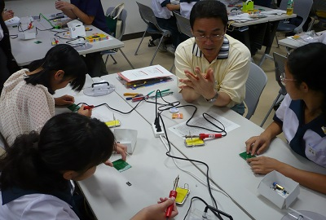
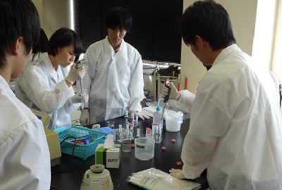
Diffusion / revelation of KAKENHI research results
Inspiring Exciting Science - Welcome to the University Laboratory - KAKENHI
(Project to return to / spread among society research results)
Aim ・・・ Researchers will promote science by communicating cutting-edge KAKENHI research results to elementary school children / students (5th / 6th grade elementary school - high school students) in ways that are easy to understand.
Program recruitment period:
November - mid-January
Trend in number of cases of implementation
Kagoshima University (implemented in July 2014)
“Experience the mystery of the eyes - Is what you are seeing really correct? -”
* By fiscal year 2014, the number of participants, not including parents and guardians, in the cumulative total since the start of the project in 2005 has broken through 40,000 people
Yamagata University (implemented in September 2014)
“Think about biological diversity - The mutual interaction of soil microorganisms, plants and insects -”
Notes:
参考

