Slide 1
Outline of New Guidelines for Responses to Research Misconduct and OIST Efforts Addressed to Research Integrity
Toshinori TANAKA
Section Leader
Occupational Safety and Heath Section
OIST
February 12, 2016
Notes:
Good afternoon and thank you for coming today’s open seminar. And, Dr. Foeger and Dr. Kuroki, thank you very much for your excellent presentations. I am Toshinori Tanaka, OIST.
I will briefly talk about the outline of the “New Guidelines on Responses to Research Misconduct" which has came effect in by last year, and OIST efforts addressed to research integrity.

Slide 2
Background of Formulation of Guidelines for Responding to Misconduct in Research (New Guidelines)
Outline of the New Guidelines
OIST Efforts Addressed to Promotion of Research Integrity
Notes:
These are the topics that I will introduce today.
The guidelines I talk today is formally called “Guidelines for Responding to Misconduct in Research”. But it is a little long. So I say just New Guidelines today.

Slide 3
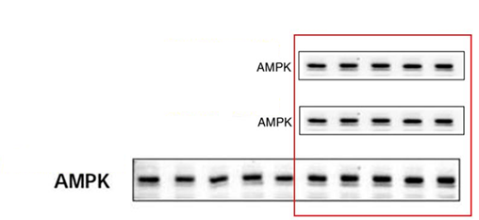
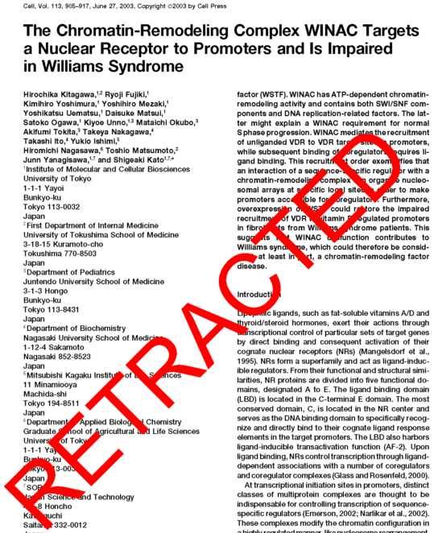
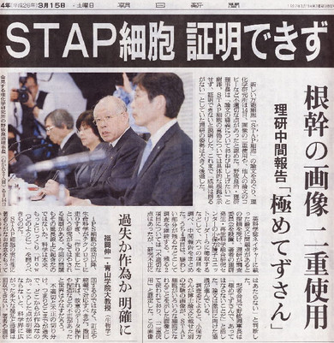
● Guidelines for Responding to Misconduct in Research Activities (2006)
MEXT Special Committee
● Code of Conduct for Scientists (2006)
Science Council of Japan
● Task Force on Misconduct in Research and Misuse of Research Funds (2013)
● Code of Conduct for Scientists (Revised Version) (2013)
Science Council of Japan
●Guidelines for Responding to Misconduct in Research (2014)
Minister's Decision
1 Background of the New Guidelines
Substantial regulations for research institutions
Research Misconduct: Fabrication, falsification, plagiarism, duplicate submission , inappropriate authorship
5 sequences are similar
Paper #3 Figure 2(B)
Paper #9 Figure 1(B)
Paper #4 Figure 1(B)
REUSE OF DATA ON DIFFERENT PAPERS
STAP CELL SCANDAL
Notes:
First, about the background of the New Guidelines.
When you hear research misconduct, you may recall STAP cell scandal, and you may think that the STAP cell scandal led to the new guidelines because the STAP cell scandal got a lot of attention from mass media and society in Japan, and you may think that the STAP cell scandal around that time, MEXT, the Ministry of Education, Culture, Sports, Science and Technology announced to formulate the new "Guidelines on Responses to Misconduct in Research Activities". The issue of research integrity has been attracting a lot of attentions from the general public, as well as from academia, since then.
However, as Dr. Kuroki mentioned in his presentation, scandals that shook the foundation of research integrity and public concerns were already apparent at least from around 2000, and the first Guidelines to prevent research misconduct were formulated in 2006. Also, the Science Council of Japan issued the statement on the "Code of Conduct for Scientists". However, reports of research misconduct cases did not stop, and MEXT set up a task force on research misconduct in 2013 to resume discussions on the prevention of research and formulated the new guidelines on research misconduct. The Science Council of Japan revised the Code of Conduct for Scientists in the same year, in 2013.
The new "Guidelines on Responses to Misconduct in Research Activities" of 2014 are formulated based on the discussions in the task force. The main difference from the predecessor and other relevant MEXT Guidelines is that the Guidelines are issued as a "decision of the Minister".
For your reference, meaning of the word "guidelines" is different between Japanese and English. In addition, the new Guidelines as a Minister's decision is different from other Japanese guidelines, to the extent that they have a certain mandatory power, which administrative guidelines in Japan generally do not have. Therefore, if any activities that do not comply with the new Guidelines are confirmed with an institution or university, the institution or university will be subject to reduction of overhead expenses and disclosure of its name by MEXT or a relevant funding agency, depending on the seriousness of the case. As such, although criminal penalties will not be imposed, socially significant penalties are set forth in the Guidelines.
In addition, misconduct in research activities is sometimes discussed referring to fabrication, falsification and plagiarism. However, in practice and in the Guidelines, misconduct is not limited to these three acts. On the other hand, it does not include some of the frequently discussed acts such as duplicate submission and inappropriate authorship.

Slide 4
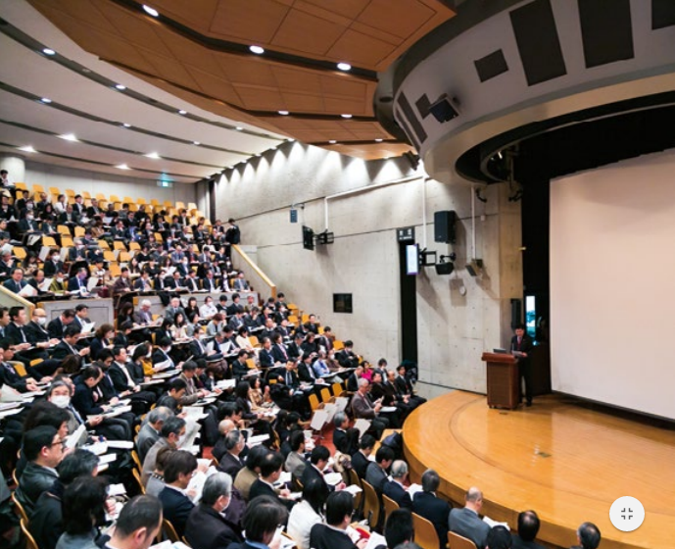
2 Outline of the New Guidelines
Guidelines for Responding to Misconduct in Research
Minister's Decision
Intensive information activities in councils, academic societies and briefings by directors and staff members of the office of MEXT
Universities prioritized the efforts to meet the demands of the new Guidelines, as an urgent task addressed by the top-management level
Appointment of faculty members, staff members and offices that are specially assigned to this task
Symposiums and seminars relating to this task
Urgent need of adding an undergraduate course and a department or a post graduate educational curriculum on responsible conduct of research
Notes:
Let me repeat that the new Research Misconduct Guidelines are issued as a Minister's decision, and each university is strongly demanded to ensure activities in compliance with the Guidelines, taking account of the emphasis and details thereof.
To this end, directors and staff members of the relevant office of MEXT gave briefing sessions on the new Guidelines in many meetings of councils and academic societies before and after the issuance of the new Guidelines to give a thorough explanation to the scientific community. On the other hand, universities and research institutions prioritized the efforts to meet the demands of the new Guidelines, the top-management level worked on this efforts as an urgent task.
As a result of that, an increasing number of universities and research institutions have set up offices and assigned faculty and staff members, which are specially assigned to the promotion of research integrity.
Like our today's seminar, universities and research institutions have been frequently providing symposiums and seminars on research integrity.
Also, in response to the demand of research ethics education by the new Guidelines, an increasing number of universities incorporated the education in the curriculum for their students.
This picture shows the liaison conference among persons in charge of research ethics education and other relevant personnel, which were held in March 2015. Universities and institutions were asked to limit a number of participant to one or two persons, but the room were too full to accommodate all people who came to the conference. This demonstrates the high level of interest in research integrity.

Slide 5
2 Outline of the New Guidelines (Direction of Revision)
There is a general tendency of lack of adequate education on research manners and researchers' ethics
Some of the researchers who are in the position of giving research guidance are not fully aware of their duties and responsibilities
Some point out that there are problems of preventing a healthy autonomous system for eliminating misconduct in the scientific community, due to rapid introduction of competitive environment, advancing subdivision and specialization of research area and growing complexity and diversity in the system for research activities.
Past practices in the efforts of preventing misconduct had heavily relied on self-discipline and responsibility of individual researchers
Data are not adequately stored in such a manner that contributes to the prevention of misconduct and to the defense of researchers themselves in case of allegation of misconduct, while ensuring verifiability of research results by third parties.
The new Guidelines have been formulated as a decision of the Minister of Education, Culture, Sports, Science and Technology.
Conventionally, responses to misconduct in research activities had heavily relied on a sole responsibility of individual researchers, but from now, research institutions will be more actively and responsibly involved in the process of preventing misconduct.
Notes:
Next, I would like to discuss the outline of the Research Integrity Guidelines.
The new Guidelines were formulated based on the old Guidelines of 2006, but were revised greatly on the following important issues:
・Insufficient research ethics education;
・Lack of recognition of duties and responsibilities of lab leaders;
・Impaired self-correction system;
・Excessive reliance on self-discipline; and
・Inadequate data storage.
In view of this, the Guidelines were revised to clearly set forth responsibilities of not only individual researchers but also their research institutions.

Slide 6
2 Outline of the New Guidelines (Basic Policies)
Basic attitudes toward misconduct
Misconduct in research activities contradicts to the nature of research activities and publication of results thereof, and betrayal of science itself.
Not only individual researchers but also research institutions are required to take strict attitudes against misconduct.
Responses to misconduct must be based primarily on the self-discipline of individual researchers and as a self-correction system based on autonomous decision-making of the scientific community or each research institution.
Research institutions actively and responsibly involve in the prevention of misconduct and create an environment that discourages acts of misconduct.
In particular, efforts addressed to the clarification of management responsibility by establishing an organizational system for assuming responsibilities and the prevention of misconduct must be promoted.
Clarification of divisions of roles and responsibilities among individual researchers, etc. in collaborative research
Appropriate checking of research outcome by PIs who are responsible for putting together the whole picture of research activities by team
Provision of appropriate advices and supporting environment that encourages young researchers, etc. to perform research activities independently (e.g., providing mentors)
Autonomy and self-discipline of researchers, scientific community, etc.
Managerial responsibilities of research institution
Notes:
The new Guidelines takes misconduct as betrayal of science itself, and demand both researchers and research institutions to take strict attitudes toward misconduct.
In addition, the new Guidelines' basic attitude towards responses to research misconduct remains the same, which is, to be based primarily on the self-discipline of individual researchers, and secondary on the self-correction system of the scientific community and the research institution.
Further, the new Guidelines demand research institutions to make efforts addressed to the development of an environment that discourages acts of misconduct, clarification of managerial responsibilities and prevention of misconduct.

Slide 7
2 Outline of the New Guidelines (Misconduct/Institutional Rules )
Misconduct in the scope of application of the Guidelines
Fabrication, falsification and plagiarism relating to data, findings of study and the like which are present in research results published in a paper submitted to academic journals, which are caused by a willful act or gross negligence of basic duty of care that must have been exercised by an ordinary researcher.
*Fabrication, falsification and plagiarism ➔ Specified Misconduct
Development and publication of institutional rules on the procedures and methods for investigation in case of a Specified Misconduct allegation:
Clarification of a person in charge of responses to misconduct, and identification of roles and scope of responsibility of the person in charge.
Strict control of confidentiality of whistleblowers and others and clarification of specific procedures after whistleblowing.
Obligation to submit reports to MEXT, etc., regarding investigation on Specified Misconduct.
Development and publication of institutional rules and systems in research institutions and funding agencies
Notes:
There are various kinds of research misconduct, and among them, fabrication, falsification and plagiarism have been defined as Specified Misconduct which is subject to penalties of the new Guidelines.
Also, the new Guidelines require research institutions to develop relevant institutional rules that clarify investigation procedures and methods to handle allegations of research misconduct and make available to public the rules, clarify a person in charge of responses to misconduct, define roles and scope of responsibility of said person, strictly maintain confidentiality of whistleblowers and clarify specific procedures after whistleblowing. The new Guidelines also set forth obligation to submit reports to MEXT.

Slide 8
2 Outline of the New Guidelines (Efforts of Each Institution)
Developing the environment for preventing misconduct
○Increasing awareness in researchers ethics through research ethics education
Research institutions: Develop necessary organizational systems including appointment of a "Research Ethics Education Officer" and provide periodical Research Ethics Education for a wide range of people who engage in research activities.
Universities: Promote Research Ethics Education to their students, in order to increase awareness in compliance regarding researchers ethics among students.
Funding agencies: Ensure completion of a program relating to Research Ethics Education by all researchers who participate in the research activities based on the competitive research funding, and ensure confirmation of completion of the Research Ethics Education.
○Storage of research data for a certain period of time and disclosure thereof by research institutions
MEXT makes a list of cases being confirmed to be misconduct and makes the list publicly available.
Making a list of misconduct cases to be available to public announcement
Notes:
The strongest emphasis of the new Guidelines is research ethics education as a means to develop an environment to prevent misconduct.
This point has been one of the most difficult tasks in many universities, but learning materials provided by the CITI Japan Project, which will be discussed later, have become one of the most popular materials.
Storage and disclosure of research data are also important tasks that the new Guidelines put an emphasis on. Universities are required to have institutional rules on these aspects.
Misconduct cases are to be listed by MEXT and be made available to public. As a matter of course, obligations to report misconduct to MEXT have been set forth.

Slide 9
2 Outline of the New Guidelines (Whistleblowing and Investigation )
Receiving allegations of specified misconduct and investigating alleged cases
Procedures and methods including receiving allegations of specified misconduct, investigation, determination, appeal and public announcement of results of the investigation to investigating alleged:
Designate a contact point for allegations and consultations, and fully inform of the contact point. *The services of the contact point may be commissioned to a third party by a contract.
Prescribe a standard period of time for investigation in research institutions
Organize an investigatory committee, in which at least half of the members are external expert members (also stipulate exclusion of interested parties).
When the investigatory committee finds it necessary, provide an opportunity for reproductive experiment, under the direction/supervision of the investigatory committee.
If a new decision that requires expert knowledge needs to be made in an appeal, the review will be conducted by replacing or adding members of the investigatory committee.
Notes:
As to procedures and methods from whistleblowing to investigations, institutions are required to have specific provisions. The new Guidelines require institutions to set forth detailed provisions on the establishment and modification of a contact point for whistleblowing and consultations, an investigation period, a composition of investigatory committee, provision of an opportunity for reproductive experiment, and appeal.

Slide 10
2 Outline of the New Guidelines (Penalties)
Measures against researchers and research institutions regarding specified misconduct
Refund competitive research funding relating to specified misconduct(*).
Restrictions on qualifications for applying for and participating in competitive research funding(*).
(*it applies to misconduct in research activities carried out based on basic expenses such as operating expense subsidy, as well as competitive research funding.)
○Ensuring development of responsible organizational structure
MEXT imposes a "supervised condition" if it confirms a deficiency in the development of organizational structure or system, etc. for responding to misconduct.
MEXT takes countermeasures for non-compliance with the supervised condition, such as reduction of "overhead expenses" for the institution.
○Ensuring speedy investigation
Reduction of "overhead expenses" if investigation relating to specified misconduct is delayed without justifiable cause.
Measures for research institutions regarding managerial responsibility as an organization
Notes:
These are the outline of penalties against research misconduct:
For researchers, refund of competitive research funds, restrictions on qualifications for applying for and participating in competitive research funding; and
For research institution, if it fails to comply with the requirements of the new Guidelines, and further fail to provide adequate improvement measures, it may be subject to reduction of overhead expenses, and so on.

Slide 11
2 Outline of the New Guidelines (Publication of Misconduct Case)
Purposes
Preventing misconduct through self-learning by researchers and other relevant members.
Utilizing in responses in case of finding occurrence of misconduct in the research institution.
Cases for which a report of Specified Misconduct (fabrication, falsification or plagiarism) was received on or after April 2015.
Misconduct in research activities such as duplicate submission and inappropriate authorship is also responded to in a same manner as the above.
Uploaded to the MEXT website
Investigation systems, investigation methods , results of investigation in the research institution
Reason why a determination of misconduct was made
Factors that fostered the occurrence of the misconduct and measures for preventing another misconduct case.
Measures taken by research institutions and funding agencies
Cases subject to publication
Items subject to publication
Notes:
As discussed before, each research institution has an obligation to report a case of misconduct in research activities to MEXT, and is expected to publicly announce details of the case. Up to now, 7 cases of misconduct in research activities have been announced on the MEXT website.

Slide 12
2 Outline of the New Guidelines (MEXT Status Survey)
Purposes
Contributing to the promotion of research activities with integrity in each research institution, by collecting information on the progress of the development of institutional systems and other efforts that may be referred to by other research institutions, and publicly announcing the same.
Document survey: Complete enumeration survey
Field survey: Selecting institutions to be subject to the survey from the following:
Research institutions ranked in higher positions on the number of selected proposals for Grant-in-Aid
Research institutions that had reported a misconduct case in the past.
Policies, etc. on the efforts responding to misconduct in research activities
Progress of the development of institutional systems
Progress of efforts addressed to foster awareness of research ethics
Storage of research data and disclosure thereof
Progress of measures for responding to Specified Misconduct such as designation of a contact point for consultation and receiving allegation and development of institutional rules
Results of the status survey will be formulated into a report and be available to public around March this year.
Survey methods
Survey items
Future plan
Notes:
At present, MEXT has been conducting a survey to collect information on whether each research institution meets the items required by the Guidelines, and the results will be available to public in March this year.

Slide 13
2 Outline of the New Guidelines (Compared with Other Countries)
HAL Typology (2009) |  |  | ENrio (Oct. 2012) "Mode of Regulation"
Type 1 | Centralized national legislative system with legal mandate (U.S., Denmark, Norway) |  | National Commissions with legal mandate (Denmark)
Type 2 | An organization constituted by non-legislated body, for undertaking supervision over research funding agency and each research institution. |  | National Advisory bodies (Germany, UK, Netherlands, etc.: 11 states*) *Including Norway.
Type 3 | Independent research integrity monitoring organization or a system that lacks compliance functions. |  | Local Commissions (France, Belgium, Ireland, etc.: 5 states)
(Note) Descriptions of the table are based on the commentary of a report (2010) by CCA. |  |  | (Note) Information on Enrio was prepared based on the reference (10/2012) prepared by the Austrian agency for research integrity (OeAWI)
Is Japan Type 1.5?
Guidelines closer to legislation
National governments conduct survey on efforts of each research institution and make any research misconduct cases available to public
Source: Matsuzawa, "Joho-kanri (Information Management)", January 2014; partially modified.
Notes:
This is a comparison of efforts on research misconduct, for your reference.
There are a quite variety of research integrity systems depending on specific counties, and these are classified into three major categories.
The first system has legislation on research integrity, and has an authoritative independent committee or research integrity office with legal mandate for the power to conduct compulsory investigation. This category is called "Type 1" in this table. Typical examples are those introduced in the United States and Denmark.
The second system is that, although legal mandate for the power to conduct compulsory investigation is not given, an organization on research integrity is set out in the government or in an external agency, which is called "Type 2" in this table. In Germany, research funding agencies are responsible for this aspect. In Type 2, there is often a tendency that the role of preventing misconduct is primarily played by experts through their advices, rather than investigation on misconduct. In other words, emphasis is on the promotion of responsible conduct of research. I have learnt that Austria, the country of one of the today's lecturers, Dr. Foeger, is also classified in Type 2.
The second system is without an independent organization that supervises research integrity, in which Guidelines and Codes play a key role to promote practices of responsible conduct of research among researchers. This is called "Type 3" in this table. Japan was previously classified into this third category, but since the issuance of the new Guidelines two years ago, I suspect that our system is in somewhere between Type 1 and Type 2.

Slide 14
3 OIST Efforts Addressed to Promotion of Research Integrity (CITI Japan Project)
Shinshu Univ.
Sophia Univ.
Kitasato Univ.
OIST
Tokyo Med. & Dent. Univ.
Fukushima Med. Univ.
CITI Japan Project
A collaborative project of 6 universities including OIST for developing, creating and propagating educational materials on research ethics that meet global standards and conform to Japanese legal frameworks and guidelines, culture and custom and views, based on materials which have been widely used in the world, particularly in the US.
Learning materials are provided online.
Notes:
Next, I would like to introduce OIST efforts addressed to increase research integrity.
OIST has been working collaboratively with these five universities in the CITI Japan Project since 2012.
This Project is subsidized by the budget of MEXT, and is aimed to create Japanese national standard learning materials for research ethics education that meet the global standard at the same time.
All learning materials are provided online. Some are already available for free.

Slide 15
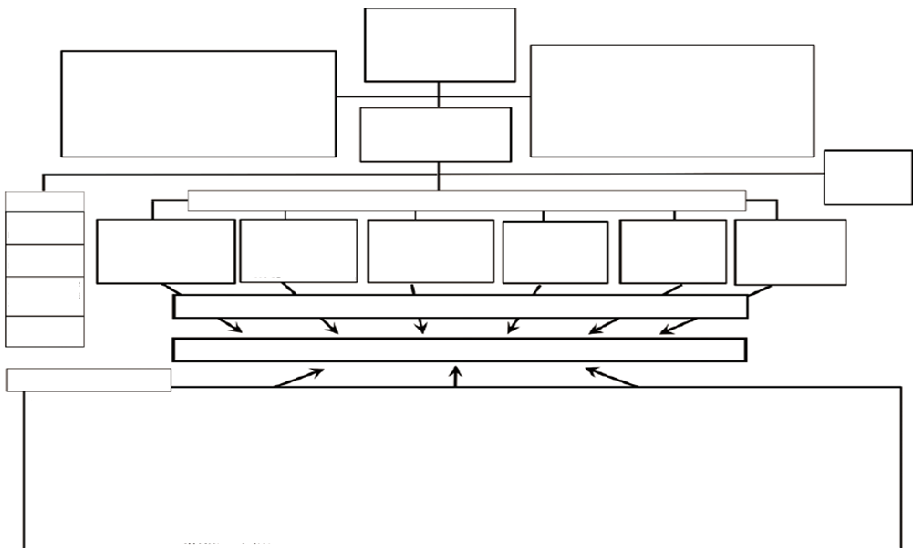
3 OIST Efforts Addressed to Promotion of Research Integrity (CITI Japan Project)
FY2014 Project Implementation Structure
Project Administrator
Yoshimitsu Fukushima (Shinshu Univ.)
Steering Committee
Tokyo Med. & Dent. Univ., Shinshu Univ., Fukushima Pref. Med. Univ., Kitasato Univ., Sophia Univ. and OIST
Project Supporting Organization: Business Department, School of Medicine, Shinshu Univ.
External Review Committee
Makoto Asashima, Director (JSPS)
Tomoaki Tsuchida, Professor (Waseda Univ.)
Kiyoshi Aoki, Professor (Sophia Univ.)
Ellen Clayton, Professor (Vaderbilt Univ.)
Sergio Utewka, Professor (Miami Univ.)
Deputy Project Administrator
- Deans of collaborator univs.
- Iekuni Ichikawa (Shinshu Univ.)
Users' meeting (annually)
Cooperative organizations
Collaborator universities
AJMC
Shinshu Univ.
"Research activities with responsibility"
"Handling of Animal Experiments"
"Materials for Engineering Fields"
Tokyo Med. & Dent. Univ.
"Human Subjects Research"
Fukushima Pref. Med. Univ.
"Research Safety"
Sophia Univ.
Consistency of materials from legal and ethical standpoints
Kitasato Univ.
"Human Genome Research"
OIST
English materials for international students
JMA/JAMS
JAXA
Operation policy meeting, editorial meeting, CITI international collaboration activities
Liaison Conference for Gene Therapy fields
Material preparation/revision, CITI enlarged body members, promotion activities
*FY2014 reviewers are mainly included in the list.
External cooperators
Narifumi Kudo (Tohoku U.), Masamichi Hayashi (Kogakuin U.), Masafumi Ata (Osaka U.), Masaki Nakamura (Osaka U.), Norio Higuchi (Tokyo U.), Koichi Miki (Keio U.), Hideyuki Murakami (NIMS), Ryuji Koike (Tokyo Med. & Dent. U.), Yoshitomo Nakano (Hiroshima U.), Shimon Tashiro (Showa U.), Yoshinobu Kitamura (Sophia U.), Masaharu Yano (Tokyo U.), Eisuke Enoki (Kinki U.), Minoru Kimura (Tokai U.), Kenichi Natsume (Kanazawa Inst. of Tech.), Hidenori Kaketani (Tsukuba U.), Tomoki Kinoshita (ACSES), Ichiro Kanaya (Osaka U.), Minoru Maruyama (Shinshu U.), Shizuaki Murata (Nagoya U.), Noriko Osumi (Tohoku U.), Shunichi Yamashita (Nagasaki U.), Syunsuke Ikeda (emeritus atTokyo Inst. of Tech.),, Yoshito Oshima (Tokyo U. Graduate School), Tetsuji Iseta (Kyoto U.), Satoshi Kodama (Kyoto U.), Yukio Sudo (JRIA), Yukito Kobayashi (Kumamoto Inst. of Tech.), Kiyoshi Tamada (Shinshu U.), Hiroo Katakura (Kansai U.), Tsunakuni Ikka (Kyoto pref. Mded. U.), Kotobu Nagai (EAJ), Yosuke Takahama (tokushima U.), Takashi Agui (Hokkaido U.), Masahiko Ichii (JANU), Kouichi Sumikura (GRIPS), Fujie Tanaka (OIST), Makoto Suzuki (OIST), Tetsunosuke Kunitomo (Toray Medical), Sumio Ozeki (Shinshu U.), Masamichi Kinomoto (BMSA), Kazuyoshi Sugiyama (NIID), Yasuharu Sugimoto (T. Sugimoto Gijutsushi Office), Atsushi Ito (Tokyo U.), and Masamitsu Tamura (emeritus at Tokyo U.)
Notes:
The Steering Committee of the Project consists of six universities including OIST. In addition, the processes of preparation and reviewing of learning materials asked for cooperation from a number of research institutions and academic, besides these six universities. There are quite many researchers and experts involved in the process of material development during the last year only.

Slide 16
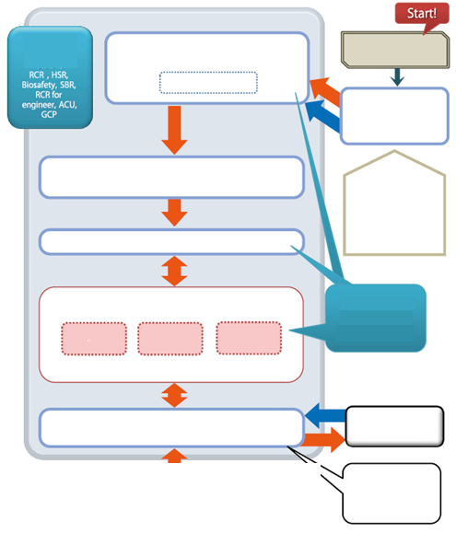
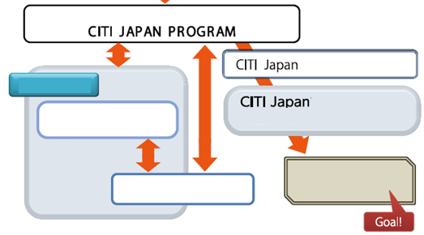
3 OIST Efforts Addressed to Promotion of Research Integrity (CITI Japan Project)
Areas of materials
Material preparation working group (Japanese version) ^{*1}
US CITI materials
Drafter ^{*2}
English Materials
CITI Japan project secretariat
CITI Japan Project Steering Committee
(Determination of reviewers, schedule coordination for material preparation, etc.)
Comments from society ^{*3}
External review committee, liaison conference, public comment procedures ^{*5} , etc.
Sphia University
Module subcommittees ^{*4} (review/discussion)
Flesh out with Japanese law, guidelines and culture
Reviewer
Reviewer
Reviewer
Project Secretariat
Collegial body of basically 3 reviewers, 1 meeting
Preparing English version
Project
OIST
Steering Committee
Material preparation working group (finalizing)
Public Comment procedures ^{*5}
Confirmation and approval of finalized materials
Inserting illustrations, proofreading, online formatting
CITI Japan
materials
US CITI (reviewing)
Notes:
This Project has been implemented in cooperation with CITI program in the United States. Our Japanese learning materials are developed based on the materials of US CITI, and translated into Japanese while fleshing out with Japanese specific contents to meet local law and guidelines, culture and custom.
Before completion of the materials, there are some additional steps, such as validation from legal standpoint. This aspect is handled exclusively and comprehensively by the faculty members of Sophia University Institute of Bioethics. OIST is a principal institution for the development of English version of the materials. Professor Tripp and Professor Arbuthnott of OIST gave us cooperation as reviewers of the English version. There were at least three steps in the single reviewing process of the English version. We are very proud of the quality of the materials as English educational materials.

Slide 17
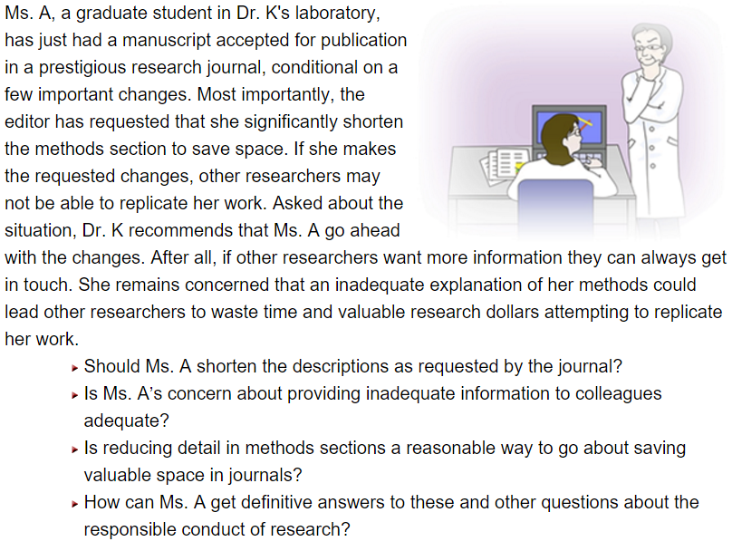
3 OIST Efforts Addressed to Promotion of Research Integrity (CITI Japan Project)
List of current learning materials:
Responsible conduct of research
A complete version
A digest version
Research safety
Chemical materials
Radioactive materials
Biosafety
Human subjects research
Handling of lab animals
GCP (clinical trials)
All materials are provided via e-learning system
Course completion and understanding checking by quizzes
Notes:
At present, CITI Japan Project provides learning courses including these subjects: responsible conduct of research; research safety; human subjects research, handling of lab animals, and GCP.
Learners receive these courses online, and can complete courses on a course basis when they achieve certain scores in quizzes provided at the end of each course.
The material of responsible conduct of research meets the requirement of research ethics education set forth by the MEXT' new Guidelines, and completion of the courses is a prerequisite for researchers who have won a research grant provided by JST.

Slide 18
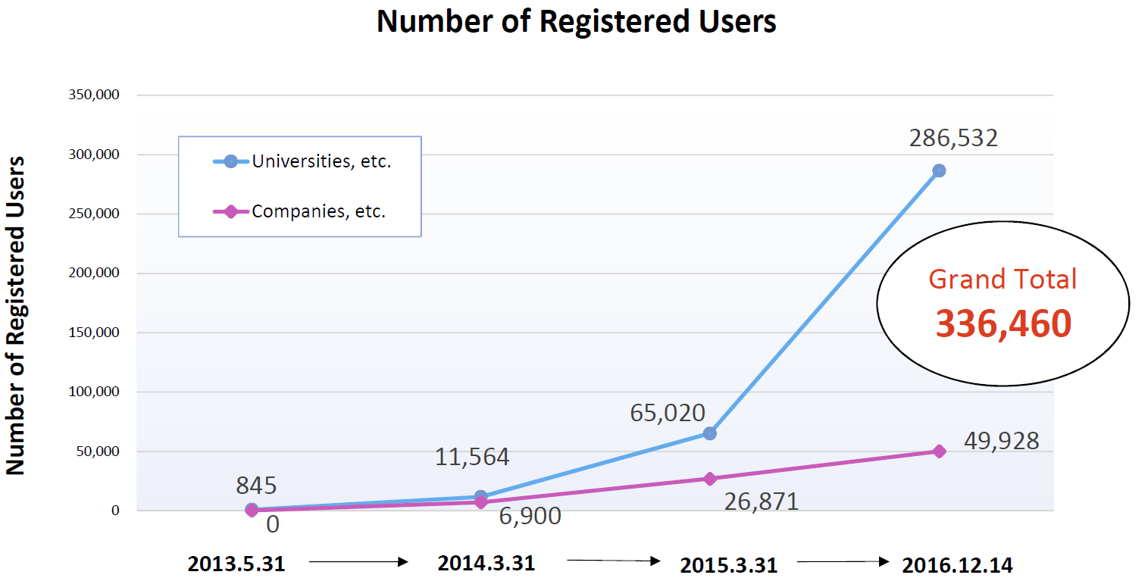
3 OIST Efforts Addressed to Promotion of Research Integrity (CITI Japan Project)
2015.12.14
Notes:
CITI Japan Project had set out an initial numerical target for the number of learners, which was 3,600 at the fifth year (FY2016). As of the end of the last year, there are over 330,000 learners, which is about 100 times the initial target.

Slide 19
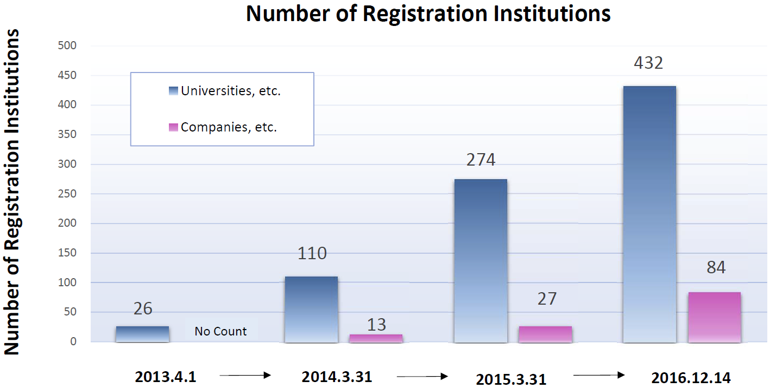
3 OIST Efforts Addressed to Promotion of Research Integrity (CITI Japan Project)
Notes:
This slide shows the number of institutions registered to the Project. 432 universities, etc., and 84 companies, etc. We can see that universities and research institutions all over the country utilize the learning materials of the Project to increase research ethics awareness.

Slide 20
3 OIST Efforts Addressed to Promotion of Research Integrity (Institutional Rules and Mechanisms for Responsible Conduct of Research)
President
Research Ethics Chief Administrative Officer
Dean of Research
Research Ethics Education Officer
Dean of Graduate School
Responsible for students
Dean of Faculty Affairs
Responsible for investigation
Dean of Research
RCR promotion
Occupational Safety and Health SL
Supporting DOR, such as material preparation and seminars
Institutional Rules
Revision of existing university rules
Chapter 4: "Research Activities" This chapter stipulates basic policies and guidelines on research integrity.
Chapter 23: "Investigation and Determination of Misconduct & Whistleblower Protection" This chapter stipulates procedures for whistleblowing, investigation and penalties. Besides research misconduct, the chapter stipulates procedures for any kind of misconduct in a broader sense such as incompliance with any laws or institutional rules and research fund misuse.
Research support staff
Students
Faculty members Researchers
Notes:
Next, I will explain institutional rules and mechanisms on research integrity at OIST.
In order to respond to the requirements of the new Guidelines, we have proceeded with development of institutional rules of OIST. As a result of discussions among concerned personnel, we decided to respond to the new Guidelines by revising chapters on research activities and misconduct which were already available at OIST, instead of developing new rules relevant to these aspect.
Chapter 4 which stipulates rules on research activities has been revised to define basic policies on research integrity and active efforts to increase research integrity such as research ethics education, and Chapter 23 which stipulates procedures for misconduct allegations has been revised to define procedures from whistleblowing and investigation to determination. These procedures may overlap with general incompliance and research fund misuse, besides research misconduct. Thus, new Chapter 23 provides comprehensive provisions for such procedures.
As for management mechanisms, the President is the Research Ethics Chief Administrative Officer, and thereunder, the Dean of Research is designated as the Research Ethics Education Officer to provide general administration of research ethics education.
In addition, persons who are directly responsible for research education are the Dean of Graduate School with respect to students, and the Dean of Research with respect to research support staff members. As for faculty members and researchers, the Dean of Research and the Dean of Faculty Affairs jointly promote research ethics among them.

Slide 21
3 OIST Efforts Addressed to Promotion of Research Integrity (Relevant Committees)
OIST has two committees on research integrity to promote efforts for misconduct prevetion and to appropriate and speedy implementation of investigation in case of a misconduct.
Misconduct Prevention Committee
Committee to Promote the Responsible Conduct of Research
Chair: Dean of Faculty Affairs
Members: Dean of Faculty Affairs, University General Counsel, Dean of Research, Chair of the Faculty Counsel, Chair of the Faculty Assembly, Occupation Health and Safety Section Leader, Grants and Research Collaborations Section Leader, external experts (need to be over half of the members), and other eligible persons whom the Chair considers necessary
After-action measures: Upon receipt of a whistleblowing of alleged misconduct, commences investigation.
Chair: Dean of Research
Members: Dean of Research, Dean of Faculty Affairs, Chair of the Faculty Counsel, Chair of the Faculty Assembly, Occupational Safety and Heath Section Leader, OIST faculty members, and external experts
Preventive measures: Prepares materials for education and training for promoting responsible research; prepares relevant institutional guidelines, providing seminars for increasing awareness, etc.
Notes:
The new Guidelines only require establishment of a committee that undertakes investigation of research misconduct. However, OIST will proceed with efforts to promote research integrity in daily research activities, based on the recognition that prevention of research misconduct by promoting responsible conduct of research is the key to achieve this purpose. To this end, a misconduct prevention committee is established separately from a committee to promote the responsible conduct of research which also acts as an investigatory committee at OIST.
This seminar has been planned by a team lead by the Dean of Research, based on this idea.

Slide 22
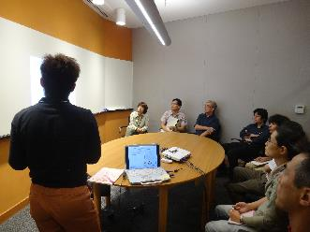
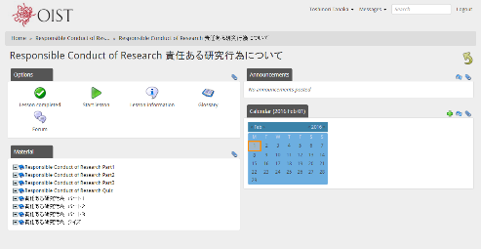
3 OIST Efforts Addressed to Promotion of Research Integrity (research ethics education )
Characteristics of research ethics education at OIST
Based primarily on E-learning materials;
While utilizing face-to-face and collective sessions;
Multitiered education is provided.
Online learning materials (Digest version; compulsory; valid for 5 years)
Online learning materials (complete version, recommended)
Instructions in each research unit
Research integrity seminar (recommended)
Update session (compulsory; annually)
University lectures
Professional Development
Notes:
Next, I will discuss research ethics education at OIST.
First, all of the faculty members, students, researchers and staff members are required to complete a digest version of learning materials of CITI Japan Project online, and completion of the complete version is recommended. In addition, completion of online materials is valid for five years, and these people are required to complete the materials again within five years.
Research ethics education for students include additional "Professional Development Course", in which they will learn research misconduct using case studies. In research units, faculty members are expected to increase awareness on research ethics through meetings during daily research activities, as leaders of their labs.
In addition, seminars on research integrity, such as today's, are held occasionally, as efforts to increase awareness through presentations by external lecturers.
All these people are required to complete update sessions on occupational safety and health and research ethics annually. In these sessions, the latest information and cautions on research integrity will be provided as needed.

Slide 23
3 OIST Efforts Addressed to Promotion of Research Integrity (Contact Points)
Contact Points
Case Category | Contact Points
 | Internal | External
Non-compliance | VPAC Compliance Section Manager | Outside lawyer
Public research fund misuse | Dean of Faculty Affairs Misuse of open-recruitment type research funding may also be reported to the Grants and Research Collaborations Section Manager or the Business Development Section Manager.
Misconduct in research activities | Dean of Faculty Affairs Occupational Health and Safety Section Manager
Notes:
Contact points on research misconduct allegations are provided for two channels: Internal and external channels.

Slide 24
3 OIST Efforts Addressed to Promotion of Research Integrity (Investigation )
Report
By face-to-face reporting, by phone or email, or through media coverage
Preliminary investigation
Dean of Faculty Affairs
Substantive investigation
Research ethics committee (Dean of Faculty Affairs, University General Counsel, Dean of Research, Chair of the Faculty Counsel, Chair of the Faculty Assembly, Occupational Safety and Heath Section Leader, Grants and Research Collaborations Section Leader, external experts (need to be over half of the members), and other eligible persons whom the Chair considers necessary)
Credibility of the rationale, reasonableness of the contents of the allegation, whether or not the investigation is warranted, etc. Retracted papers are also in the scope of investigation, confirmation of source of funds
A report to the President within 30 days
Reporting to the President of the investigation results within 150 days
Appeal
Appeal within 14 days
If a re-investigation starts, a conclusion within 50 days
Penalty and Report
Penalty in accordance with the institutional rules
Reporting to relevant organizations (e.g., MEXT, funding agency)
Notes:
A series of procedures including whistle blowing, investigation and penalties is implemented in accordance with the new Guidelines. As for the members of the research ethics committee who are responsible for investigation, the Chair is the Dean of Faculty Affairs, and other members include University General Counsel, Dean of Research, Chair of the Faculty Counsel, Chair of the Faculty Assembly, Grants and Research Collaborations Section Leader, Occupational Safety and Health Section Leader and external experts. External experts are invited so as to be at least a half of the members of the committee.

Slide 25
Sources and Acknowledgement
Promotion of Research Activities with Integrity, November 11, 2015, Office for Research Integrity, Knowledge Infrastructure Policy Division, Science and Technology Policy Bureau, MEXT
Takaaki Matsuzawa, National Research Integrity System in Other Countries (1), Joho-kanri (Information Management), vol. 56. no. 10, 2014
Hickling Arthurs Low Corporation (HAL) , "The State of Research Integrity and Misconduct Policies in Canada", October, 2009.
The European Working Group Meeting of the Global Research Council, "European Network of Research Integrity Offices", Brussels 22, October, 2012.
Council of Canadian Academies (CCA) , "Honesty, Accountability and Trust : Fostering Research Integrity in Canada-Expert Panel on Research Integrity", 2010, ISBN-978-1-926558-26-4
CITI Japan Project Steering Committee, Meeting and Workshop References
CITI Japan project members
Notes:
A series of procedures including whistle blowing, investigation and penalties is implemented in accordance with the new Guidelines. As for the members of the research ethics committee who are responsible for investigation, the Chair is the Dean of Faculty Affairs, and other members include University General Counsel, Dean of Research, Chair of the Faculty Counsel, Chair of the Faculty Assembly, Grants and Research Collaborations Section Leader, Occupational Safety and Health Section Leader and external experts. External experts are invited so as to be at least a half of the members of the committee.

Slide 26
Thank you.

