Slide 1
The European way to promote research integrity
Nicole Foeger
Austrian Agency for Research Integrity
European Network of Research Integrity Offices (ENRIO)
Okinawa Institute of Science and Technology Graduate University 12.02.2016
22/10/12, Brussels – Belgium

Slide 2
Research Integrity (RI) - a global issue
International cooperation
Researcher moving to other countries
international campus/
PhD programmes
cultural, linguistic, political barriers
RI: Same understanding of definitions, standards and procedures?
RI: Law? No law? „Soft law“?
…

Slide 3
Research Integrity in Europe
USA 1989:
Office of Inspector General OIG (NSF) and Office of Research Integrity ORI (HHS,..)
Pioneers in Europe: Scandinavian countries in early 1990‘s
Germany 1998 (DFG and MPG)
UK 2006
Austria 2008
European Network of Research Integrity Offices 2007/2008
(ENRIO; representatives from 23 European countries)

Slide 4
Important Documents
ESF Member Organsation Forum on Research Integrity (2008)
European Code of Conduct (2010; ESF/ALLEA)
www.esf.org
World Conferences on Research Integrity:
Lisbon (2007)
Singapur (2010): Singapore Statement
Montreal (2013): Montreal Statement
Rio de Janeiro ( May/June 2015)

Slide 5
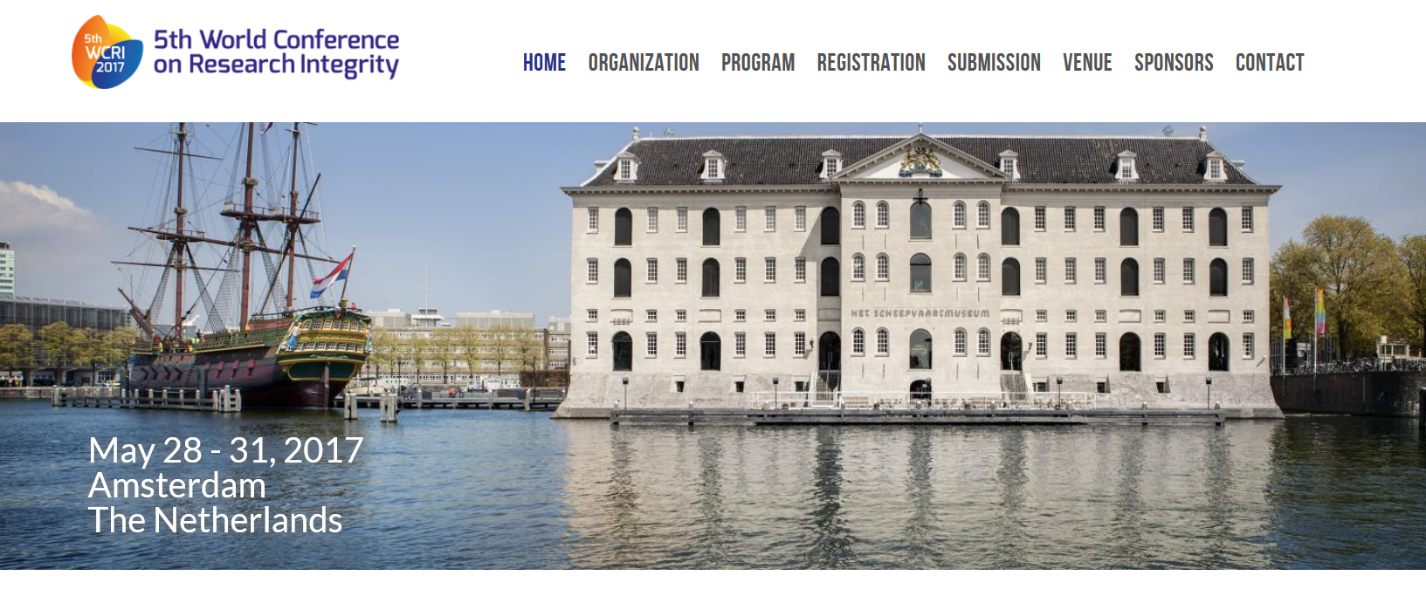
http://www.wcri2017.org/

Slide 6
„We do not want to have a Court,
we want scientists to behave“
P. Drenth (All European Academies; ALLEA)
6

Slide 7
Principles of Research Integrity in Europe

Slide 8
http://www.singaporestatement.org/
published 2010

Slide 9
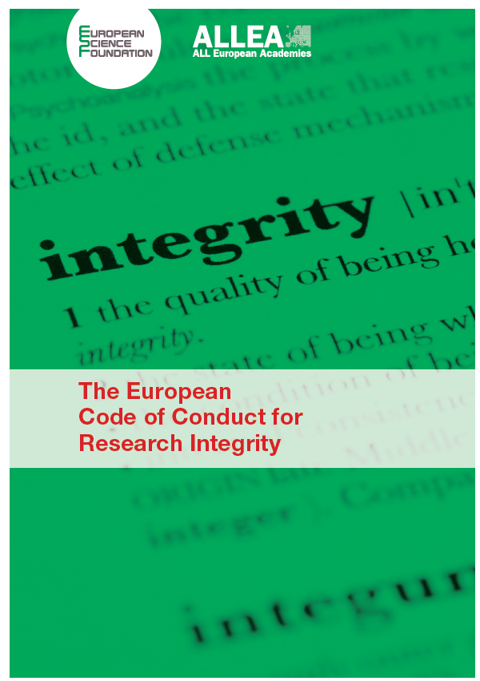
Principles of Integrity
Honesty
Reliability
Objectivity
Impartiality and Independence
Openness and Accessibility
Fairness
Duty of care for participants (human beings, animals) and the environment)
Responsibility for future science generations
published 2010

Slide 10
Good research practices* (I)
DATA
All data should be
stored in a secure and accessible form,
documented and
archived for a substantial period of time (at least 5 yrs, preferably 10 yrs)
*The European Code of Conduct (ESF/ALLEA)

Slide 11
Good research practices* (II)
PROCEDURES
All research should be designed and conducted in ways that avoid negligence,
haste, carelessness and inattention.
Researchers should minimise impact on the environment and use resources
efficiently.
Clients and/or sponsors should be alerted to the ethical and legal obligations
of the researcher.
Clients and/or sponsors should be made aware of the vital importance
of publication of the research findings.
*The European Code of Conduct (ESF/ALLEA)

Slide 12
Good research practices* (III)
RESPONSIBILITY
All research subjects – human, animal or non-living – should be handled with
respect and care.
The health, safety or welfare of a community or collaborators should not be
compromised.
Researchers should be sensitive to their research subjects.
Human subject protocols should not be violated
Animals should be used in research only after alternative approaches
have proved inadequate.
*The European Code of Conduct (ESF/ALLEA)

Slide 13
Good research practices* (IV)
PUBLICATION
Results should be published in an open, transparent and accurate manner, at
the earliest possible time, unless intellectual property considerations justify delay.
All authors, unless otherwise unspecified, should be fully responsible for the
content of publication.
Intellectual contributions of others should be acknowledged and correctly cited.
Honesty and accuracy should be maintained in communication with the public
and the popular media.
Financial and other support for research should be acknowledged.
*The European Code of Conduct (ESF/ALLEA)

Slide 14
Good research practices* (V)
EDITORIAL RESPONSIBILITY
An editor or reviewer with a potential conflict of interest should withdraw from
involvement with a given publication or disclose the conflict to the readership
Reviewers should provide accurate, objective, substantiated and justifiable
assessments, and maintain confidentiality.
Reviewers should not, without permission, make use of material in submitted
manuscripts.
The same applies for reviewers of research proposals, applications by individuals
for appointment or promotion or other recognition.
*The European Code of Conduct (ESF/ALLEA)

Slide 15
Research misconduct*
MISCONDUCT
Fabrication
Falsification
Plagiarism
Misrepresentation of interests, breach of confidentiality,
lack of informed consent, abuse of research subjects or materials
Improper dealing with infringements; e.g. attempts to cover up misconduct,
reprisals on whistleblowers
*The European Code of Conduct (ESF/ALLEA)

Slide 16
The diversity of Europe

Slide 17
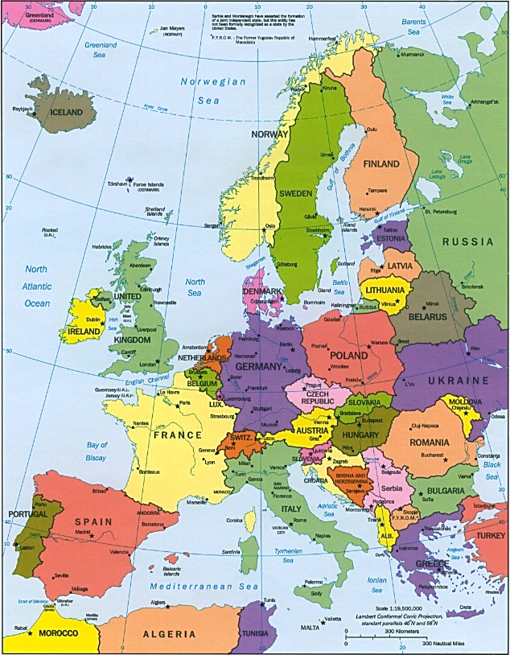
EUROPE
47 independent countries
More than 150 languages
More than 740 million inhabitants
Different forms of government
Diversity of traditions and cultures
…

Slide 18
www.enrio.eu

Slide 19
The „history“ of ENRIO
Founded 2007/2008 (after 1st WCRI, Lisbon)
Initiative of UKRIO: First meeting in 2008 with 8 representatives
January 2016: Participants from 23 European countries

Slide 20
ENRIO Members
Members belong to:
national organisations responsible for investigation and/or oversight of allegations of research misconduct
organisations providing funding for research (if there are no organisations as mentioned in a)
Academies and other learned societies or the like with a special interest in promoting research integrity e.g. by promoting training and education and/or establishing rules or structures for the investigation of allegations as mentioned under a
Other relevant bodies or groups that support the goal of ENRIO but are not included in 2a - 2 c.

Slide 21
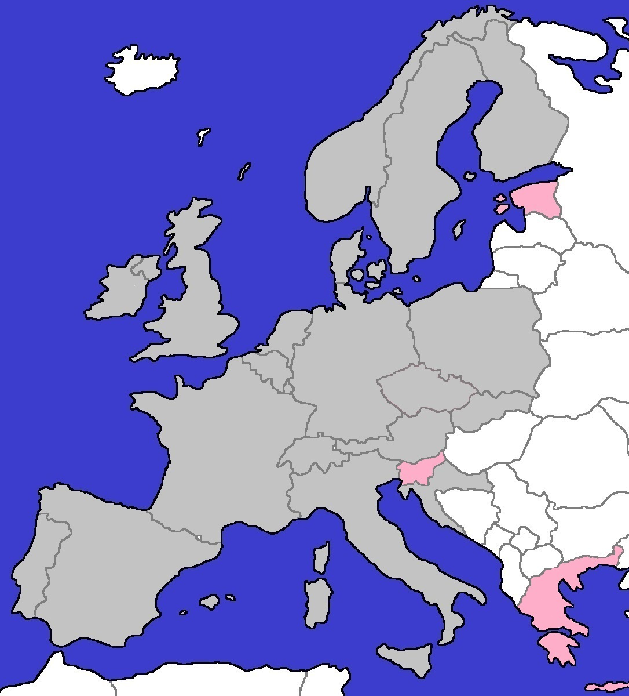
ENRIO: Members 2016
Member
05/2015 by OeAWI
■ 
ABBREVIATIONS
Austria OeAWI Austrian Agency for Research Integrity
Belgium VCWI Flemish Commission for Research Integrity
Croatia CESHE Croatian Committee on Ethics in Science and Higher Education
Czech Republic Academy of Sciences of the Czech Republic
Denmark DCSD Danish Committees on Scientific Dishonesty
Estonia ETAg Estonian Research Council
Finland TENK Finnish Advisory Board on Research Integrity
France CNRS Centre national de la recherche scientifique
INSERM Institut national de la santé et de la recherche médicale
Germany OMBUDSMAN Ombudsman für die Wissenschaft
SciInt Scientificintegrity.de
Greece EARTHnet
RCR-Greece
EARTHnet
Ireland HRB Health Research Board
RIA Royal Irish Academy
Italy CNR Consiglio Nazionale delle Ricerche
Luxembourg FNR Fonds National de la Recherche
Netherlands LOWI National Board for Research Integrity
Norway ETIKKOM The National Committees for Research Ethics
Poland PAN Polska Akademia Nauk
Portugal FCT Portuguese Foundation for Science and Technology
Slovak Republic SRDA Slovak Research and Development Agency
Slovenia CWS Committee for women in science
Spain CSIC Consejo Superior de Investigaciones Científicas
Sweden CEPN Expert Group for misconduct in research at the Central Ethical Review Board
Switzerland SA Swiss Academies of Arts and Sciences
United Kingdom UKRIO UK Research Integrity Office
© digitale-europakarte.de
Member
Observer
Observer
TENK
ETIKKOM
CEPN
ETAg
DCSD
HRB
RIA
UKRIO
SciInt
PAN
LOWI
VCWI
OMBUDSMAN
FNR
AV CR
CNRS
INSERM
SRDA
OeAWI
SA
CWS
CESHE
CNR
FCT
CSIC
EARTHnet
RCR-Greece

Slide 22
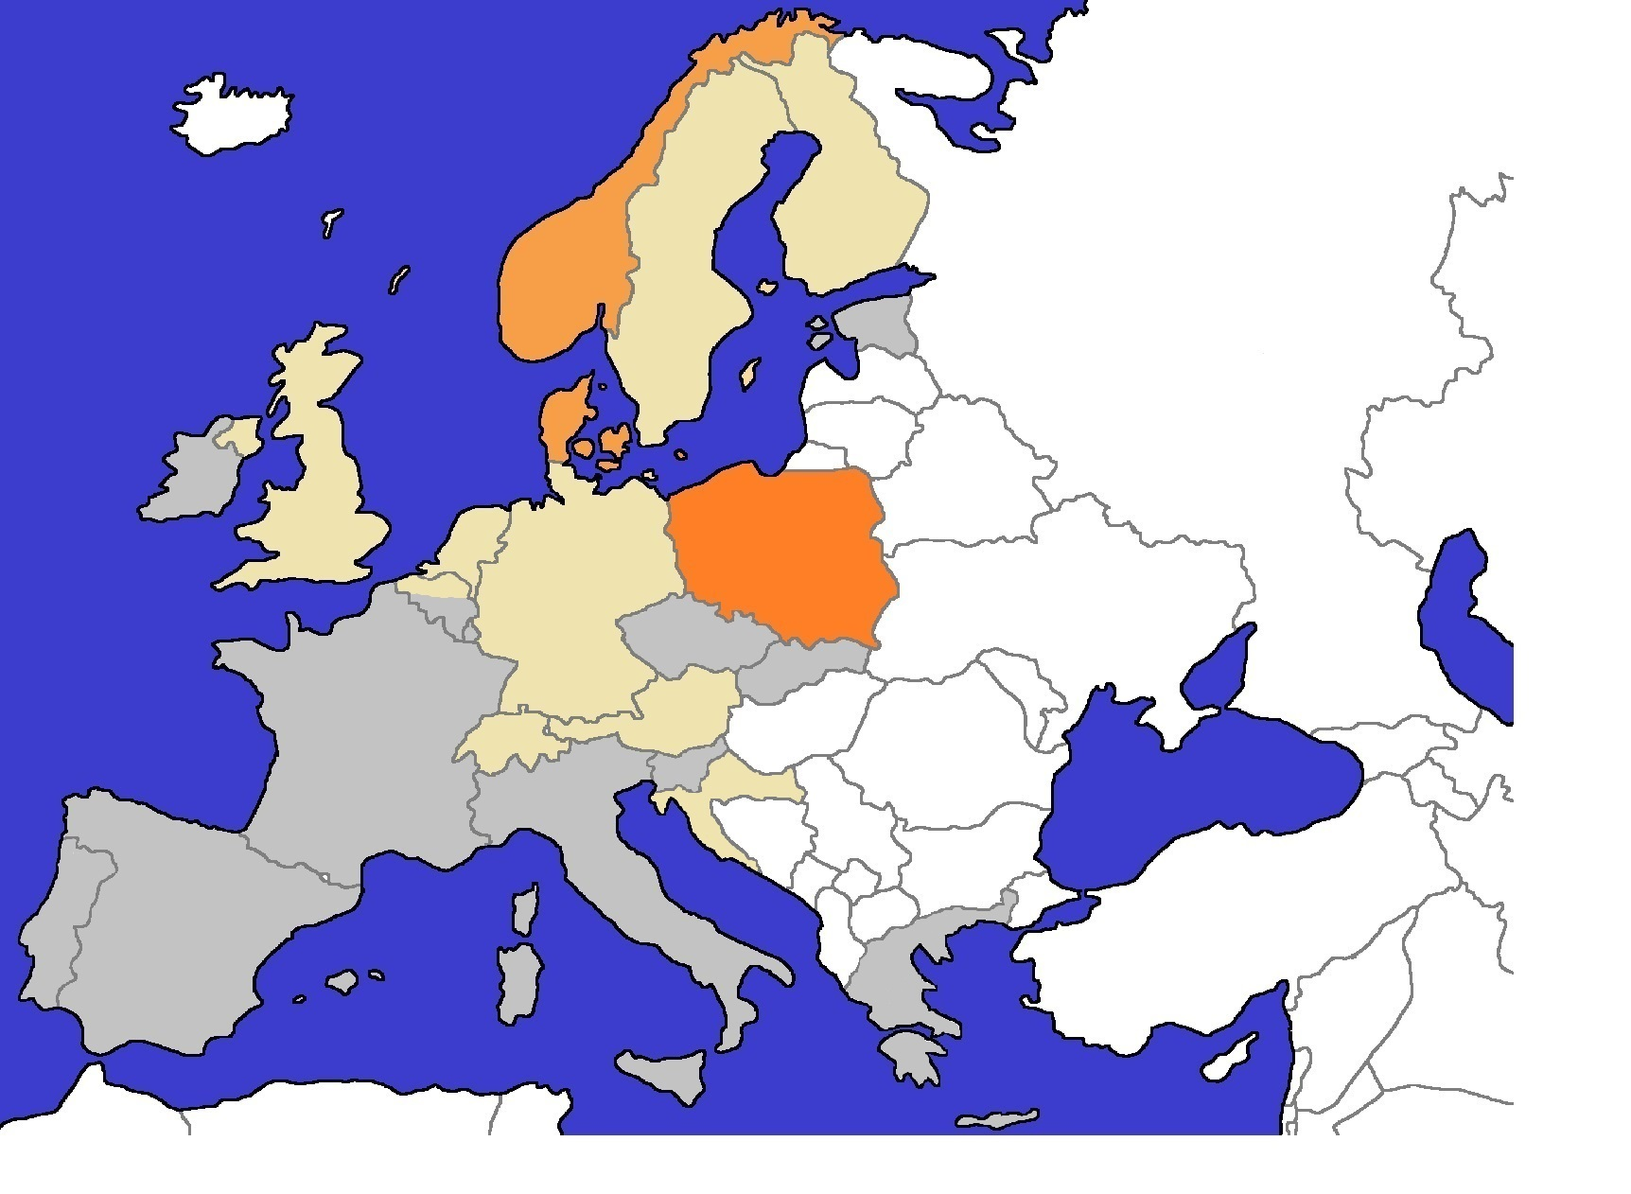
Investigation of Research Misconduct – Level of regulation
05/2015 by OeAWI
■ local commission(s)  national advisory commission
■ national commission with legal mandate
ABBREVIATIONS
Austria OeAWI Austrian Agency for Research Integrity
Belgium VCWI Flemish Commission for Research Integrity
Croatia CESHE Croatian Committee on Ethics in Science and Higher Education
Denmark DCSD Danish Committees on Scientific Dishonesty
Finland TENK Finnish Advisory Board on Research Integrity
Germany OMBUDSMAN Ombudsman für die Wissenschaft
Netherlands LOWI National Board for Research Integrity
Norway ETIKKOM The National Committees for Research Ethics
Poland PAN Polska Akademia Nauk
Sweden CEPN Central Ethical Review Board
Switzerland SA Swiss Academies of Arts and Sciences
United Kingdom UKRIO UK Research Integrity Office
© digitale-europakarte.de
TENK
ETIKKOM
CEPN
DCSD
UKRIO
PAN
LOWI
SciInt
VCWI
OMBUDSMAN
OeAWI
SA
CESHE

Slide 23
ENRIOs strengths
Exchange of information and experience
Improve own national structures and procedures
Support/Advice members having no national structures
Discussion of Cases
Hot topics: “plagiarism”, “authorship”, “digital data storage”,…

Slide 24
ENRIO aims to….
Share experience
Investigation of allegations of research misconduct
Training/Education in good scientific practice
Develop proposals for national and international organizations
Cooperations with other international organizations with interest in RI

Slide 25
Different national RI systems
Denmark
Finland
Austria

Slide 26
Denmark

Slide 27
Denmark (1)
Danish Committees on Scientific Dishonesty (DCSD)
part of the Ministry (M. of Science, Innovation and Higher Education)
„scientific dishonesty“ is defined by law
Consolidation Act No. 1064 (6.9.2012; Parliament)
Executive Order No. 306 (20.4.2009; Government/Ministry)

Slide 28
Denmark (2)
Danish Committees on Scientific Dishonesty (DCSD)
Committee on Scientific Dishonesty for
Research in Health and Medical Sciences
Research in Natural, Technological and Production Science
Research in Cultural and Social Science
Permanent Board: members elected for 4 + 2 years

Slide 29
Denmark (3)
Danish Committees on Scientific Dishonesty (DCSD)
1 Chair for all 3 Committees + 6 members (6 proxy) each
Chair is a high court judge
Members are renowned scientists
appointed by the Ministry
Decisions are made public in extenso, anonymized
[No mandate to promote RI in Denmark]

Slide 30
Finland

Slide 31
Finland (1)
Finnish Advisory Board on Research Integrity (TENK)
Founded in 1991
Introduced by Ministry of Education and Culture
Elected for 3 years
8 Members (Universities, Academy, Funding Agency, Ministerial Advisor)

Slide 32
Finland (2)
Finnish Advisory Board on Research Integrity (TENK)
Advisory Board; investigation by institutions
Informs public about Ethics in Science
Teaching/Training RI

Slide 33
Austria

Slide 34
Austrian Agency for Research Integrity (1)
Key role of the Austrian Science Fund
Autonomy of universities:
No intervention from politics
Not in hands of a “non-scientific” institution
Not part of the Ministry; independent organization
34

Slide 35
Austrian Agency for Research Integrity (2)
founded in 2008 (16 founding members)
set up as an association in accordance with the Austrian Associations Act; membership is voluntary AND is “confession” to good scientific practice
today 37 member institutions
Financed through membership fees
35

Slide 36
Austrian Agency for Research Integrity (3)
Austrian Commission for Research Integrity
Advisory Board
6 members: renowned scientists, different disciplines
Appointed by the Austrian Research Council
Non-Austrians!!!

Slide 37
Austrian Agency for Research Integrity (4)
1. Raising awareness: seminars, lectures, workshops,..
2. „service facility“:
guarantee independent investigation in cases of alleged research misconduct
advise members in all matters related to research integrity
mediation in case of conflict
3. National and international Networking

Slide 38
Efforts in Europe and future plans

Slide 39
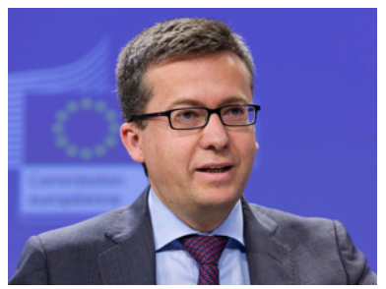

Slide 40
Council of the European Union
(EU-Presidency in Luxembourg 2015: research integrity as hot topic)
Council Conclusions on Research Integrity (adopted Nov 2015)
[…] ACKNOWLEDGES that integrity in both public and private research can be damaged by research misconduct and
RECOGNISES that research misconduct, including questionable research practices can lead to considerable negative economic impact and costs for both the public and private sector …

Slide 41
Council of the European Union
Council Conclusions on Research Integrity (adopted Dec. 2015)
[…] CALLS for the fostering of an institutional culture of research integrity in order to create, mainly through clear institutional rules, procedures and guidelines as well as training and mentoring based on the exchange of best practices, a climate in which responsible behaviour is expected at individual and institutional level

Slide 42
Council of the European Union
Council Conclusions on Research Integrity (adopted Dec. 2015)
[…] EMPHASISES the need for measures to prevent and address research misconduct, including questionable research practices […]
HIGHLIGHTS the role that education, training and life-long learning at different stages of the researchers' careers can play in this respect

Slide 43
Council of the European Union
Council Conclusions on Research Integrity (adopted Dec. 2015)
[…] STRESSES the need for the implementation of research integrity principles* as a guarantee for high quality research in Europe while avoiding administrative burden […]
*European Code of Conduct (ALLEA/ESF 2010)

Slide 44
Council of the European Union
Council Conclusions on Research Integrity (adopted Dec. 2015)
[…] INVITES Member States and the Commission to promote existing research integrity networks, such as the European Network of Research Integrity Offices (ENRIO), including training activities based on the "train-the-trainer" principle in order to move towards a higher degree of consistency of research integrity practices in Europe;

Slide 45
Council of the European Union
Council Conclusions on Research Integrity (adopted Dec. 2015)
[…] CALLS on Member States, research funders and the research community together to explore ways for diminishing incentives for research misconduct, focusing on positive incentives for the promotion of the quality of research and on them to develop guidelines to address misconduct

Slide 46
Council of the European Union
Council Conclusions on Research Integrity (adopted Dec. 2015)
[…] CALLS on all actors involved, including individual researchers, the research community, research performing and research funding organisations, universities, public authorities and scientific journal editors, to define and implement policies to promote research integrity and to prevent and to address research misconduct, including questionable research practices.

Slide 47
Other initiatives in Europe
Science Europe Working Group on Research Integrity
LERU (League of European Research Universities) Expert Group on Research Integrity
PRINTEGER (Promoting Integrity as an Integral Dimension of Excellence in Research); EU-funded project
4th World Conference on Research Integrity in Amsterdam 2017
…

Slide 48
Europe: Does self-regulation work?
Krista Varantola (Finland):
„No, does not work if there is no extra-institutional control“
“Yes, if there is a national-level system”

Slide 49
Challenges in Europe
Variety of rules, systems,.. on research integrity
Almost no mandatory training on RI
Almost no research on research integrity
..

Slide 50
bonne pratique scientifique
Gute wissenschaftliche Praxis
dea-chleachtas taighde
Goede wetenschapspraktijk
hea teadustava
poctivost
Buena práctica científica
Good scientific practice
god videnskabelig praksis
ορθή επιστημονική πρακτική
wetenschappelijke integriteit
God forskningssed
Dobre praktyki w badaniach naukowych
Správna vedecká prax
god vitenskapelig praksis

