Slide 1
Okinawa Institute of Science and Technology Graduate University HEART RA/Admin Session 2
16th July, 2015

Slide 2
Agenda
Objective and Goal of this session 5min
Project overview – sequence of activity leading from FY2014 to FY2015 - 20min
FY2014 overview
Why SAP has been selected as new ERP
FY2015 HEART project - Current status - Project members - Question from the OIST staff members - Schedule
New operation with SAP – what are points of change? 10min
Q&A session 60min
Refer to Question list Question list consists of; Inquiry to HEART project mail, Q&A from previous RA/Admin admin session, and Questionnaire for previous session
If you have any questions, please feel free to ask us.

Slide 3
1. Objective and Goal of this session
Objective
Fill the communication gap between audience and HEART project
Today’s session
We will share some information about HEART project, and answer the inquiries
Goal
Your questions are resolved!
モヤモヤ ⇒ スッキリ！

Slide 4
2. Project Overview 2-1. FY2014 overview
The following are FY2014 overview as we have explained in previous session. Today, we will explain red-highlighted points in more details.
Replacement of the OIST ERP systems identified as a high priority
Steering Committee and Project organization are formed
Apr
2014
Ernst and Young selected as project consultant
Review of business process and current ERP systems begins
Sep 2014
Interviews held with faculty, RA’s and administrative staff to gather requirements
Workshops held to discuss process and system changes
Key criteria for the new system approved by the steering committee Decision taken to separate the project into two phases; Finance, and HR
Oct 2014 - Feb 2015
Specification and requirements for the new system completed, reviewed and approved by the steering committee
Tender process for a new ERP product and integrator company initiated
Mar
2015
Review of tender submissions by OIST (including faculty) and external reviewers from Weizmann and HP
SAP selected as the ERP product
ABeam selected as the integrator company
Apr
2015

Slide 5
2. Project Overview 2-1. FY2014 overview – how requirements of OIST are determined?
Based on the interview sessions, Future business workflows and specifications of new function had been determined in FY2014.
2014 Sep
Oct
Nov
Dec
2015 Jan
Feb
Mar
Business Practice Report
Review Future business workflows (draft) from the viewpoint of operability.
Classify must-have and nice-to-have system functions.
Obtain consensus from SC
Interview sessions (Steering Committee members, Faculty members, RAs, RSD, Budgeting, Procurement, Accounting, Travel Expense, HR, Graduate School)
Document current processes
Design future models
Workshop
New Business
Practice Design
Determining Specification
Specify business functions of new ERP.
New ERP Selection
Steering Committee

Slide 6
2. Project Overview 2-2. Why SAP has been selected as new ERP?
According to the RFP of OIST, some ERP package system and the Integrator had been bidden. OIST selected new ERP package and integrator based on the following criteria.
Criteria | Priority | Contents
Language | 1 | User interface manageable in English, and ideally in Japanese Data manageable both in English and in Japanese
Credentials | 2 | Japanese laws and regulations University-specific operations Experience with overseas implementation
Flexibility | 3 | Adaptability to OIST’s future business operations
Support system | 4 | Bilingual (English and Japanese) support Location
Integrator | 5 | History of successful experience implementing the given system
Usability | 6 | Intuitive user interface
A far-sighted OIST’s features, key point of criteria is “Global standard “ system.

Slide 7
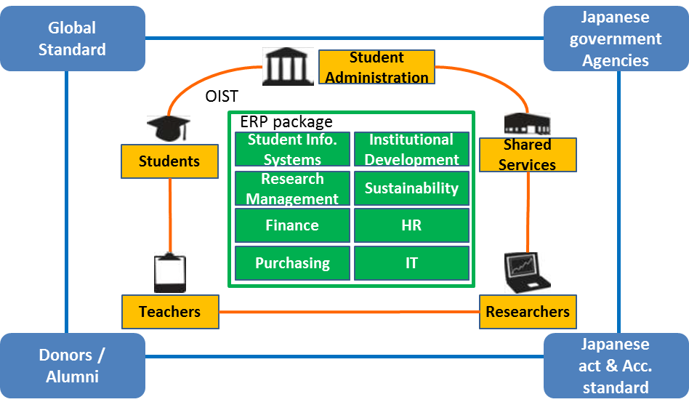
2. Project Overview 2-2. Why SAP has been selected as new ERP? – Appendix
For OIST, set to achieve further advancement and expansion as a globally recognized graduate school, it is critical to place a package system at the base that can flexibly respond with ease and extensions to change.

Slide 8
2. Project Overview 2-2. Why SAP has been selected as new ERP? – Appendix
There are implementation cases of SAP to University of Japan (National/Private) and an independent administrative institution.
Based on the uniqueness of OIST, these several cases (not only national university) are useful for OIST to refer to the SAP usage method.
Society | Number of Students | N/P | Scope
 |  |  | Budgeting | Accounting | Procurement
Hiroshima University | 15,588 | National | 〇 | 〇 | △
Kochi University | 5,700 | National | 〇 | 〇 | 〇
A Private University | 20,000 | Private | 〇 | 〇 | 〇
B Private University | 30,000 | Private
Kyoto College of Graduate Studies for informatics | 328 | Private | 〇 | 〇 | △
C Prefectural University | 2,800 | Prefectural | 〇 | 〇
Research organization of information and systems | - | Other | 〇 | 〇 | 〇
National institute of Natural Sciences | - | Other | 〇 | 〇 | 〇
National Institute of Multimedia Education | - | Other | 〇 | 〇 | 〇

Slide 9
2. Project Overview 2-2. Why SAP has been selected as new ERP? – Appendix
There are implementation cases of SAP to University of abroad.
Stanford University
Oxford University
MIT
Princeton University
Cambridge University
UC Berkeley
Yale University
Duke University
Columbia University
University of Pennsylvania
Johns Hopkins University
Cornell University
University of Michigan
University of Toronto
ETH Zurich
University of Warwick
National University of Singapore
University of Hong Kong
EPFL
Karolinska Institute
LMU Munich
University of Manchester
Postech
Boston University
Kyoto University
KU Leuven
Ecole Normal Paris
Penn State University
Leiden University
University of Utrecht
Purdue University
Wageningen University
Erasmus University
Delft University
University of Heidelberg
UPMC
University of Lund
NTU
University of Zurich
Univ. Paris-Sud
University of Ghent
Michigan State University
Monash University
University of Arizona
University of Queensland

Slide 10
2. Project Overview 2-3. FY2015 HEART project – Overall schedule of FY2015
2015 |  |  |  |  |  |  |  | 2016
5 | 6 | 7 | 8 | 9 | 10 | 11 | 12 | 1 | 2 | 3
Kick off
Pilot
Basic Design
Stage 1 Cutover (Budgeting, PROC, Travel expense)
Development
Test
UAT
Prep
Stage 1 cutover
Stage 2 Cutover
Stage 2 cutover
Development
Test
UAT
Prep
Training

Slide 11
2. Project Overview 2-3. FY2015 HEART project – Current status
After the selection of software and integrator, we renamed the project as HEART and has started implementation: based on specifications for the new system approved by the steering committee on FY2014.
2015
May | June | July | August
Today
HEART project start
Pilot phase
Confirm requirements of OIST through Sessions ➔ Requirements of OIST approved by steering committee on end of June.
Basic Design phase
Basic design (major codes, screen, and report design) will be completed*1 ➔ Basic design will be determined based on the approved requirements.
*1 Major codes (BU, budgeting code, vender code etc.), Screen design (items, sort etc.), and Report design (items, sort, format etc.))
Development phase

Slide 12
2. Project Overview 2-3. FY2015 HEART project – Project members
Following is an organization chart of HEART project.
Steering Committee
Change Control Board（CCB）
EY advisors
Project Manager
Mr. Sato Ms. Ogo
Ms. Ota(ISS)
Mr. Sakuma
PMO
Mr. Ikuta
Ms. Konno Ms. Wada
Change Mgmt. team
Finance team
Development team
System team
Ms. Kawabata Ms. Chibana Ms. Omine(ISS)
Ms. Konno
<Budgeting> Mr. Magai <Acc and travel> Mr. Uramoto Ms. Nishime <Procurement>
Mr. Ogawa <Workflow/Master> Mr.Ozaki(ISS)
Mr. Kagawa Mr. Takagi
TBD
Mr. Morrison(ISS)
Mr. Shanmugalingam (ISS)
Mr. Ito
Ms. Wada
Mr. Matsushima
Mr.Aritaki Mr. Xie
Ms. Jin Mr. Matsuura
Mr. Huh Mr.Tarmizee

Slide 13
2. Project Overview 2-3. FY2015 HEART project – Question from the OIST staff members
We received some inquiries from OIST staff members via ‘Previous RA/Admin admin staff sessions’ and their ’questionnaire’, and HEART project e-mail. (Please refer to the Q&A list as your handout materials.) We will answer clearly to your inquiries in today’s session.
If you have any further questions, please ask us.

Slide 14
2. Project Overview 2-3. FY2015 HEART project – Schedule
Followings are HEART project schedule for Stage1 cutover (about Budgeting, Procurement, and Travel expense process).
We will prepare another sessions for you; Demonstration session and Training session.
2015
July | August | September | October | November | December
Basic Design phase
Development
Test (project internal)
User Test
Prep
Develop OIST’s screen and function
PJ member will check the system function will realize the OIST’s requirements
OIST users will check the SAP’s usability according to the test scenario
Cut over!
Demo session
Training session
Share screen and function for OIST and explain new operational flow in details.
We will prepare some training courses (each process and functions) and training materials & operational manuals.

Slide 15
3. New operation with SAP – what are points of change?
Followings are current operation image. There are a lot of interacting connection on your daily operation.
Executives
Budgeting members
Faculty members
Accounting members
Research administrators
Current ERP
Procurement members
Admin/RSD staffs

Slide 16
3. New operation with SAP – what are points of change?
Example of inefficient point of current operational process.
Executives
What is the status of the purchase request?
Budgeting members
Faculty members
Accounting members
Research administrators
Interrupt your daily business!
Interrupt your daily business!
Current ERP
The request had been already processed!
We can not confirm the status on ERP… Call or e-mail to PROC section
Procurement members
Admin/RSD staffs

Slide 17
3. New operation with SAP – what are points of change?
Example of inefficient point of current operational process.
Executives
Interrupt your daily business!
Budgeting members
Faculty members
Download takes more than 30 minutes after the download button was pushed!
Accounting members
Research administrators
Current ERP
We need budget report in CSV format.
Procurement members
Admin/RSD staffs

Slide 18
3. New operation with SAP – what are points of change?
Example of inefficient point of current operational process.
We need management report including past budgeting information. Format is… necessary items are…
Executives
Budgeting members
Faculty members
Increase extra work!
Accounting members
Research administrators
Current ERP
Download necessary data… Extract the data in format they need… there are discrepancies between data extracted from different systems!
Procurement members
Admin/RSD staffs

Slide 19
3. New operation with SAP – what are points of change?
Followings are To-be operation image with SAP. SAP is a one platform system, therefore almost all of necessary information can be checked their own PC.
SAP prepare some report including free format report – user can change the format the report on your PC screen.
Executives
Budgeting members
Faculty members
Data is managed in one platform, therefore we can check data relationship easily and data mismatch doesn’t happen.
SAP
Accounting members
Research administrators
Processing time to output report will be faster than current ERP.
Almost all of approval status can be checked from your own PC.
Procurement members
Admin/RSD staffs

Slide 20
4. Q&A session
Please refer to the Q&A list in your handout materials.
If you have additional inquiries, please let us know after we explain Q&A list contents.

