Slide 1
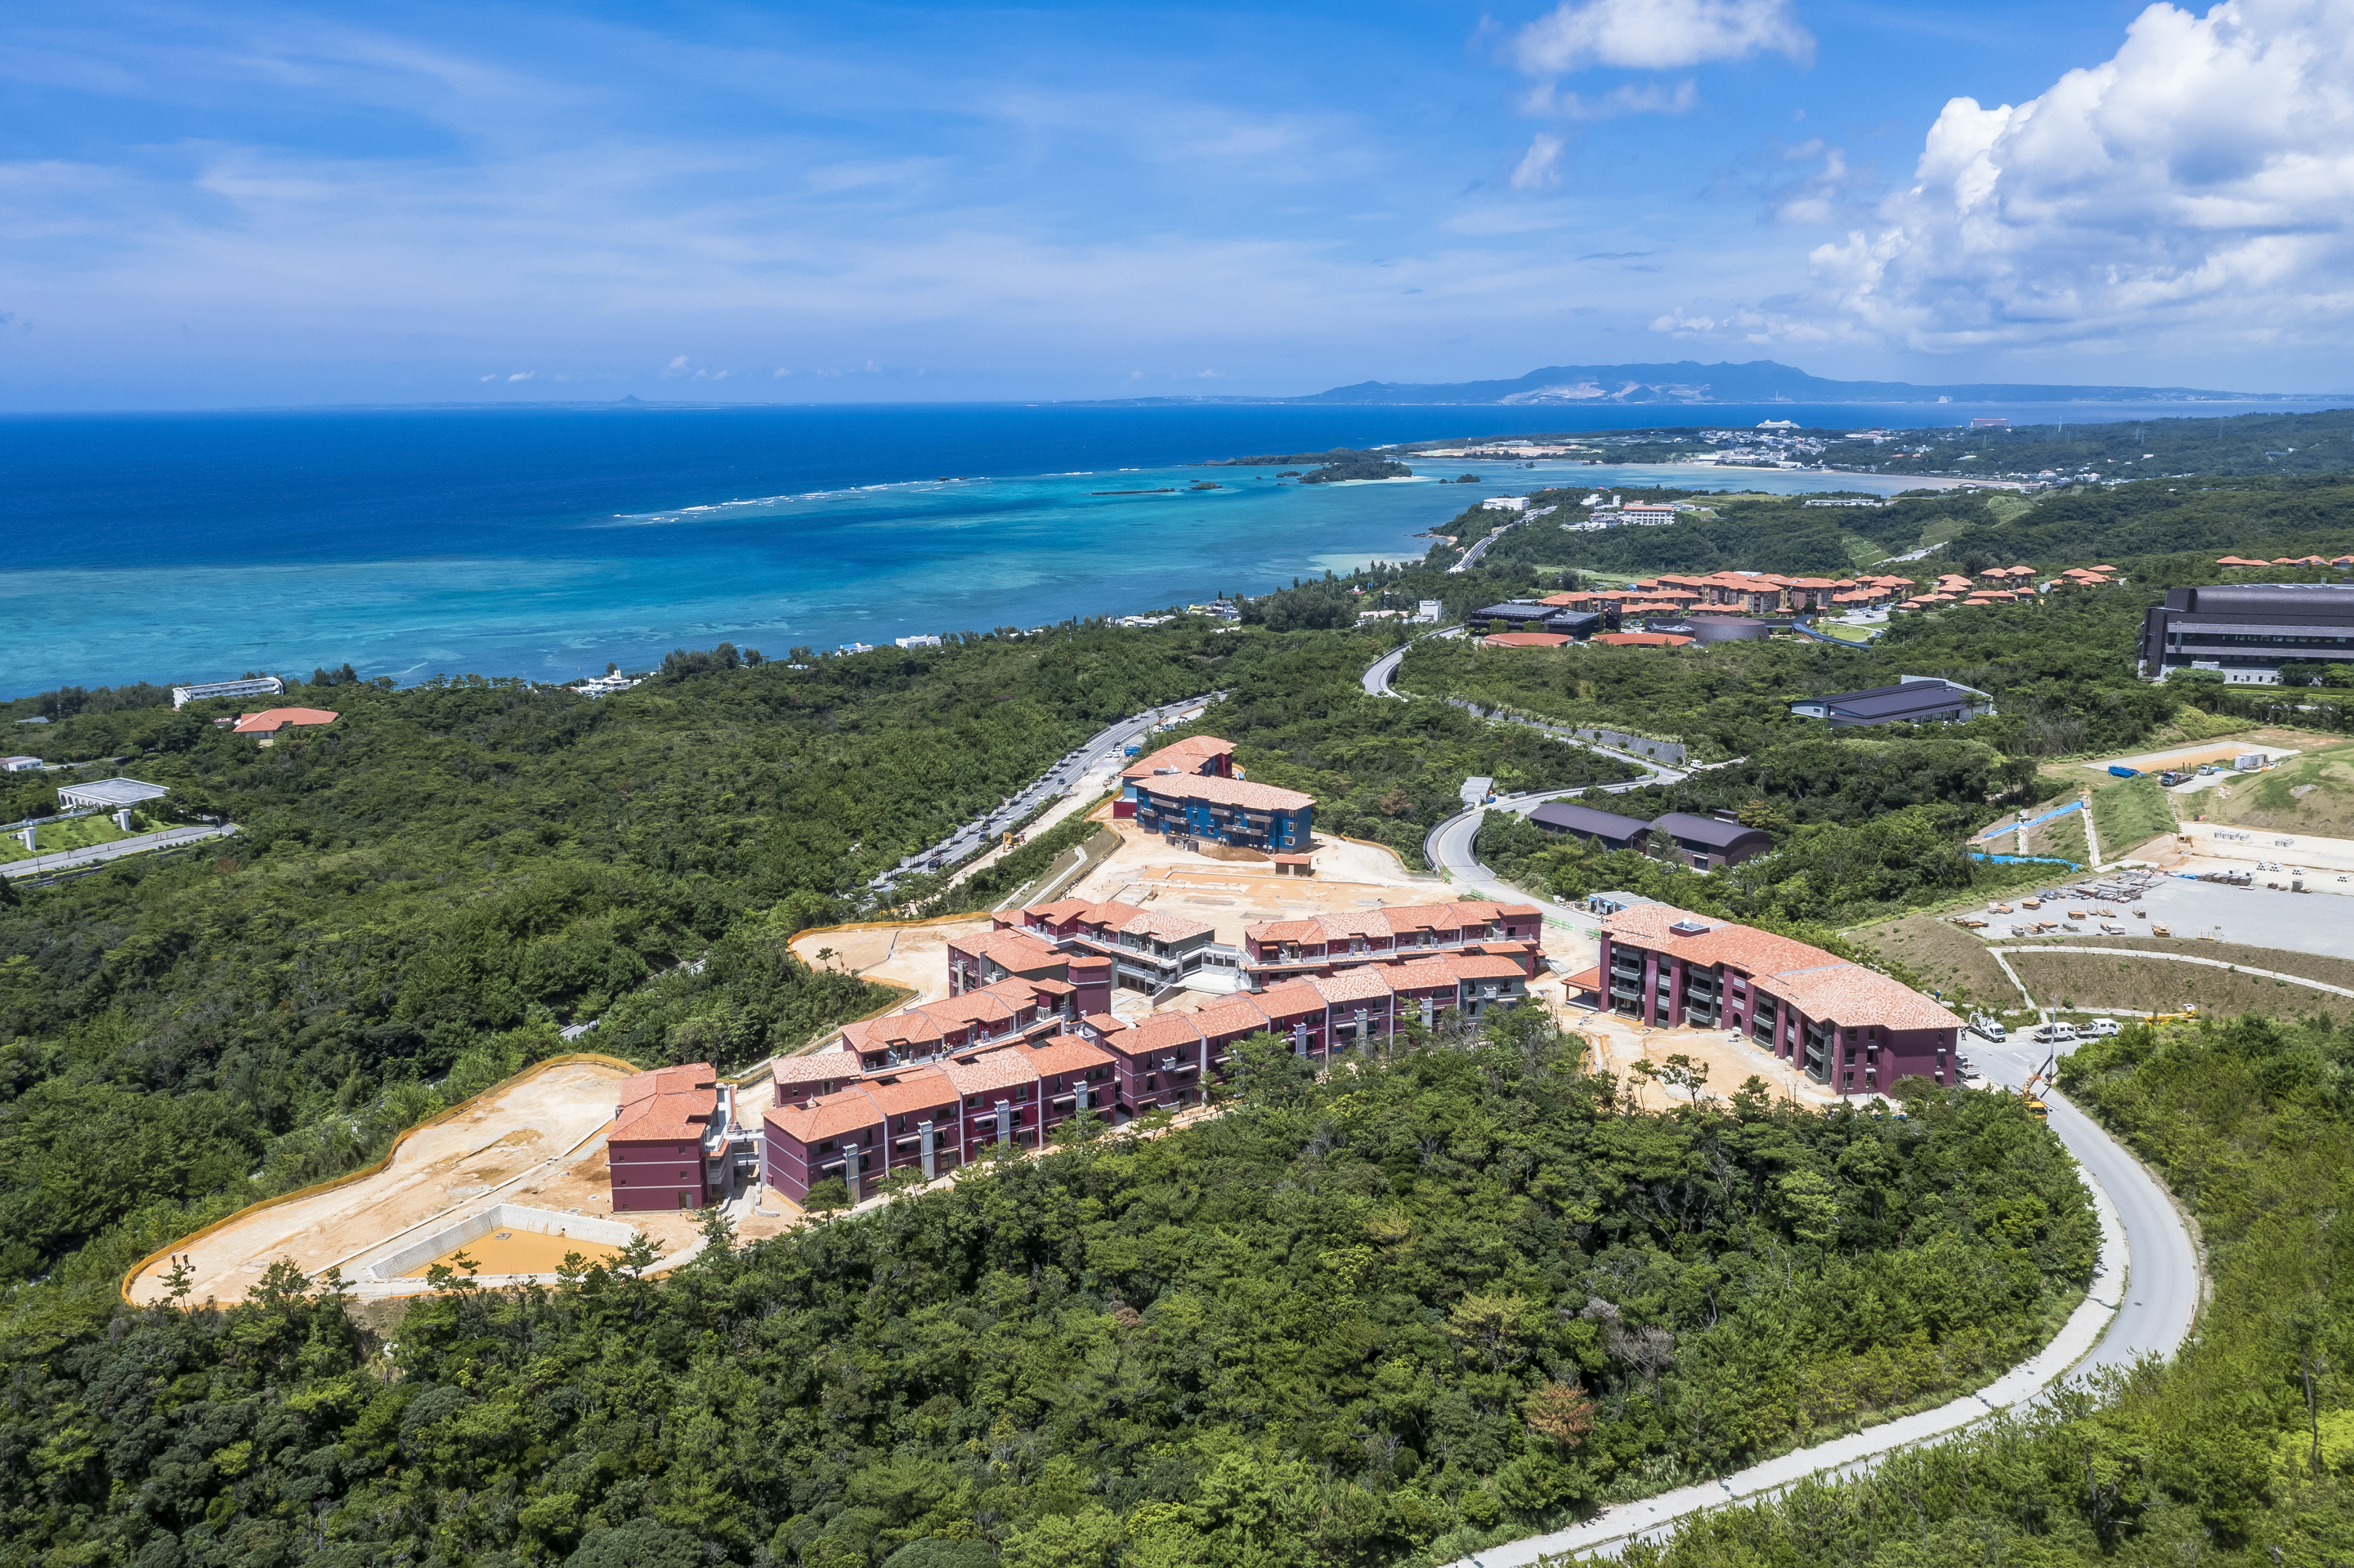
Housing Orientation
Housing Management Section

Slide 2
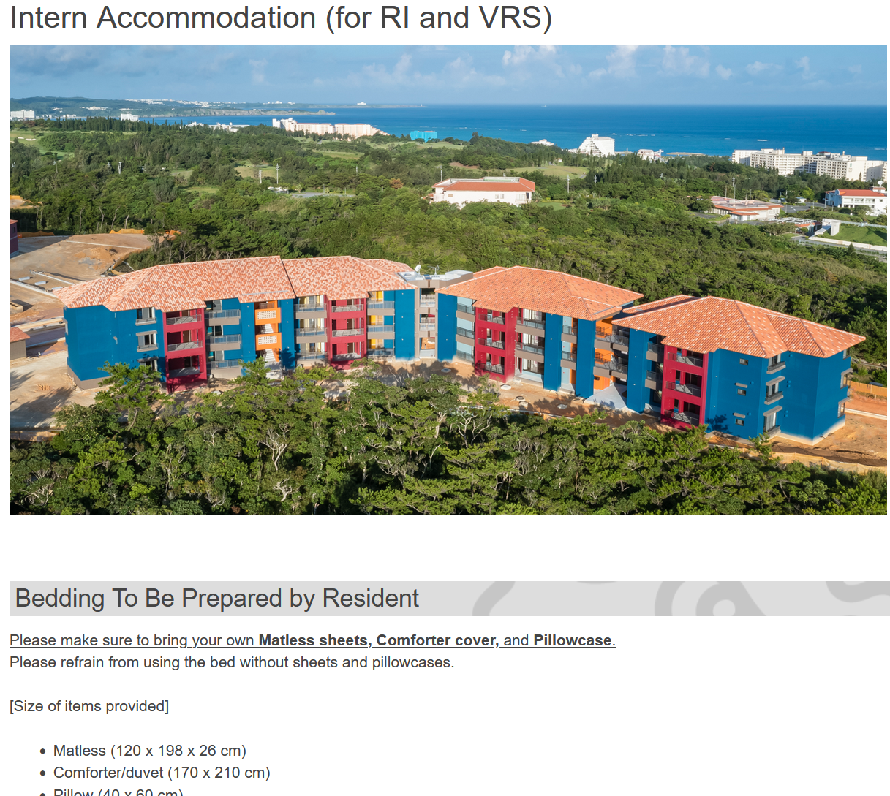
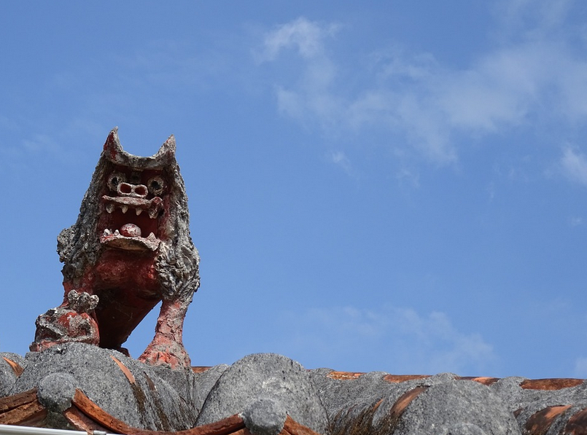
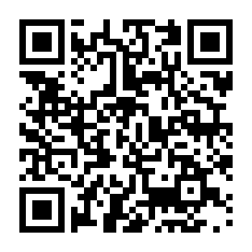
Intern Accommodation
Website (In the room information email)
Housing Procedure & Rules
①Accommodation Procedure for Research Intern Accommodation ②Intern Accommodation Agreement
[ Link ]

Slide 3
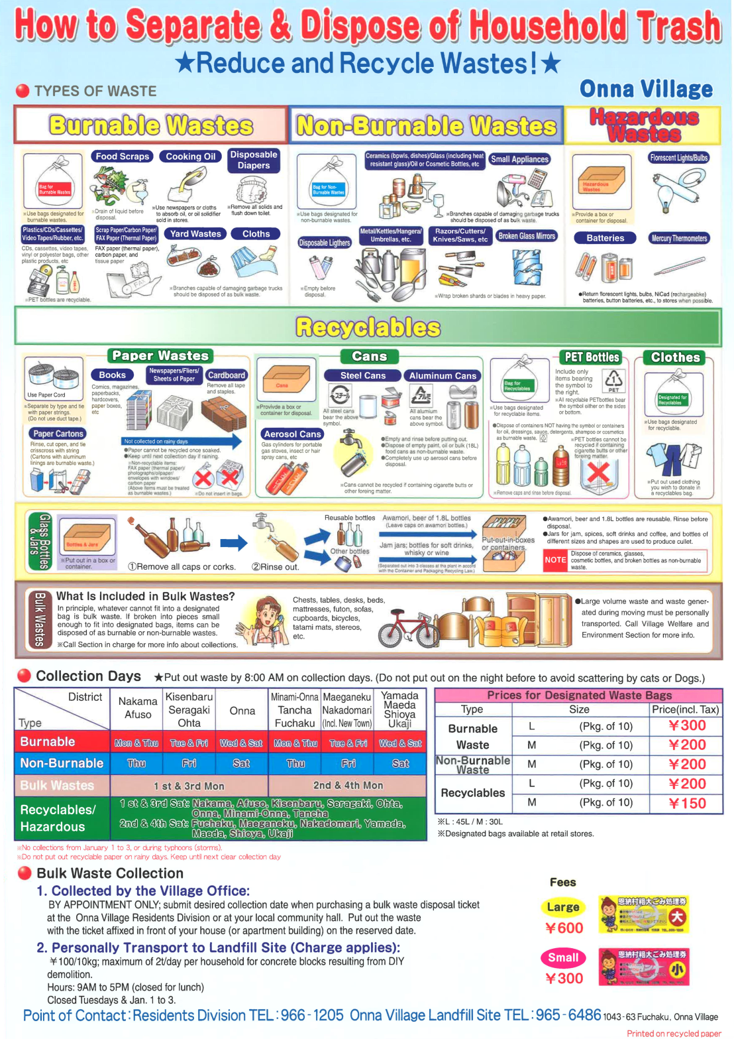
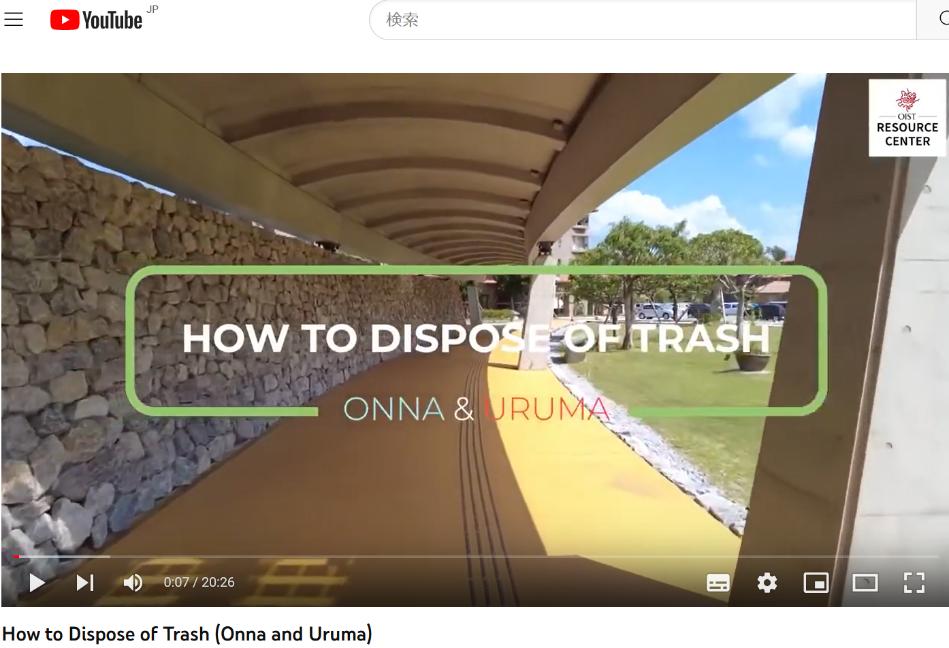
Household Trash
IMPORTANT
Separate your trash!
Buy designated garbage bags
[ Link ]
[ Link ]
Notes:
I will explain about garbage disposal since we have always difficulties, so please let me play a video to make it clear.

Slide 4
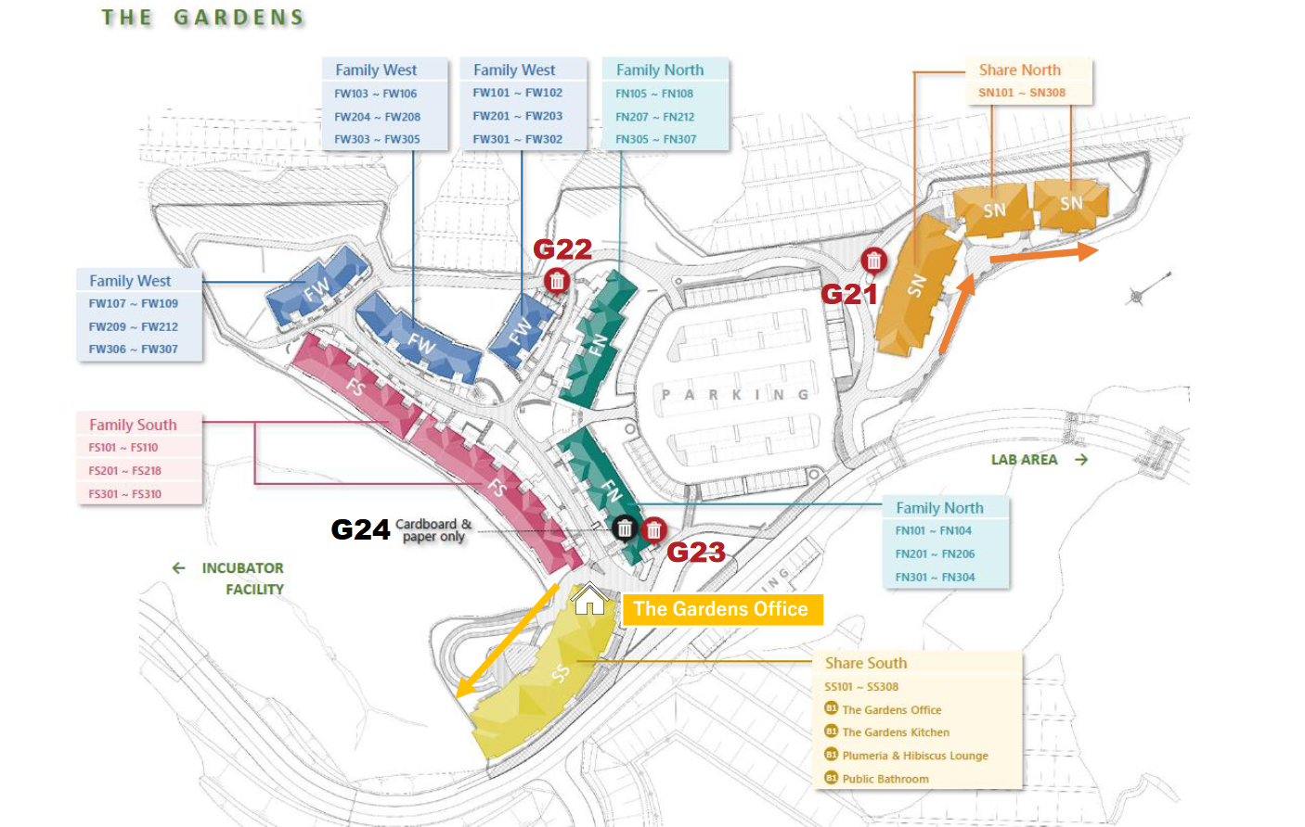
Garbage Collection Area

Slide 5
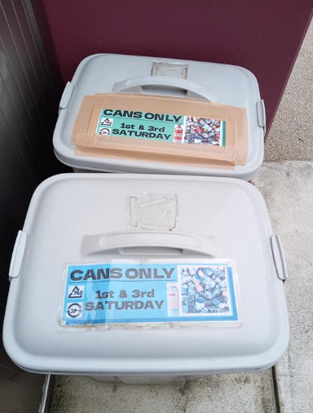
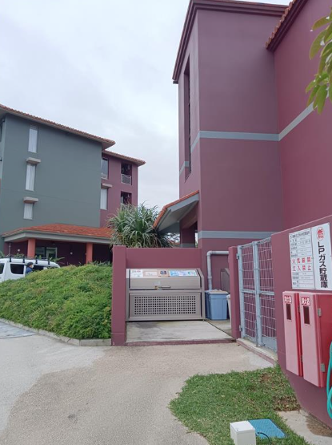
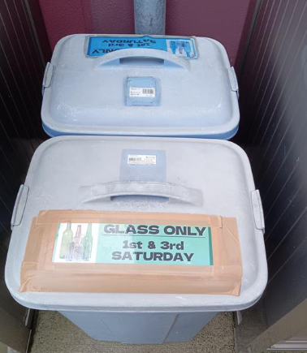
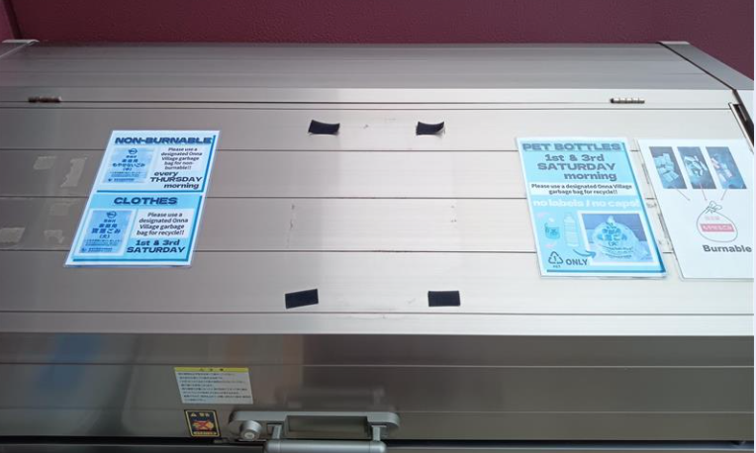
G23
Burnable, Non-burnable wastes, cans, glasses, Recyclables

Slide 6
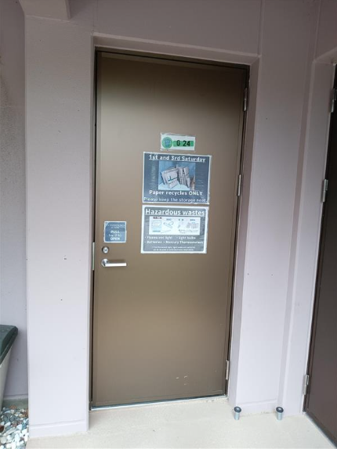
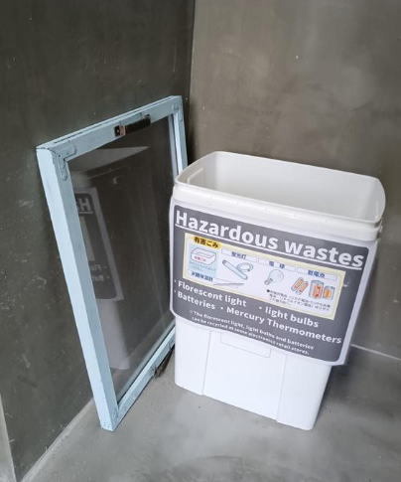
G24
Cardboards, papers, Hazardous wastes

Slide 7
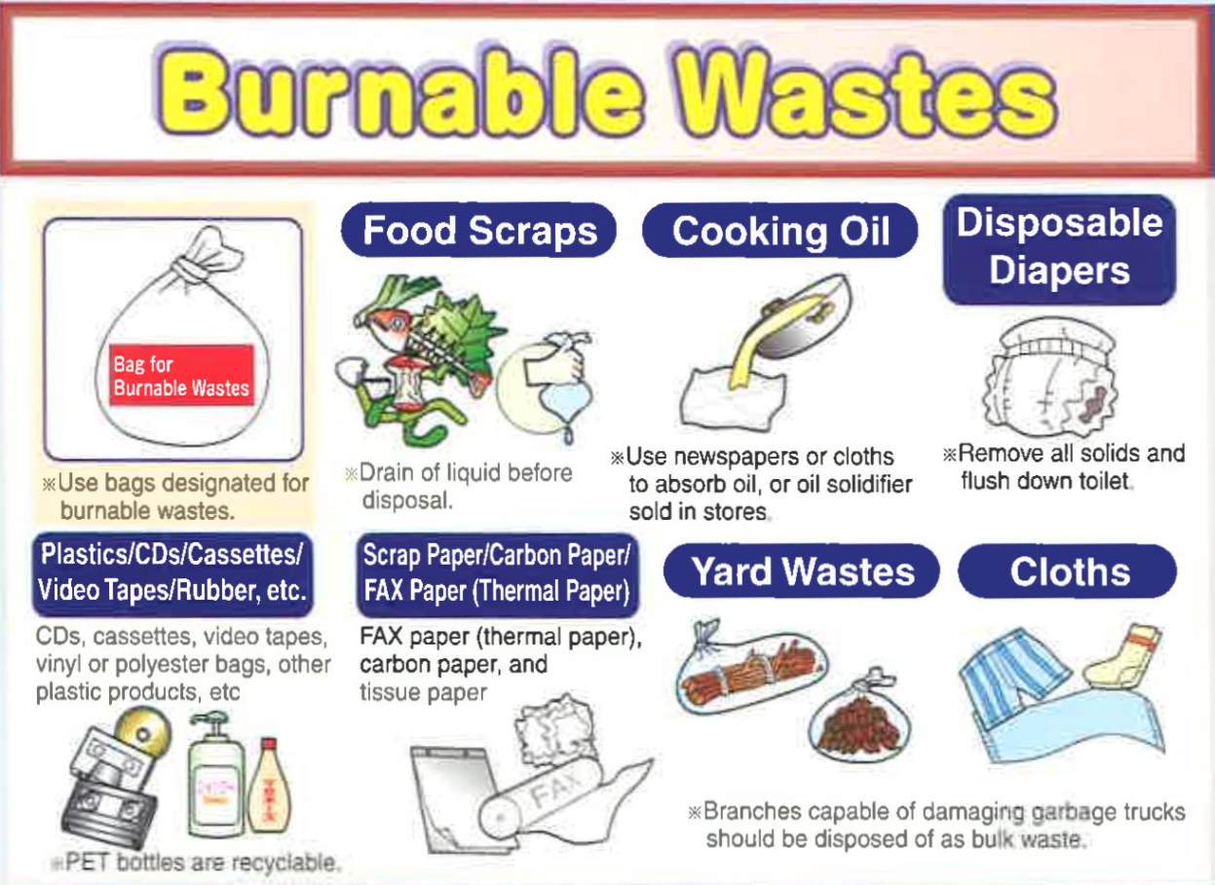
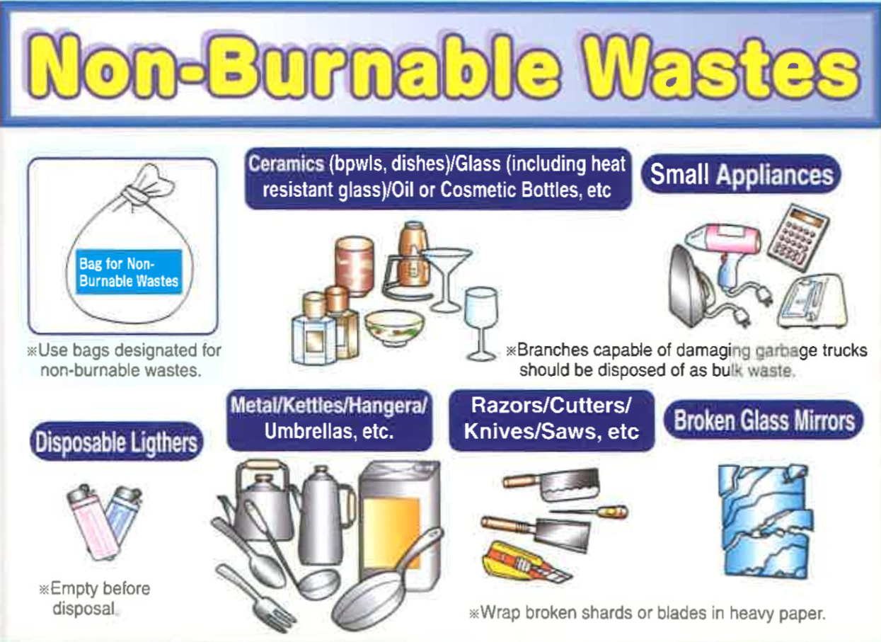
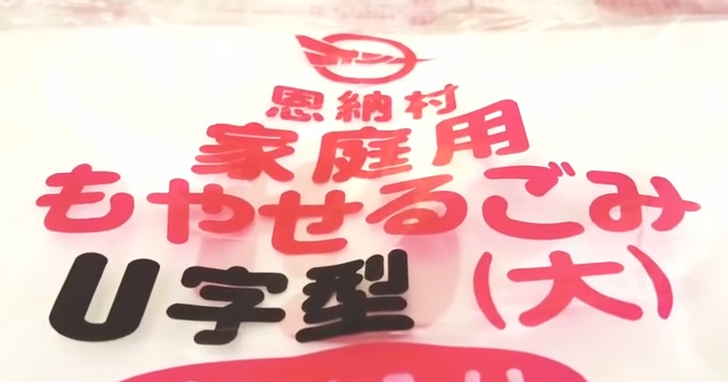
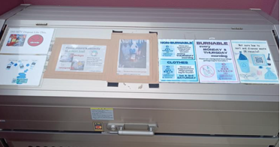
Do NOT mix with non- burnable wastes such as cans, bottles & metals.
Do NOT mix with recyclables.
Bring them to G21, 22, 23

Slide 8
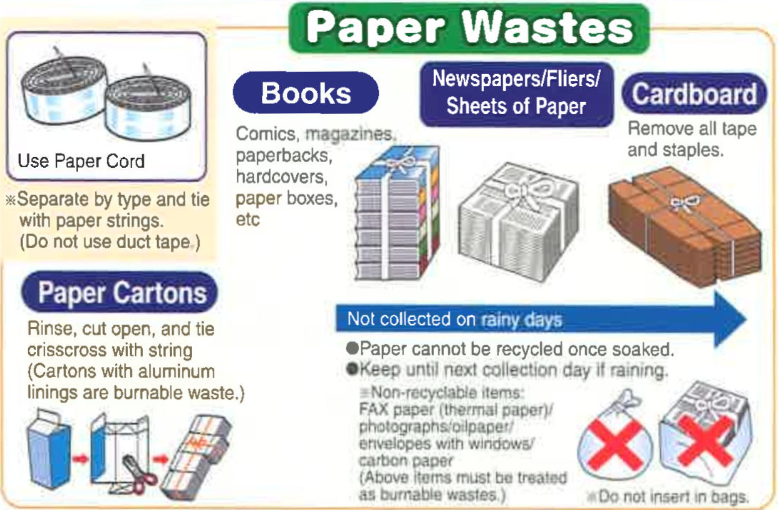
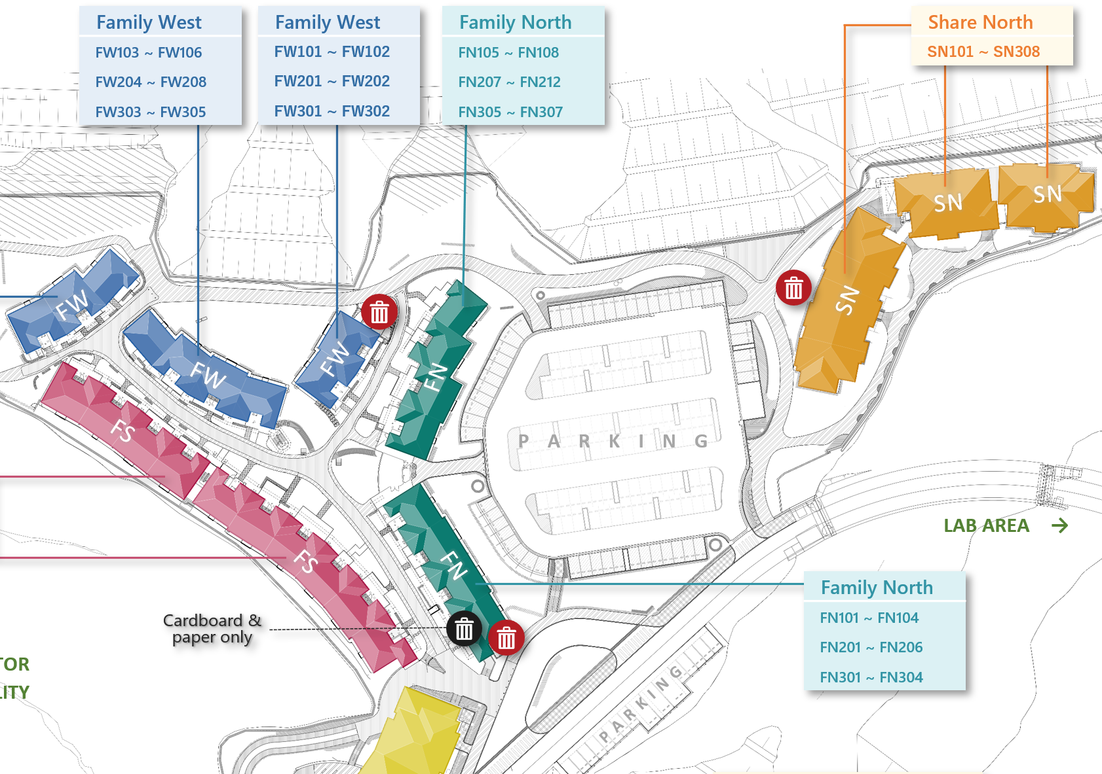
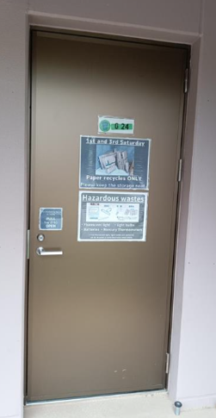
Garbage collection areas
Please
Do!
Tie with paper string.
Leave in the paper garbage storage.
★ The Gardens Office

Slide 9
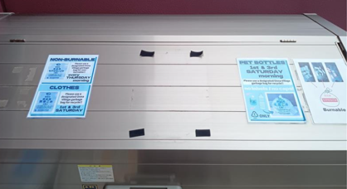
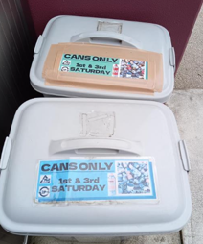
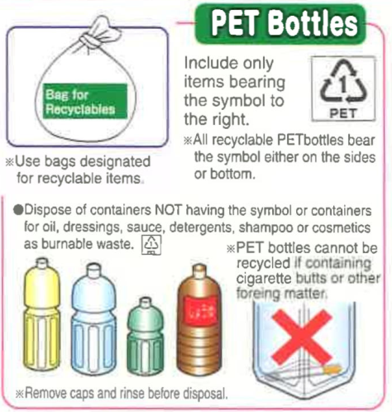
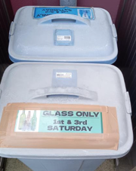
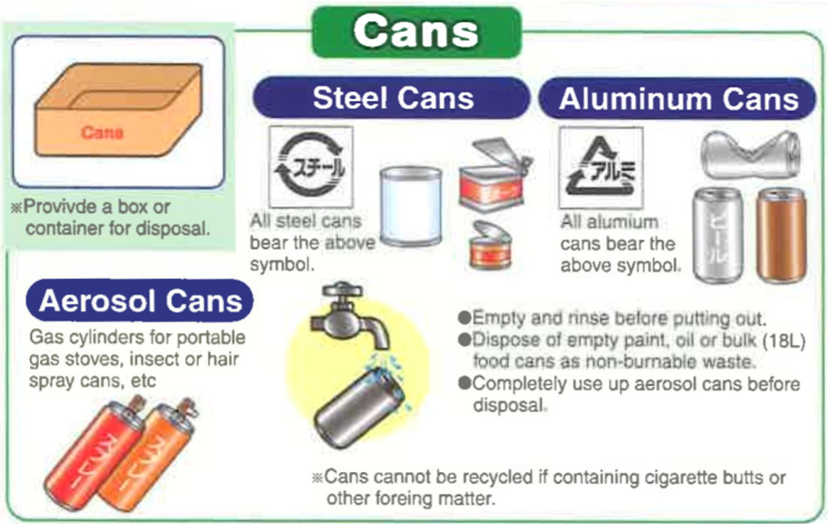
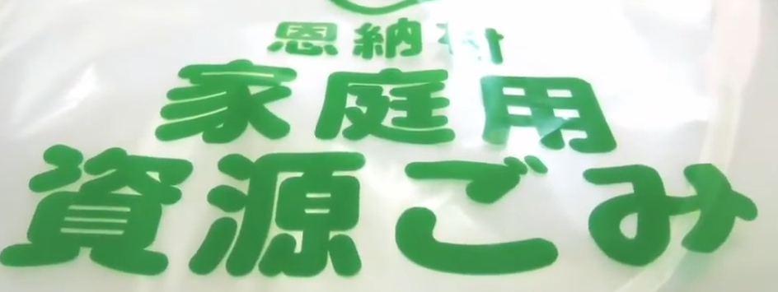
Please
Do!
Remove caps and labels
Rinse out
Please
Do!
De-pressurize Aerosol cans
Bring them to G21, 22, 23

Slide 10
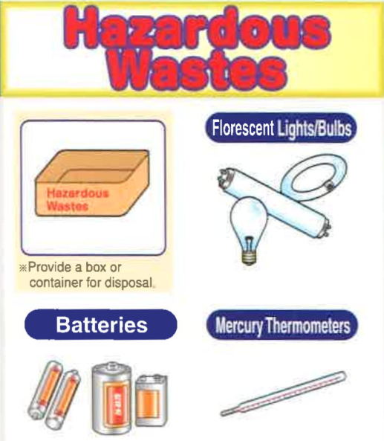
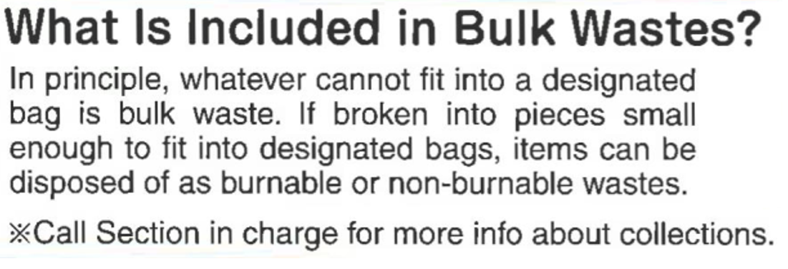
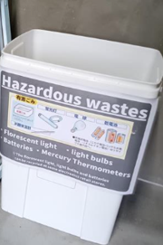
Please go to Onna municipal office
Please
Do!
Buy a collection voucher.
Make a reservation
Do NOT mix with other waste.

Slide 11
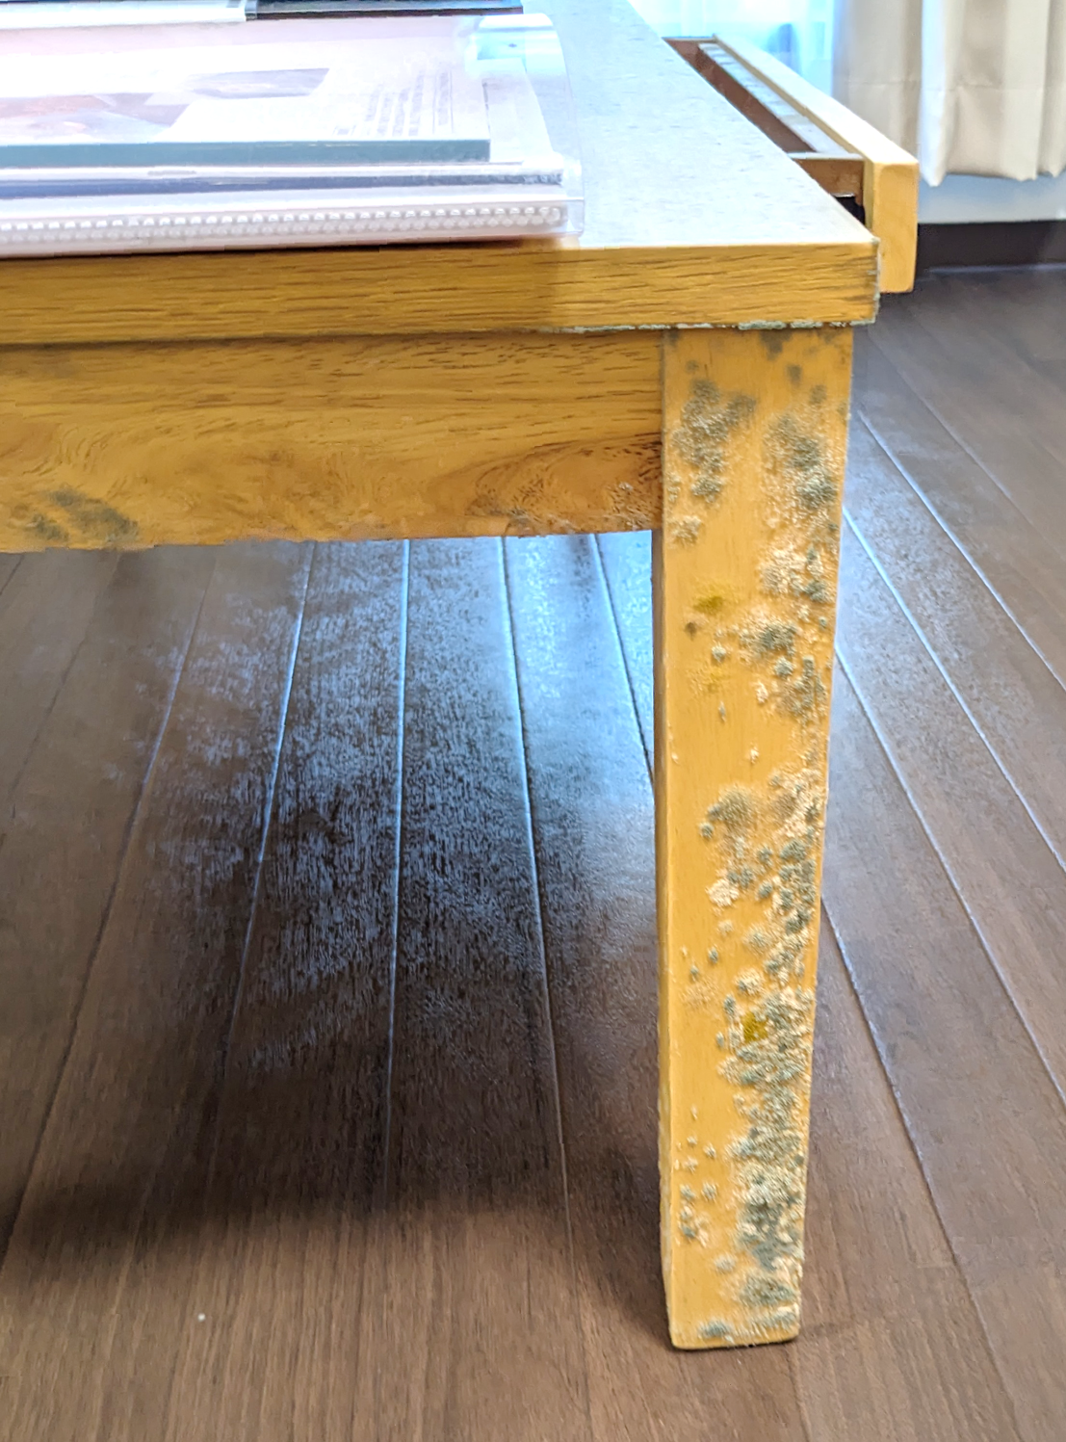
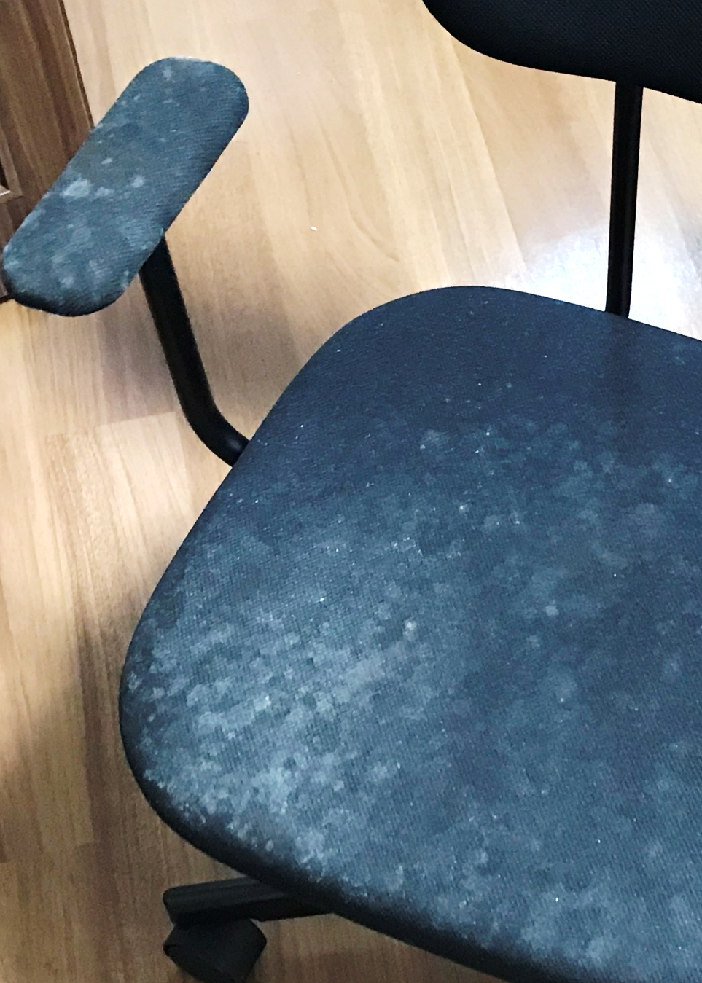
Control Humidity
Mold If you see mold, please wipe away asap!
Recommended A/C setting
Feb 15 – Nov 15:
(Dry mode : -1 to +2)
Or
Cool Mode at 25 or 26℃ Nov – Feb 15 : Up to you!
Condensation
Notes:
Oki is humid whole year. Nov-mid Feb it gets mild so you don’t need to put AC all the time but after mid-Feb, please put AC 25 keep the room dry. Also, please not to set too cold like 19, you will get condensation to the next room. If you have a bookshelf, it gets easy to get moldly please be careful, check it often.

Slide 12
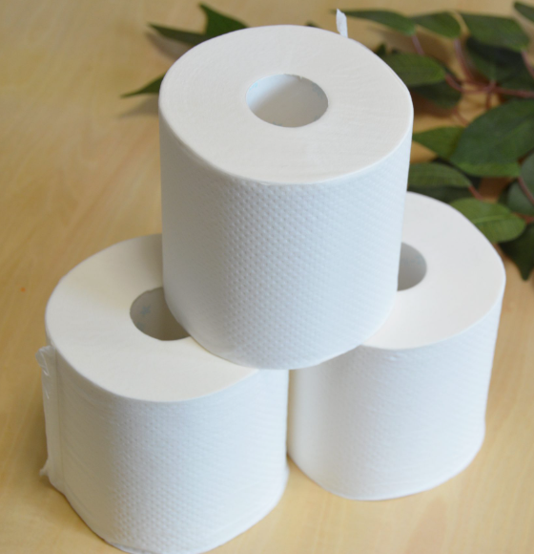
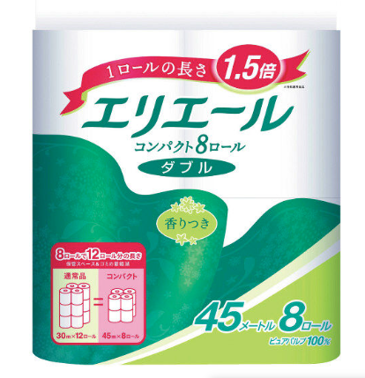
Please flush only toilet paper in the toilet.
Notes:
We sometimes hear drain pipe get clogged. One time we had a leather sheet cause clogging, please use only toilet paper.

Slide 13
Please be quiet after 8PM

Slide 14
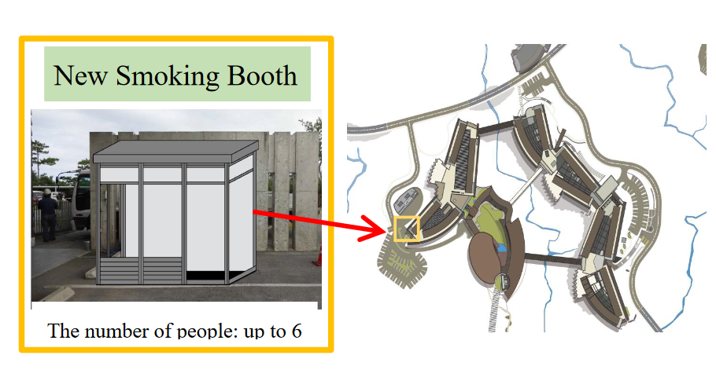
Please smoke at DESIGNATED SMOKING AREA
Lab1
Notes:
It is located outside of Lab 1, next to Bosai Center

Slide 15
Inspection
①
②
③
OIST Internship
We check based on Cleaning checklist
Do NOT put any personal item in common area
If you find previous resident’s items, please dispose them.
When you get 2 warnings, you have to pay for cleaning fee.
Preparation inspection
– Staff will enter empty bed room and check common area.
On-site inspection
– Staff and resident check together.
Move out inspection
– Staff will check empty bed room and common area
Notes:
We have 4 different kinds of inspection. We will contact you in advance when we do, and we don’t enter your bedroom except on-site inspection before you leave.

Slide 16
When you check out… Please return your keys to RED BOX in the Gardens office!!

Slide 17
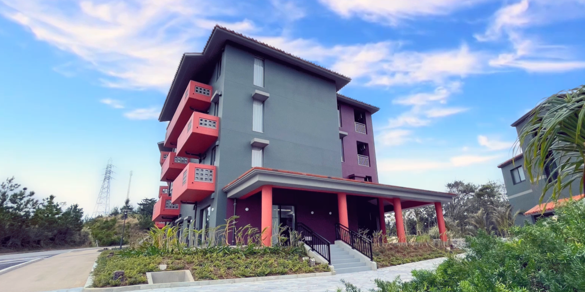
Contact Information
The Gardens Office
University
Housing Management Company
Housing Management Section
student-housing@oist.jp
Gradens Office
gardens_office@gojin.co.jp
OPEN HOURS Weekdays 9:00 – 17:30
OPEN HOURS Weekdays 9:00 – 18:00 Weekends & Holidays 9:00 – 17:00
Room allocation
Monthly & Move-out inspections
Building management
Furniture, AC/, Gas stove
Nighttime Emergency
050-5835-2236

