Slide 1
SCIENCE FRIDAY @ SAP
Learning Goal: Lear the meaning of water tension ?
Learning Objectives:
To nurture curiosity.
To create a climate of discovery.
To maintain the rigor of the STEM lessons with playful and fun challenges.
To build scientific vocabulary to promote scientific literacy at a young age.
To build the following inquiry skills:
Problem solving
Critical and creative thinking
Observation
Prediction
Analysis
Conclusion
Materials:
plastic cup
plastic tube
paper
Water magic module

Slide 2
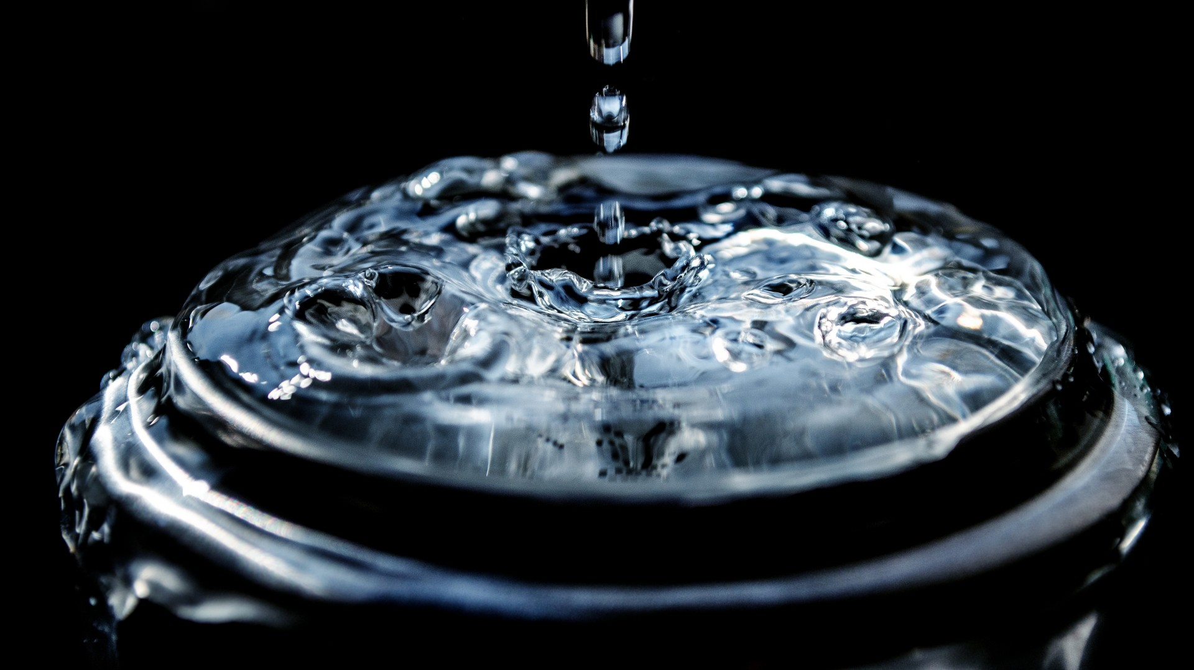

Slide 3
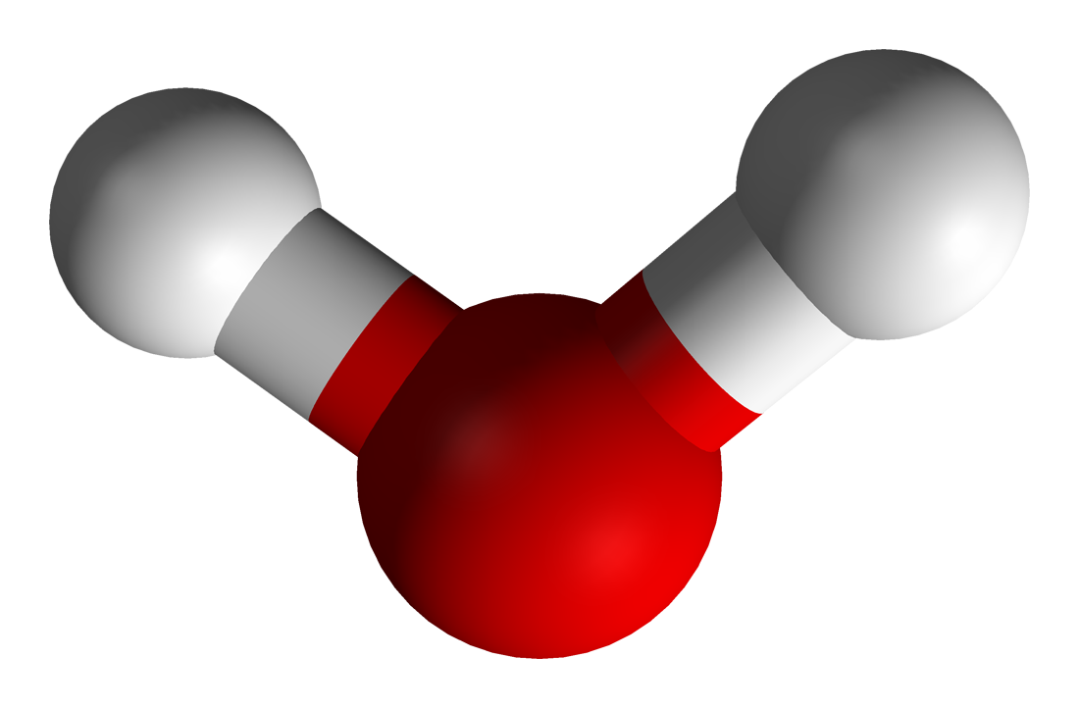
Water molecule
This Photo by Unknown Author is licensed under CC BY-SA

Slide 4
SCIENCE FRIDAY @ SAP
Method
move the water from one cup to the other using only the tube, and not assisting while the water is moving
Question:
What is water tension, what can it do?

Slide 5
サイエンスフライデー@ SAP
学習の目標：洗剤の成分は何か？それはどのように脂をきれいにするか？
学習のねらい:
好奇心を育む
発見の雰囲気をつくりだす
遊び心のある楽しいチャレンジでステム教育の精密さを維持する
若い年齢で科学リテラシーを促進するための科学用語を構築する
次のスキルを育てる:
問題解決
批判的かつ創造的な思考
観察
予測
分析
結論
材料:
水
カップ
チューブ
Water magic module

