Slide 1
IEEE ICDL 2024 Tutorial Typical and Atypical Development of Neurorobots Based on Free Energy Principle
Jun Tani
Okinawa Institute of Science and Technology
Japan
Yuichi Yamashita
National Center of Neurology and Psychiatry
Japan

Slide 2
Jun Tani, Dr.
Dr. Eng. from Sophia University in Tokyo (1996)
Researcher in Sony Computer Science Lab (1993)
Team leader in Riken Brain Science Institute (2000)
Professor in Korean Institute of Science and Technology (2012)
Professor in Okinawa Institute of Science and Technology (2017)

Slide 3
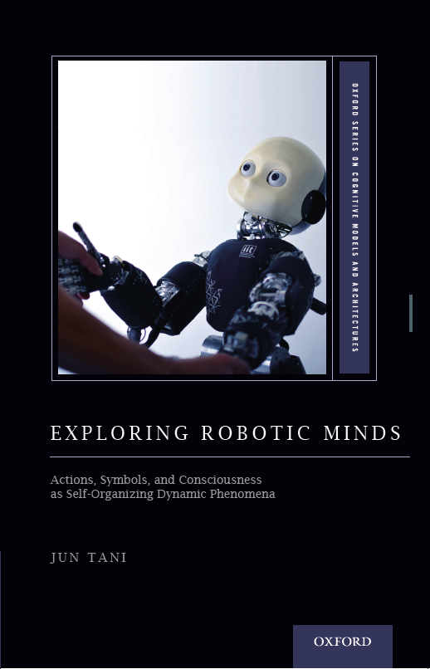
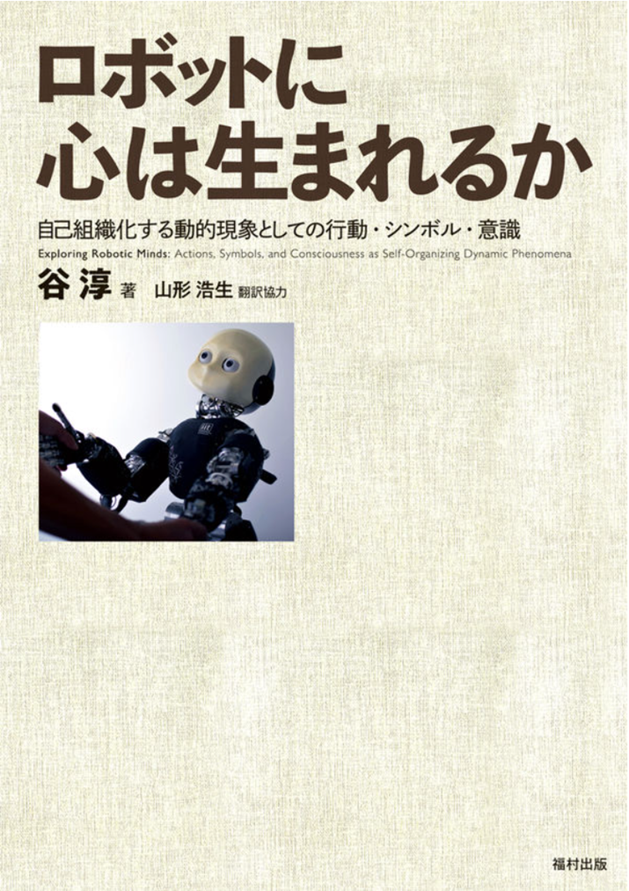
福村出版から翻訳本 (2022)
Published from Oxford Univ. Press. (2016)

Slide 4
Yuichi Yamashita, MD, PhD.
MD, Tohoku University School of Medicine (1998)
PhD, Tohoku University Graduate School of Medicine (2013)
Clinical Psychiatrist in Tohoku Univ. Hospital and Tokyo Metropolitan Matsuzawa Hospital (1998~2005)
Technical staff/Research associate in RIKEN Brain Science Institute (Tani-team, 2006~2011)
Researcher in JST ERATO Okanoya Proj (2011~2013)
Section Chief in National Center of Neurology and Psychiatry (2013~)

Slide 5
Tutorial Program
14:00~
1 Introduction of the speaker and explanation of the
purpose (Tani) 10min
1.1 Intuitive explanation of FEP related to cognitive
neuroscience and developmental disorder.
(Yamashita) 20 min
1.2 Mathematical formulation of FEP, PC, and AiF (Tani)
25min
14:55~
Introduction of Bayesian RNN models based on FEP
(Tani) 25min
2.1 Basic architecture and mechanisms
2.2 Mathematical and numerical characteristics
15:20~ Break 30min
15:50~ 3 Typical development of neurorobots (Tani) 40min 3.1 Arbitrating top-down and bottom-up processes by
regulating precision structure 3.2 Development of the higher-order cognition 16:30~ 4 Altered AiF process of neurorobots (Yamashita) 30min 4.1 Functional disconnection as acute
episode(SZ)/inherent characteristics (ASD) 4.2 Hierarchy of precisions and traits for SZ and ASD 17:00~ 5 Open discussion with participants 30min

Slide 6
The Basics and Mathematical Formulation of FEP

Slide 7
Bayesian Inference Problem Setup
$$pθ\left(z\right)$$
KL-Div. Min.
Top-down prior
$$Z$$
$$θ$$
$$pθ\left(z|x\right)$$
True posterior
$$qφ\left(z\right)$$
$$pθ\left(x|z\right)$$
Approximate
Bottom-up posterior inference
$$X$$
Min. error
$$Min F\left(q\right)=−E_{q_{∅}\left(z\right)}[lnp\left(x | z\right)]+KL(q_{∅}(z)||p_{θ}\left(z\right))$$
Accuracy
Complexity
$pθ\left(z\right)$: Prior of latent variable z parameterized by $θ$.
$pθ\left(x|z\right)$: Likelihood parameterized by $θ$.
$pθ\left(x|z\right)pθ\left(z\right)$ = $pθ\left(x,z\right)$: Generative model parameterized by $θ$.
$pθ\left(z|x\right)$ = p_{θ}(x,z) / p_{θ}(x) : Intractable true posterior for z given x.
$qφ\left(z|x\right)$: Recognition model to estimate posterior for z given x with parameter φ

Slide 8
Free Energy Formulation (1)
Introduce parametric model q_{φ}(z) to approximate the true distribution p_{θ}(z|x) where z as state and x as observation.
φ: variational paramters
Minimizing the KL divergence from p to q
$KL(qφ(z)|\left|pθ\left(z | x\right)\right)= \sum_{z}{qφ(z)log\frac{qφ(z)}{pθ\left(z | x\right)}}$
Minimize
$$=\sum{q(z)log\frac{q(z)}{p(x,z)}+logp\left(x\right)=F+logp\left(x\right)≥0}$$
F: free energy
Minimize
Const.
Minimize
Const.
$$Min F\left(q\right)=\sum{q(z)log\frac{q(z)}{p(x,z)}=\sum{q\left(z\right)log\frac{q\left(z\right)}{p\left(z\right)}−\sum{q(z)logp\left(x | z\right)}}}$$
$$=KL(q(z)|\left|p\left(z\right)\right)−E_{q(z)}[logp\left(x | z\right)]$$
KLD between approx. posterior and prior
Likelihood

Slide 9
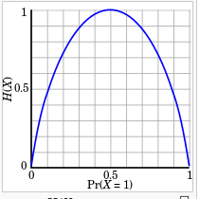
Free Energy Formulation (2)
$$F\left(q\right)=\sum{q\left(z\right)log\frac{q\left(z\right)}{p\left(x,z\right)}=−\sum{q\left(z\right)logp\left(x,z\right)−\left(−\sum{q(z)logq(z)}\right)}}$$
Internal energy
Entropy
In this formula, minimizing free energy means that (1) joint probability of sensation and its estimated cause (recognition density) is maximized and (2) entropy for the cause should be increased meaning that recognition density should be more distributed.
Increase of the entropy can avoid overfitting.
Entropy: x=[0, 1]
H(x) = -P(x)logP(x)-P(1-x)logP(1-x)

Slide 10
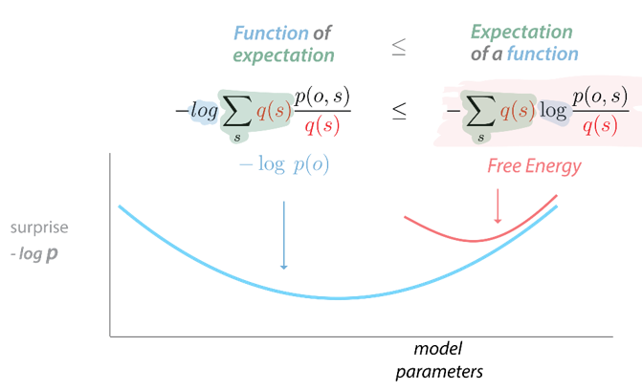
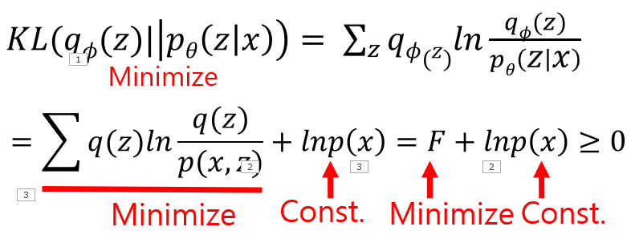
Free Energy Formulation (3)
Free energy
$$−logP\left(x\right)=−log\sum_{z}{q\left(z\right)}\frac{p\left(x,z\right)}{q\left(z\right)} ≤−\sum_{z}{q\left(z\right)}log\frac{p\left(x,z\right)}{q\left(z\right)}$$
:Jensen’s inequality
$$−logP\left(o\right)=$$
F as upper bound of surprise
Surprise
$$−logp\left(x\right)=\int{qφ\left(z\right)\log\left(\frac{q\left(z\right)}{p\left(x,z\right)}\right)dz}−KL(q||p)$$
When the estimated posterior becomes equal to the true posterior, the free energy becomes equal to surprise.

Slide 11
Free Energy Represents the Upper Bound of Surprise
$$−logp\left(X\right)=F−KL\left(q\left(z\right)||p\left(z|X\right)\right)$$
Since the KL term is positive, free energy becomes the upper bound of the surprise.
Surprise/Entropy
Free energy
Minimize
F
$$KL\left(q\left(z\right)||p\left(z|X\right)\right)$$
F
$$KL\left(q\left(z\right)||p\left(z|X\right)\right)$$
Surprise
Surprise
$−logp\left(X\right)$: constant
$−logp\left(X\right)$: constant
By minimizing free energy, approximated posterior becomes closer to the true one.

Slide 12
Introduction of Bayesian RNN models based on FEP

Slide 13
Predictive-Coding-Inspired Variational Bayes RNN (PV-RNN)
(Ahmadi & Tani, 2019)
Min. free energy
Max. Accuracy term
Complexity term
$$F=\sum_{t=1}^{T}{E_{q_{∅}(Z_{1:t}|x_{t:T})}\left[−\left[lnP_{θ,x}(x_{t}|d_{t})\right]+w∙KL\left[q_{∅}\left(Z_{t} | x_{t:T}\right)||P_{θ,z}(Z_{t}|d_{t−1})\right]\right]}$$
Approx. posterior Prior
With an assumption of Gaussian with σ=1.0
$\frac{1}{2}{\left(\frac{x_{t}−μ_{t}}{σ}\right)}^{2}+logσ$
Meta-prior
$$KL(q||p)$$
Prediction, inference, and learning of PV-RNN
Sequential gaussian prior (Chung et al., 2017)
Posterior update
Posterior
Time-varying Gaussian distribution
Min
Min
Min
$$≅$$
$$≅$$
$$≅$$
$$≅$$
$$≅$$
The effects of changing w (1) in learning and (2) during environmental interactions will be examined.
.
$$≅$$
Probabilistic latent variable
$$z_{1}^{sp}$$
KL-Div.
KL-Div.
KL-Div.
$$≅$$
$$z_{1}^{q}$$
$$z_{2}^{sp}$$
$$≅$$
$$z_{2}^{q}$$
$$z_{3}^{sp}$$
$$≅$$
$$z_{3}^{q}$$
Deterministic latent variable
$$d_{1}$$
$$d_{2}$$
$$d_{3}$$
Prediction
(Prop. & Vision)
$${\overline{x}}_{1}$$
$${\overline{x}}_{2}$$
$${\overline{x}}_{3}$$
$$e_{1}$$
Min
$$e_{2}$$
Min
$$e_{3}$$
Min
Observation
(Prop. & Vision)
$$x_{1}$$
$$x_{2}$$
$$x_{3}$$
Time step

Slide 14
Online error regression of the past and prediction of the future in a hierarchical PV-RNN

Slide 15
Now
update
update
update
Slow dynamics
L3
UG
$$z_{3,1}^{q}$$
$$z_{3,2}^{p}$$
$$≅$$
$$z_{3,2}^{q}$$
$$z_{3,3}^{p}$$
$$z_{3,3}^{q}$$
$$z_{3,4}^{p}$$
$$z_{3,5}^{p}$$
$$≅$$
$$≅$$
β
W
W
0
$$d_{3,1}$$
$$d_{3,2}$$
$$d_{3,3}$$
$$d_{3,4}$$
$$d_{3,5}$$
update
update
update
Intermediate dynamics
L2
UG
$$z_{2,1}^{q}$$
$$z_{2,2}^{p}$$
$$≅$$
$$z_{2,2}^{q}$$
$$z_{2,3}^{p}$$
$$z_{2,3}^{q}$$
$$z_{2,4}^{p}$$
$$z_{2,5}^{p}$$
$$≅$$
$$≅$$
β
W
W
0
$$d_{2,1}$$
$$d_{2,2}$$
$$d_{2,3}$$
$$d_{2,4}$$
$$d_{2,5}$$
update
update
update
Fast dynamics
L1
UG
$$z_{1,1}^{q}$$
$$z_{1,2}^{p}$$
$$≅$$
$$z_{1,2}^{q}$$
$$z_{1,3}^{p}$$
$$z_{1,3}^{q}$$
$$z_{1,4}^{p}$$
$$z_{1,4}^{p}$$
$$≅$$
$$≅$$
β
W
W
0
$$d_{1,1}$$
$$d_{1,2}$$
$$d_{1,3}$$
$$d_{1,4}$$
$$d_{1,5}$$
$${vp}_{1}$$
$${vp}_{2}$$
$${vp}_{3}$$
$${vp}_{4}$$
$${vp}_{5}$$
Visuo-proprioceptive
$${\overline{vp}}_{1}$$
$${\overline{vp}}_{2}$$
$${\overline{vp}}_{3}$$
Error regression for the past
Look ahead prediction

Slide 16
Now
Update only the posterior while fixing connectivity weights
update
update
update
Slow dynamics
L3
UG
$$z_{3,1}^{q}$$
$$z_{3,2}^{p}$$
$$≅$$
$$z_{3,2}^{q}$$
$$z_{3,3}^{p}$$
$$z_{3,3}^{q}$$
$$z_{3,4}^{p}$$
$$z_{3,4}^{q}$$
$$z_{3,5}^{p}$$
$$z_{3,6}^{p}$$
$$≅$$
$$≅$$
$$≅$$
β
W
W
W
$$d_{3,1}$$
$$d_{3,2}$$
$$d_{3,3}$$
$$d_{3,4}$$
$$d_{3,5}$$
$$d_{3,6}$$
update
update
update
Intermediate dynamics
L2
UG
$$z_{2,1}^{q}$$
$$z_{2,2}^{p}$$
$$≅$$
$$z_{2,2}^{q}$$
$$z_{2,3}^{p}$$
$$z_{2,3}^{q}$$
$$z_{2,4}^{p}$$
$$z_{2,4}^{q}$$
$$z_{2,5}^{p}$$
$$z_{2,6}^{p}$$
$$≅$$
$$≅$$
$$≅$$
β
W
W
W
$$d_{2,1}$$
$$d_{2,2}$$
$$d_{2,3}$$
$$d_{2,4}$$
$$d_{2,5}$$
$$d_{2,6}$$
update
update
update
Fast dynamics
L1
UG
$$z_{1,1}^{q}$$
$$z_{1,2}^{p}$$
$$≅$$
$$z_{1,2}^{q}$$
$$z_{1,3}^{p}$$
$$z_{1,3}^{q}$$
$$z_{1,4}^{p}$$
$$z_{1,4}^{q}$$
$$z_{1,5}^{p}$$
$$z_{1,6}^{p}$$
$$≅$$
$$≅$$
$$≅$$
β
W
W
W
$$d_{1,1}$$
$$d_{1,2}$$
$$d_{1,3}$$
$$d_{1,4}$$
$$d_{1,5}$$
$$d_{1,6}$$
$${vp}_{1}$$
$${vp}_{2}$$
$${vp}_{3}$$
$${vp}_{4}$$
$${vp}_{5}$$
$${vp}_{6}$$
$${\overline{vp}}_{1}$$
$${\overline{vp}}_{2}$$
$${\overline{vp}}_{3}$$
$${\overline{vp}}_{4}$$
Error regression for the past
Look ahead prediction

Slide 17
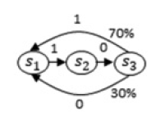
A simple experiment: Learning with Probabilistic FSM
Time step
KL-Div.
KL-Div.
KL-Div.
KL-Div.
KL-Div.
KL-Div.
$$z_{1}^{p}$$
$$≅$$
$$z_{1}^{q}$$
$$z_{2}^{p}$$
$$≅$$
$$z_{2}^{q}$$
$$z_{3}^{p}$$
$$≅$$
$$z_{3}^{q}$$
$$z_{4}^{p}$$
$$≅$$
$$z_{4}^{q}$$
$$z_{5}^{p}$$
$$≅$$
$$z_{5}^{q}$$
$$z_{6}^{p}$$
$$≅$$
$$z_{6}^{q}$$
$$d_{1}$$
$$d_{2}$$
$$d_{3}$$
$$d_{4}$$
$$d_{5}$$
$$d_{6}$$
$${\overline{x}}_{1}$$
$${\overline{x}}_{2}$$
$${\overline{x}}_{3}$$
$${\overline{x}}_{4}$$
$${\overline{x}}_{5}$$
$${\overline{x}}_{6}$$
Training sequence
$$e_{1}$$
$$e_{2}$$
$$e_{3}$$
$$e_{4}$$
$$e_{5}$$
$$e_{6}$$
1 0 1 1 0 0
Target P-FSM to be learned
Training with a large w and a small w.

Slide 18
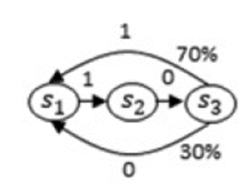
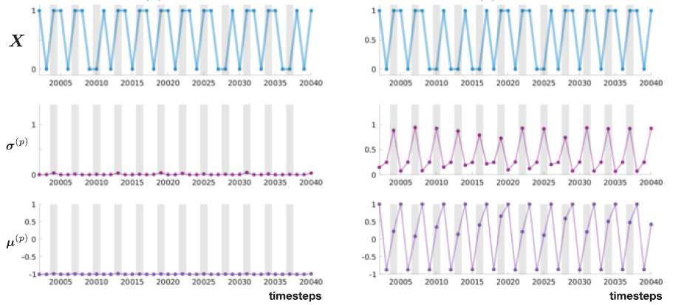
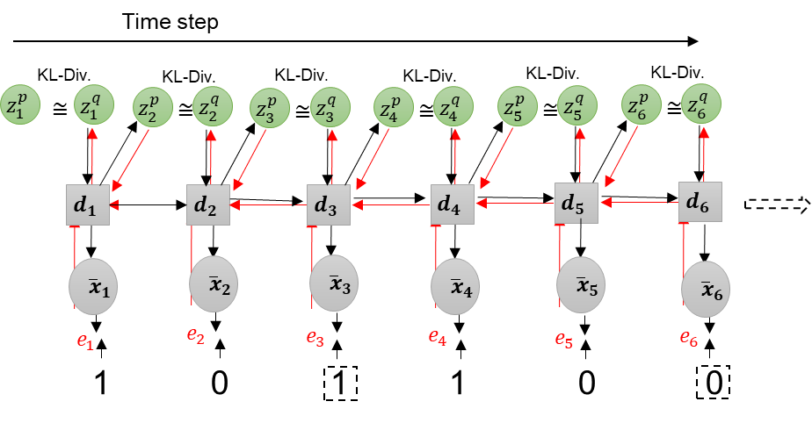
Test generation after training with different values of w
Deterministic dynamics
(positive Lyapunov exp.)
Stochastic dynamics
Out
Prior σ
W=0.1 (large)
W=0.025 (small)

Slide 19
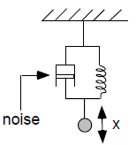
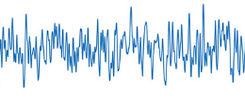
Different Structures Self-Organized Depending on W through Learning
(Ahmadi & Tani, 2019)
$$F\left(θ,∅\right)=−\sum_{t=1}^{T}{E_{q_{∅}(Z_{t}|{\overline{d}}_{t−1}, x_{1:T})}\left[lnP_{θ,x}(x_{t}|{\overline{d}}_{t−1}, Z_{t})\right]+w}∙KL\left[q_{∅}\left(Z_{t} | {\overline{d}}_{t−1}, x_{1:T}\right)||P_{θ,z}(Z_{t}|{\overline{d}}_{t−1})\right]$$
Min. Reconstruction error
Min. KL div. between posterior and prior
Meta-Prior
Fluctuated spatio-temporal patterns
Reconstruct
Reconstruct
Deterministic chaotic
Stochastic process
Noise
Large
$$w$$
Small
High-precision prior (small $σ$)
Low precision-prior (large $σ$)
Deterministic
Probabilistic

Slide 20
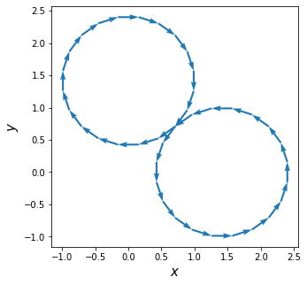
A Simple Example of Training Stochastic/Probabilistic Dynamics
Circle with small noise added
Circle with large noise added
Random switching point
Training trajectory

Slide 21
Learning Continuous trajectories with PV-RNN with Gaussian outputs (Ohata et al., 2023)
$≅:$ KL divergence
UG: unit gaussian
Now
update
update
update
L1
$$z_{1,1}^{q}$$
$$≅$$
$$≅$$
$$z_{1,4}^{p}$$
$$≅$$
$$z_{1,2}^{p}$$
$$z_{1,2}^{q}$$
$$z_{1,3}^{p}$$
$$z_{1,3}^{q}$$
$$z_{1,4}^{p}$$
UG
0
$$d_{1,1}$$
$$d_{1,2}$$
$$d_{1,3}$$
$$d_{1,4}$$
$$d_{1,5}$$
$${\overline{x}}_{1}$$
$${\overline{x}}_{2}$$
$${\overline{x}}_{3}$$
$${\overline{x}}_{4}$$
$${\overline{x}}_{5}$$
Gaussian outputs
e
e
e
$$x_{1}$$
$$x_{2}$$
$$x_{3}$$
Reflection for the past
Look ahead prediction

Slide 22
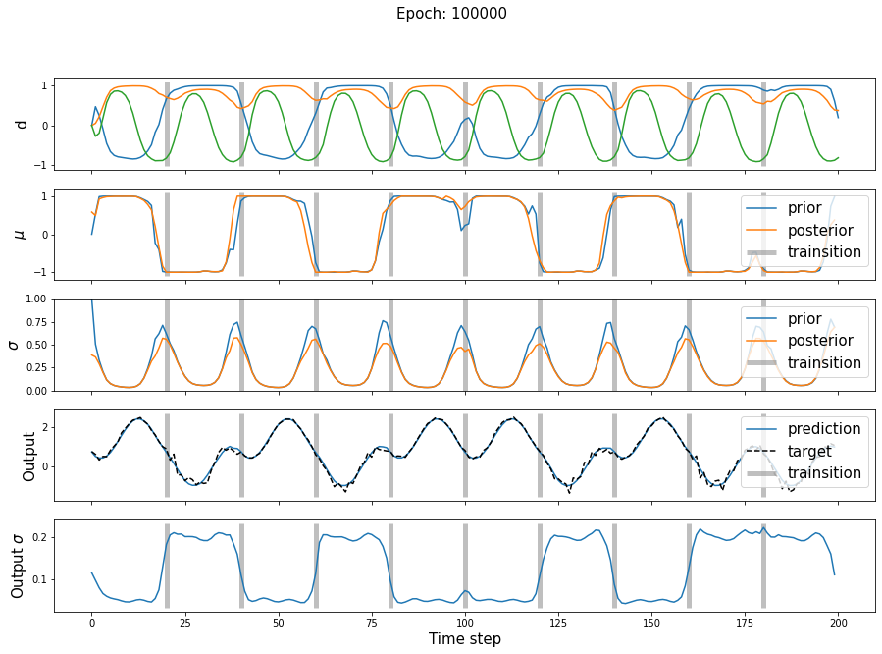
A Training Result

Slide 23
Neurorobotics Experiments using PV-RNN

Slide 24
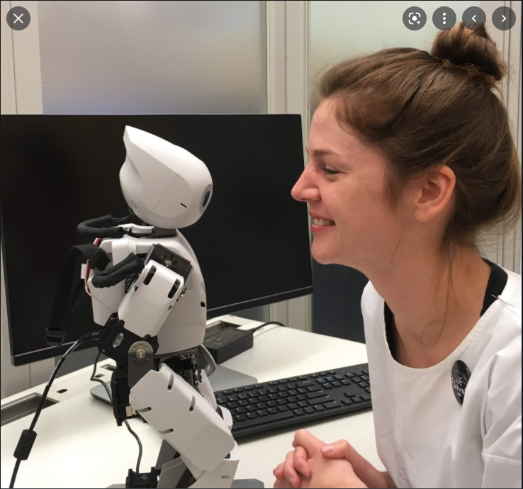
Robot-Robot Imitative interaction (Wirkuttis & Tani, 2021)
Notes:
10 min:

Slide 25
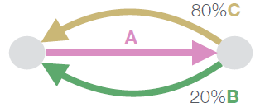
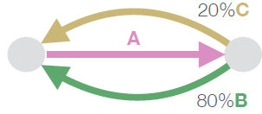
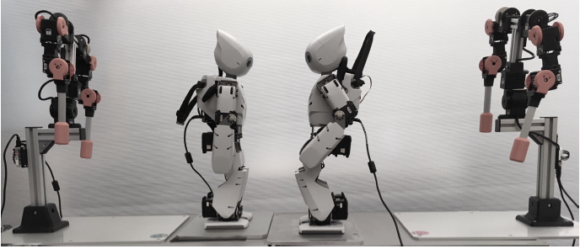
Synchronized Imitative interaction (Wirkuttis & Tani, 2021)
Each robot is pre-trained to generate/predict sequences of primitive patterns that follow a specific probabilistic finite state machine (P-FSM).
Two P-FSMs are conflictive.
Training is repeated with setting different w values for each robot.
After learning, two robots interact by generating own intended movement patterns while perceiving patterns generated by the other.
Conflictive
They learn to predict visuo-proprioceptive sequences in which vision is a mirror image of own posture. The vision is represented with simple features (X-Y positions of both hands)
Robot 1
Robot 2

Slide 26
Generating own action while inferring that of the counterpart
Robot 1
Robot 2
Approx. posterior update
Approx. posterior update
Prior
Prior
Proprioception
Joint angles
Joint angles
Controller
Controller
Movement
Vision
Vision
Body kinematics
Error
Body kinematics
Vision
Vision
Error

Slide 27
Now
Update only the posterior while fixing connectivity weights
update
update
update
Slow dynamics
L3
UG
$$z_{3,1}^{q}$$
$$z_{3,2}^{p}$$
$$≅$$
$$z_{3,2}^{q}$$
$$z_{3,3}^{p}$$
$$z_{3,3}^{q}$$
$$z_{3,4}^{p}$$
$$z_{3,4}^{q}$$
$$z_{3,5}^{p}$$
$$z_{3,6}^{p}$$
$$≅$$
$$≅$$
$$≅$$
β
W
W
W
$$d_{3,1}$$
$$d_{3,2}$$
$$d_{3,3}$$
$$d_{3,4}$$
$$d_{3,5}$$
$$d_{3,6}$$
update
update
update
Intermediate dynamics
L2
UG
$$z_{2,1}^{q}$$
$$z_{2,2}^{p}$$
$$≅$$
$$z_{2,2}^{q}$$
$$z_{2,3}^{p}$$
$$z_{2,3}^{q}$$
$$z_{2,4}^{p}$$
$$z_{2,4}^{q}$$
$$z_{2,5}^{p}$$
$$z_{2,6}^{p}$$
$$≅$$
$$≅$$
$$≅$$
β
W
W
W
$$d_{2,1}$$
$$d_{2,2}$$
$$d_{2,3}$$
$$d_{2,4}$$
$$d_{2,5}$$
$$d_{2,6}$$
update
update
update
Fast dynamics
L1
UG
$$z_{1,1}^{q}$$
$$z_{1,2}^{p}$$
$$≅$$
$$z_{1,2}^{q}$$
$$z_{1,3}^{p}$$
$$z_{1,3}^{q}$$
$$z_{1,4}^{p}$$
$$z_{1,4}^{q}$$
$$z_{1,5}^{p}$$
$$z_{1,6}^{p}$$
$$≅$$
$$≅$$
$$≅$$
β
W
W
W
$$d_{1,1}$$
$$d_{1,2}$$
$$d_{1,3}$$
$$d_{1,4}$$
$$d_{1,5}$$
$$d_{1,6}$$
$${vp}_{1}$$
$${vp}_{2}$$
$${vp}_{3}$$
$${vp}_{4}$$
$${vp}_{5}$$
$${vp}_{6}$$
$${\overline{vp}}_{1}$$
$${\overline{vp}}_{2}$$
$${\overline{vp}}_{3}$$
$${\overline{vp}}_{4}$$
Error regression for the past
Look ahead prediction

Slide 28
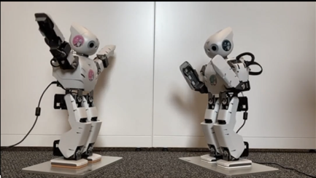
Specific Questions
What sorts of interaction can emerge?
Do they always imitate each other synchronously or do they sometime generate their own intended movements by ignoring others?
How does w affect the nature of dyadic interactions?
Let’s look at a robot simulation experiment!!

Slide 29
Note: This is not a real-time interaction, but a simulation.

Slide 30
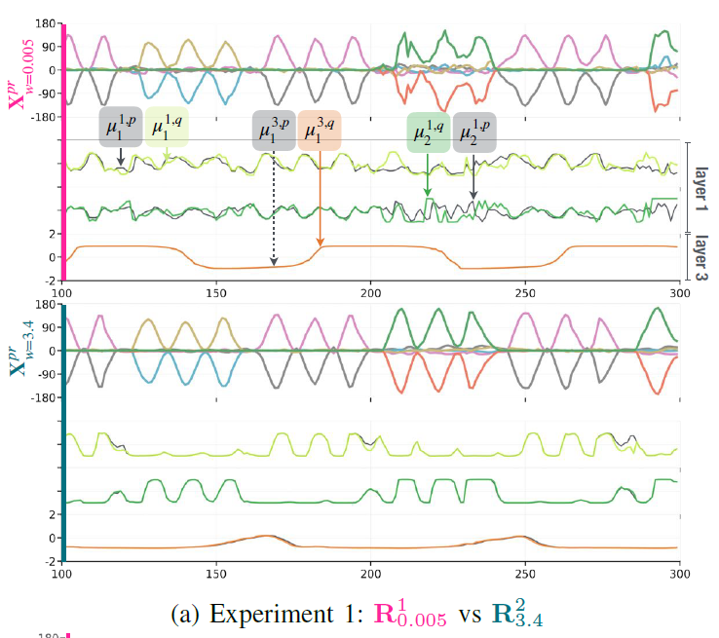
Robot 1: w=0.005
vs
Robot 2: w=3.4
C
A
B
A
Robot 1: w=0.005
Some divergence between posterior & prior
Robot 2: w=3.4
No divergence between posterior & prior
video

Slide 31
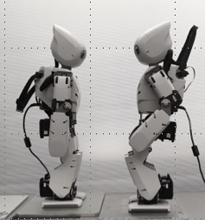
Strong Prior w=3.4
Weak Prior w=0.005
Fluctuated spatio-temporal patterns
prior
posterior
posterior
Reconstruct
Reconstruct
sense
sense
Deterministic chaos
prior
Stochastic process
High precision
Low precision
Noise
Large
$$w$$
Small
Leader
Follower
Now
Now
$$z_{1}^{q}$$
$$z_{2}^{q}$$
$$z_{4}^{q}$$
$$z_{4}^{q}$$
$$z_{3}^{q}$$
$$≅$$
$$z_{3}^{sp}$$
$$z_{2}^{q}$$
$$≅$$
$$z_{2}^{sp}$$
$$z_{1}^{q}$$
$$z_{2}^{sp}$$
$$≅$$
$$z_{3}^{sp}$$
$$≅$$
$$z_{3}^{q}$$
$$d_{4}$$
$$d_{4}$$
$$d_{3}$$
$$d_{2}$$
$$d_{1}$$
$$d_{1}$$
$$d_{2}$$
$$d_{3}$$
$$x_{4}$$
$$x_{4}$$
$$x_{3}$$
$$x_{2}$$
$$x_{1}$$
$$x_{1}$$
$$x_{2}$$
$$x_{3}$$
$$e_{2}$$
$$e_{3}$$
$$e_{3}$$
$$e_{2}$$
$$e_{1}$$
$$e_{1}$$
$${\overline{x}}_{3}$$
$${\overline{x}}_{2}$$
$${\overline{x}}_{1}$$
$${\overline{x}}_{1}$$
$${\overline{x}}_{2}$$
$${\overline{x}}_{3}$$
Postdiction by ER
Prediction
Postdiction by ER
Prediction
Dominate

Slide 32
Shifting w during interactions
In our study, w was set in the training phase.
Can we arbitrate the top-down and bottom-up processes of an agent by shifting w during interaction?
Can the same individual become active or passive by changing w depending on situations?
Ohata & Tani (2020) showed that we can.
Wataru Ohata
Notes:
3.5 min
In the previous study, w was set in the training phase and it was fixed during action generation.
----
----
----

Slide 33
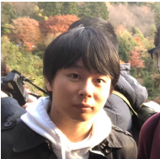
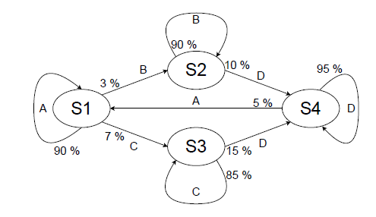
Human-Robot Interaction through Kinaesthesis/force
(Sawada et al., 2023)
Probabilistic FSM representing the target movement probabilistic transition to be trained.
KLD
Error
Small w case
Force
A, B, C, D: different cyclic movement patterns
Notes:
My student, Hiroki tested this idea in his HRI interaction experiment focusing on kinaesthesis (ケネスシ‘ーセス）.
Hiroki trained a humanoid robot, Torobo to generate probabilistic movement pattern transitions as like shown in this P-FSM.
After the training, while the robot generating pattern transitions, Hiroki attempted to induce unlearned transitions through physical interaction and examined the encountering reaction force with different w, small or large.

Slide 34
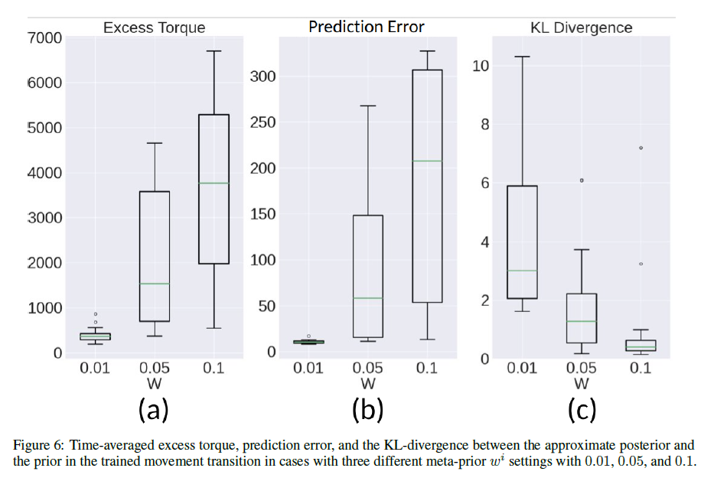
Large w
Hard to change Torobo movement patterns
encountering with large reaction force with its
strong intention.
Small w
Easy to change the patterns encountering
only with small reaction force with its weak
intention.
Human can feel intention of Torobo through kinaesthesis
Top-down prior → Reaction force
Max. Accuracy term
Complexity term
$$F=\sum_{t=1}^{T}{E_{q_{∅}(Z_{1:t}|x_{t:T})}\left[−\left[lnP_{θ,x}(x_{t}|d_{t})\right]+w∙KL\left[q_{∅}\left(Z_{t} | x_{t:T}\right)||P_{θ,z}(Z_{t}|d_{t−1})\right]\right]}$$
Notes:
In the large w case, hard to change Torobo movements encountering with large reaction force since its intention is strong.
In the small w case, .....
The point is that humans can feel the intention of of Torobo, either weak or strong through the force felt in their hands.
The top-down prior is transformed into the force.
I think that this type of bodily interaction should be the basis for HRI before introducing linguistic communication.

Slide 35
Development of the higher-order cognition

Slide 36
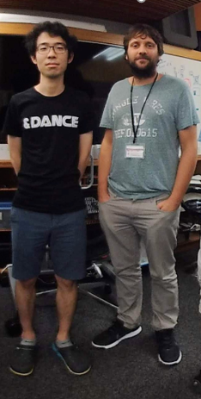
Queißer, J. F., Jung, M., Matsumoto, T., & Tani, J.
“Emergence of Content-Agnostic Information Processing by a Robot Using Active Inference, Visual Attention, Working Memory, and Planning.”
Neural Computation., 2021
Minju Jung (left) and Jeff Queißer (right)

Slide 37
This study investigates:
Goal-directed action plan generation of robot object manipulation with vision by extending active inference (AIF) (Friston et al.,2011, 2012)
Development of skills for visual attention & visual working memory through the end-to-end learning (Inspired from DRAW by Gregor et al., 2015; Rao & Ballard, 2005).
Development of Prefrontal-Cortex-like executive control.
Out of distribution generalization

Slide 38
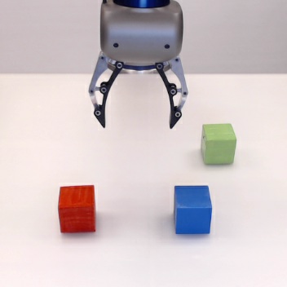
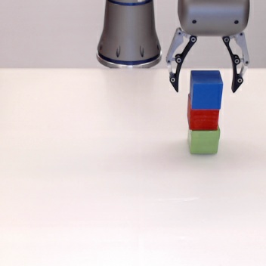
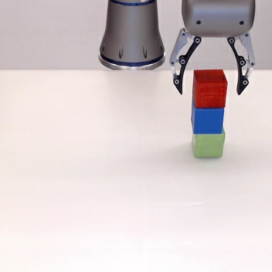
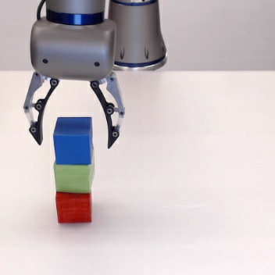
Goal-Directed Plan Generation in a Multiple Block Stacking Task
Initial block configuration visual images
(every trial different)
Red, green, and blue objects are used for the task training.
VP-plan1
VP-plan2
VP-plan3
Goal block configurations specified by visual images
OOD generalization!!
Novel color object
Learning: 300 visuo-proprioceptive trajectories in achieving different goals using R, G, B objects.
Test: Plan generation for unlearned object configuration using both learned and unlearned color objects.

Slide 39
Model Network
Probabilistic Latent state
Executive LSTM
Probabilistic Latent state
Probabilistic Latent state
Multi-Layer LSTM
for Motor
Multi-Layer convLSTM
for Vision
Pixel image (40x40x3)
8 joint angles
Proprioception prediction

Slide 40
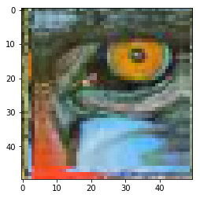
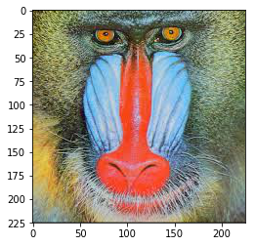
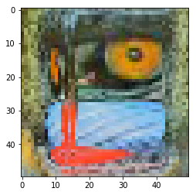
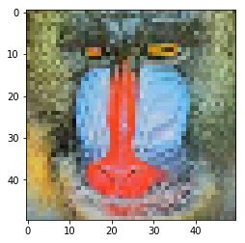
Model Network
Probabilistic Latent state
Executive LSTM
Probabilistic Latent state
Probabilistic Latent state
Multi-Layer LSTM
for Motor
Multi-Layer convLSTM
for Vision
Pixel image (40x40x3)
8 joint angles
Atten. Param
Affine
Transformation
PM
Inverse
PM
Forward
Read-out
Read-out
Proprioception prediction
VWM-1
(64x64x3)
Visual Attention
Vision prediction
(64x64x3)
PM
VWM-2
(40x40x3)
Write-in
PM
VWM-1 System
Forward
Write-in
VWM-2 System
Peripheral vision
Attended vision
Inverse
(X, Y)
Focus ratio 90%
Continuous transformation
with Atten. Param
(X, Y, Focus-ratio)
Focus ratio 50%
Focus ratio 20%
Forward

Slide 41
Model Network
Probabilistic Latent state
Executive LSTM
Probabilistic Latent state
Affine transformation
with
Trans. Param
(ΔX, ΔY, ΔScaling)
Probabilistic Latent state
Multi-Layer LSTM
for Motor
Multi-Layer convLSTM
for Vision
Pixel image (40x40x3)
8 joint angles
Atten. Param
Affine
Transformation
Mask1
Mask3
Trans. Param
PM
Inverse
PM
Forward
Read-out
Read-out
Proprioception prediction
VWM-1
(64x64x3)
Mask2
Visual Attention
Vision prediction
(64x64x3)
PM
VWM-2
(40x40x3)
Write-in
Mask4
PM
VWM-1 System
Forward
Write-in
VWM-2 System
Peripheral vision
Attended vision
Pixelwise mask operation
Pixelwise mask
$$V_{Out}=G { V}_{In1}+\left(1−G\right) { V}_{In2}$$
A weighted sum of two visual inputs using pixelwise mask is computed to obtain the visual output.

Slide 42
Model Network
Probabilistic Latent state
Executive LSTM
Probabilistic Latent state
Affine transformation
with
Trans. Param
(ΔX, ΔY, ΔScaling)
Probabilistic Latent state
Multi-Layer LSTM
for Motor
Multi-Layer convLSTM
for Vision
Pixel image (40x40x3)
8 joint angles
Atten. Param
Affine
Transformation
Mask1
Mask3
Trans. Param
PM
Inverse
PM
Forward
Read-out
Read-out
Proprioception prediction
VWM-1
(64x64x3)
Mask2
Visual Attention
Vision prediction
(64x64x3)
PM
VWM-2
(40x40x3)
Write-in
Mask4
PM
VWM-1 System
Forward
Write-in
VWM-2 System
Peripheral vision
Attended vision
The proposed generative model includes “innate” functions of visual masks, attention filter, and affine transformation.
These functions are parameter-controlled by the higher level and differentiable.
Those parameters are also latent variables.

Slide 43
Learning
Approx. posterior and connectivity weights are updated by minimizing the evidence free energy.
Approx. posterior
Probabilistic Latent state
Executive LSTM
Update
Update
Approx. posterior
Update
Probabilistic Latent state
Multi-Layer LSTM
for Motor
Multi-Layer convLSTM
for Vision
Probabilistic Latent state
Approx. posterior
Pixel image (40x40x3)
8 joint angles
Atten. Param
Affine
Transformation
Mask1
Mask3
Trans. Param
PM
Inverse
PM
Forward
Read-out
Read-out
Proprioception prediction
VWM-1
(64x64x3)
Mask2
Visual Attention
Vision prediction
(64x64x3)
PM
VWM-2
(40x40x3)
Write-in
Mask4
PM
Error
Error
VWM-1 System
Forward
Write-in
VWM-2 System
Vision target
Peripheral vision
Attended vision
Proprioception target

Slide 44
Planning
Approx. posterior is updated by minimizing the expected free energy.
Approx. posterior
Probabilistic Latent state
Executive LSTM
Update
Approx. posterior
Update
Update
Probabilistic Latent state
Multi-Layer LSTM
for Motor
Multi-Layer convLSTM
for Vision
Probabilistic Latent state
Approx. posterior
Pixel image (40x40x3)
8 joint angles
Atten. Param
Affine
Transformation
Mask1
Mask3
Trans. Param
PM
Inverse
PM
Forward
Read-out
Read-out
Proprioception prediction
VWM-1
(64x64x3)
Mask2
Visual Attention
Vision prediction
(64x64x3)
PM
VWM-2
(40x40x3)
Write-in
Mask4
PM
Error
VWM-1 System
Forward
Write-in
VWM-2 System
Plan generated
Peripheral vision
Attended vision
Vision goal target at distal step

Slide 45
Experimental results with unlearned color objects
Manipulating unlearned orange block
Manipulating unlearned purple block

Slide 46
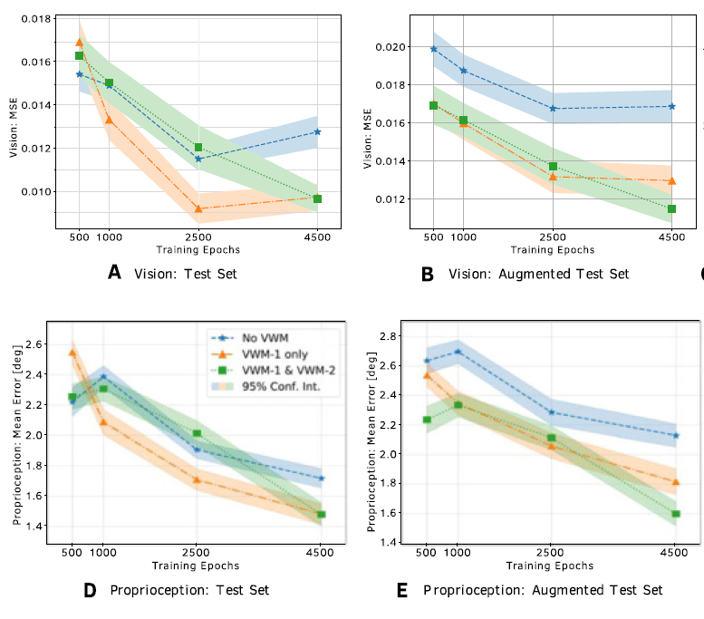
Performance Analysis Through Repeated Experiments Errors between Grand Truths and Generated Plans
Learned colors
Unlearned colors
Vision
No VWMs
VWM1
VWM1+VWM2
Both VWM1 and VWM2 are required to deal with unlearned color objects.
Proprioception
No VWMs
VWM1
VWM1+VWM2

Slide 47
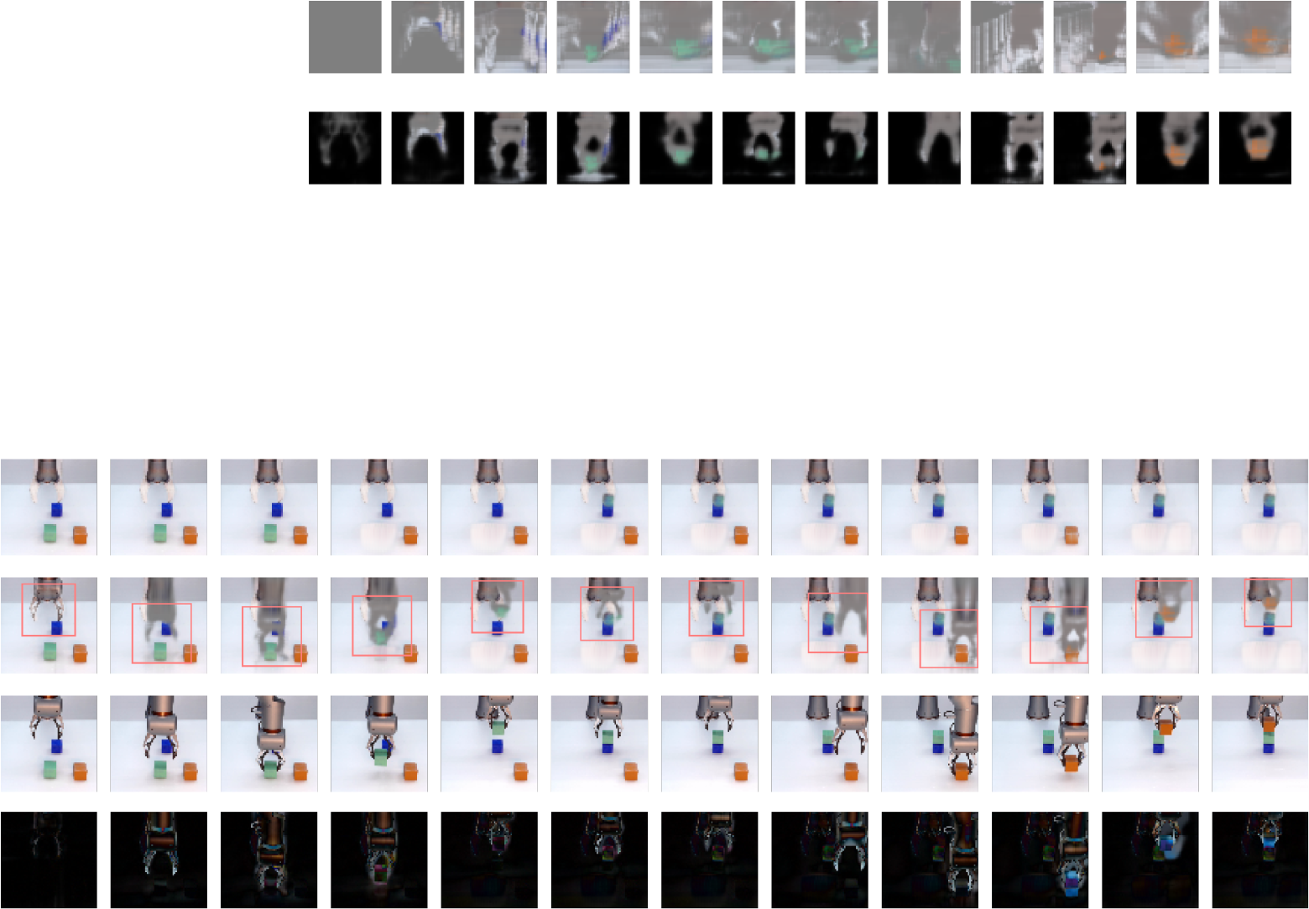
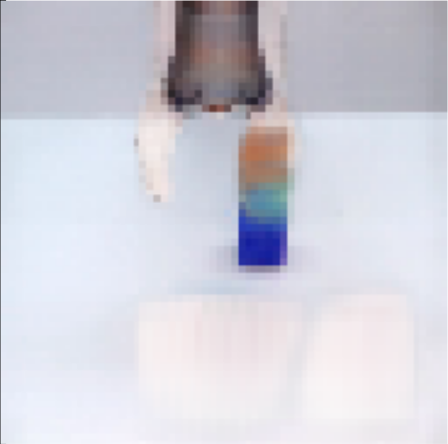
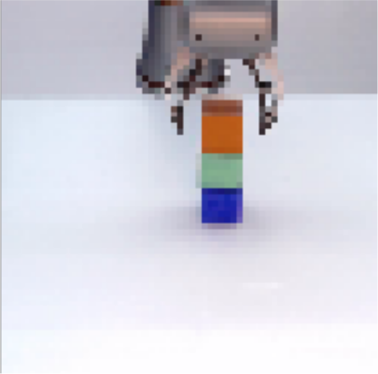
Unlearned orange color object case
Temporal zooming in of VWM-2
Temporal zooming in of VWM-2
VWM-2
VWM-1
Subgoal chunking
Generation
Ground truth
Proprioception
Goal image specified
8 16 24 32 40 48 56 64 72 80 88 96
Blue object is occluded.
Time t [steps]
Object permanency
Subgoal chunking
Content agnostic information processing in the higher-order cognition
Dealing with unlearned objects (OOD generalization)

Slide 48
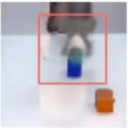
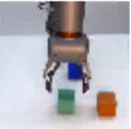
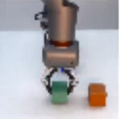
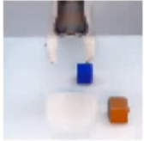
Emergence of Prefrontal-Like Executive Control
LSTMs
Pixel-wise mask
Parameter
Affine transformation
The 2nd WM
Masked copy
The 1st WM
Masked copy

Slide 49
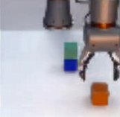
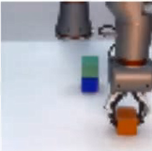
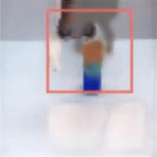
Emergence of Prefrontal-Like Executive Control
Content-agnostic information process for dealing with new color objects.
Contents (images of colored objects) and functions for manipulating them (image transformation) are separated.
Conventional generative models like conv-LSTM are not.
Prefrontal-like executive control
The higher-level LSTMs manipulates functions in the lower-level using control parameters (affine trans., masks, focusing).
The higher level deploys these cognitive resources in a compositional manner.
LSTMs
Pixel-wise mask
Parameter
Affine transformation
The 2nd WM
The 1st WM
Masked copy
Masked copy

