Slide 1
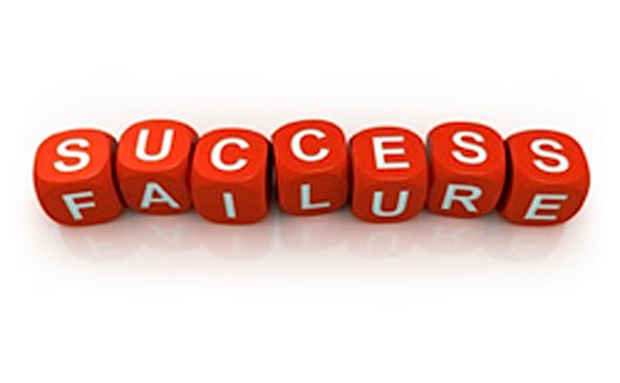
Relating to success and failure In an academic environment stories of success and failure can dominate, but sometimes we do not subject these stories to the same critical analysis that we would our research. If you have ever found that the prospect or experience of failure has had a disproportionate effect on your performance, hopes or enjoyment then join us to find ways of relating to these ideas that work best for you and share your learning with others!
Please sign up for a 6-week lunchtime group to examine how success and failure are socially-constructed, through selected readings, discussion and exercises, with the aim of giving each person a chance to explore what works best for them.
By the end you should have clearer ideas of how to prevent ideas of success and failure from overshadowing your hard work and happiness.
Sign up at:
successfail

