Slide 1
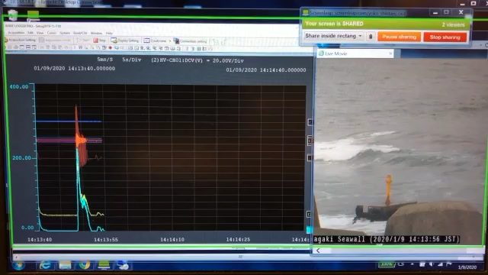
Seragaki Ducted WEC Monitor (2020 Jan.9th)

