Slide 1
How to Lead Better
Patricia Rankin, Professor of Physics, University of Colorado, Boulder
Patricia.Rankin@Colorado.Edu

Slide 2
Plan
What makes a team?
What leadership styles work?
How do you develop your leadership?
Specific “Power” Skills
recruiting/retaining, mentoring, consensus building, conflict management, planning, budgeting, meetings, grant writing….
And how you build those skills

Slide 3
Want to make well led, well managed research groups an expectation….
Go beyond subject skills to professional skills
How do you work in a group environment to improve chances of success?
How do you manage your time?
Quality/Quantity
Can you negotiate for resources you need?
Can you deal with conflict and keep focus on decision to be made not personalities?

Slide 4
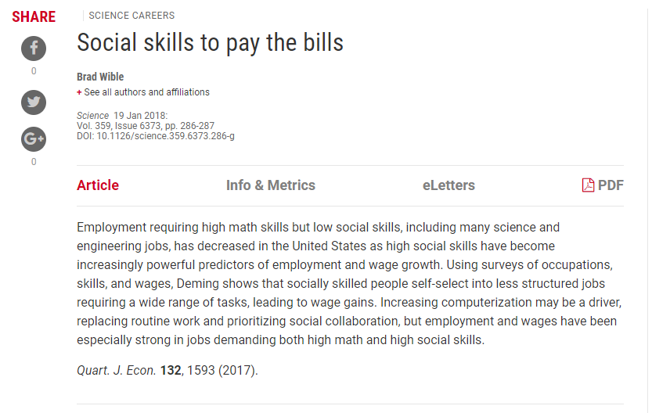
Need to broaden grad education (and at other levels)

Slide 5
Approach
Flexible!
Ask questions – what do you want to get from this….(I want you to benefit from time)
Some background/theory/motivation
Focus – implementation
What to do
How to do it

Slide 6
Ground Rules
Ground Rules
I would like you to feel free to raise issues, including ones related to your work environment that we can brainstorm solutions to
Can we agree that any such discussions remain private to this group?
I expect everyone to respect everyone in group and their right to their opinions
Questions for you
What do you want to learn from this time?
How can you participate most effectively to help yourself meet your goals?
What can I and others do to help you meet your goals (now or later)?

Slide 7
Who are you?
Pair up
One descriptor and one fun fact!
But – you introduce/share about your partner!
Listening practice – communication skill

Slide 8
Communication skills leave a big impression
One-on-one, in a meeting, or for a seminar. People will remember very little of what you say and a lot about how you say it!
Stick to a few take-aways (1-2 for a meeting, no more than 3 for a seminar)
Speak clearly
Make eye contact
No upspeak
Don’t touch your hair or face
Rehearse to see if you have any verbal tics
ahs, ums, likes – to excess
Land your points
Shorten your sentences
BREATHE!
Articulate your words
Use silence
Eliminate qualifiers
Notes:
Upspeak – rising intonation at end of sentence – like asking a question

Slide 9
Is this a good team?

Slide 10
What makes a team?
At is most basic – a team is greater than the sum of its parts (HBR, The Discipline of Teams, Katzenbach and Smith)
Common commitment/purpose
Share shaping/response – set specific goals
Attainable, measurable
Individual and mutual accountability
Constructive conflict
Share information and best practices

Slide 11
Collegiality/Conflict
At core, STEM is set of techniques to approach better understanding of our world
Collegiality is not an absence of conflict but defines how we handle conflict
Have a standard of professional behavior
Ethics
Treatment of others
Responsibilities to our students
Disagree on substance not personal attacks
“First Responder” – if you see a problem - act

Slide 12
S.M.A.R.T

Slide 13
S.M.A.R.T Goals/New Habits
Specific
Measurable
Achievable
Relevant
Timely
Can make SMARTER – add Evaluate/Exciting, Re-assess/Redo

Slide 14
E can be ecological or… R can be Rewarding …..

Slide 15
Motivation – focus on groups/teams
Science increasingly requires team efforts
Grand challenge problems require inter/trans disciplinary teams
Scott Page in “The Difference – How the Power of Diversity Creates Better Groups, Firms, Schools and Societies” uses mathematical simulations to show that groups of diverse problem solvers generally outperform groups of high-ability problem solvers
http://www.enlightenmenteconomics.com/blog/index.php/2017/08/how-diversity-pays-off/

Slide 16
Independent skills/Ladders/Trees
Do you learn things independently or sequentially?
Learn different periods of history
Learn Newtonian mechanics, Einsteinian mechanics
Leadership?
In reality – fields often inter-relate and learning some groups of tools allows people to branch off in many directions – eg understanding conservation laws in physics can have applications in many sub fields
The more trees and the more branches the more advantage to bringing in diverse skills.

Slide 17
Solution Spaces
Physics (for example) is “Ladder Like” – promotes “expert” opinion
One clear, correct solution (Mt Fuji)
Easily recognized when found
Like Z⁰ resonance
Adding physicists doesn’t necessarily
Improve chance of finding the solution

Slide 18
Over time though increasing need to address “Grand Challenge” Problems
These problems have a complex solutions space, many things to optimize (Rocky Mountains)
Need diverse approaches
Need people to voice objections/bring up issues
To avoid getting to top of a local
peak rather than a fourteener
need different skills
Value of broad recruitment of grad
students, postdocs
Matters ? Lots more women
died in auto accidents before
women auto engineers…

Slide 19
Wisdom of Crowds… Caveats
Page’s work is related to the concept that crowds can do better than individuals
Wikipedia
Problem is – reliability of an article edited by many people likely better than an article written by only one person – but how do you tell them apart?
Works best when crowd is diverse (and all listened to) and when there is a clear correct answer (eg to a math problem)
Bad if specialist knowledge key – like risk assessment
Works best when people agree on what is trying to be accomplished
Preference/value diversity can create conflict

Slide 20
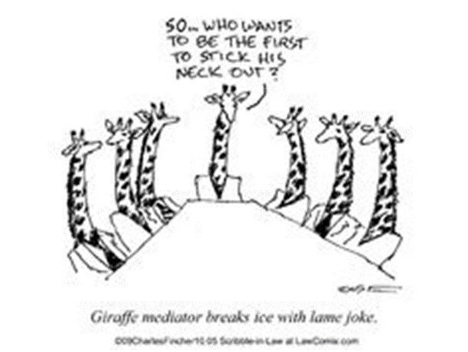
Do you want a lot of people with similar skills/personalities?
Basketball teams – tallest possible players
U.S. Hockey Miracle team
Not best players, best team players
U.S. Challenger disaster

Slide 21
Paradigms of Organizational Structures (Thomas and Ely, 1996)
The Discrimination and Fairness Paradigm
Stresses equal opportunities
“I treat everyone equally badly”
Role models/Survivors
The Access and Legitimacy Paradigm
Focuses on difference
People work where they can contribute most based on “their experiences”
Women are drawn to life sciences
Focus on skill development to enable people to fit (deficit model)
“Fix the women”/”Lean-in”

Slide 22
Third Paradigm – want to encourage!
The Learning and Effectiveness Paradigm
Incorporates, integrates different perspectives
What can an individual bring of value to group
Characteristics of third paradigm organizations
Good leadership/tone set from the top (allies)
Transparent processes
Clear communications
“Lean Out”/Process Driven

Slide 23
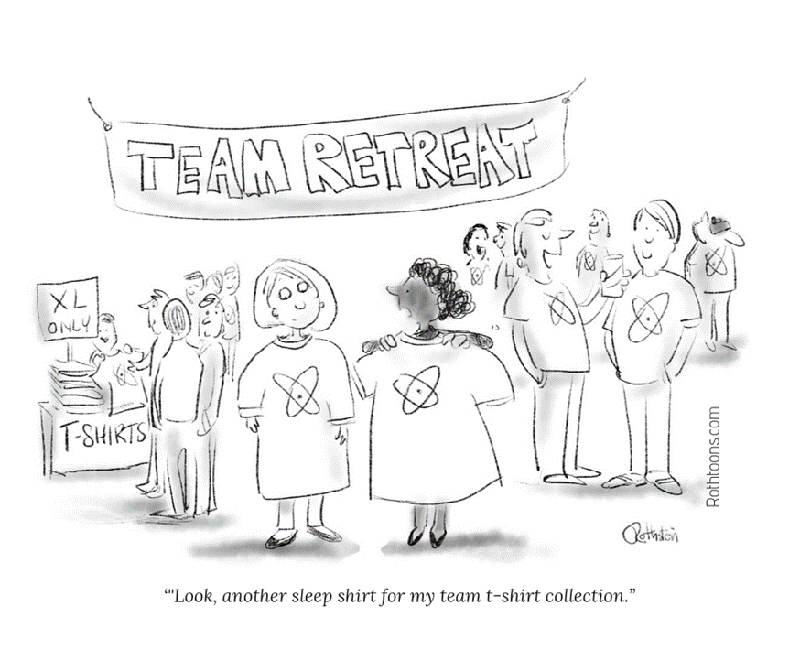
Diversity alone doesn’t necessarily help

Slide 24
Equity/Diversity/Inclusion
Diversity of a group is the wrong metric
Inclusion is a better one
Equity – who is invited to sit at table
Diversity – who is sitting at table
Inclusion – who speaks and has influence at table
Not so easy
Cognitive errors/bias
Not just a matter of individual change
But essential

Slide 25
Class – discuss!
Are good crisis leaders good “day to day” leaders?
“Leader’s courage (from french coeur = heart) is ultimately not for self but for all the people depending on him to lead” – John C. Maxwell – “The Right to Lead”
Are good “day to day” leaders good crisis leaders?
Who is the better leader – someone who succeeds in a task but many of team die or someone who fails but keeps team alive?

Slide 26
What Do the Best Leaders Have in Common?
A high degree of emotional intelligence
Notes:
Great leaders come in all shapes and sizes. Some are reserved and analytical, while others shout their messages from the mountaintops.
Different situations call for different styles.
But the best leaders all have a high degree of emotional intelligence.
This is the ability to monitor your feelings and those of others and to use that information to guide your thinking and behavior.

Slide 27
Emotional intelligence is twice as important as technical skills or IQ.
Notes:
Technical skills and smarts matter, of course, but they’re essentially table stakes for leadership positions: Although you need them to get into the game, they don’t guarantee that you’ll win.
Emotional intelligence is twice as important for jobs at all levels.
And in the top tier, it accounts for nearly 90% of the difference between average and star performers.

Slide 28
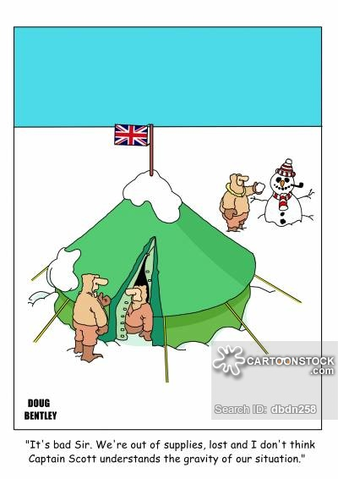
Scott of the Antarctic (film)
Reached the South Pole in 1912 after Amundsen
Perished on trek back
One of party - Captain Oates - sacrificed himself by going out into storm so he would not slow down his companions
Grave marked by quotation from Tennyson “to strive, to seek, to find and not to yield”
Initially seen as heroic, later as flawed, role in failure still debated
Didn’t use dogs
Unusually severe weather

Slide 29
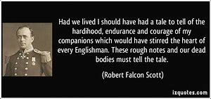
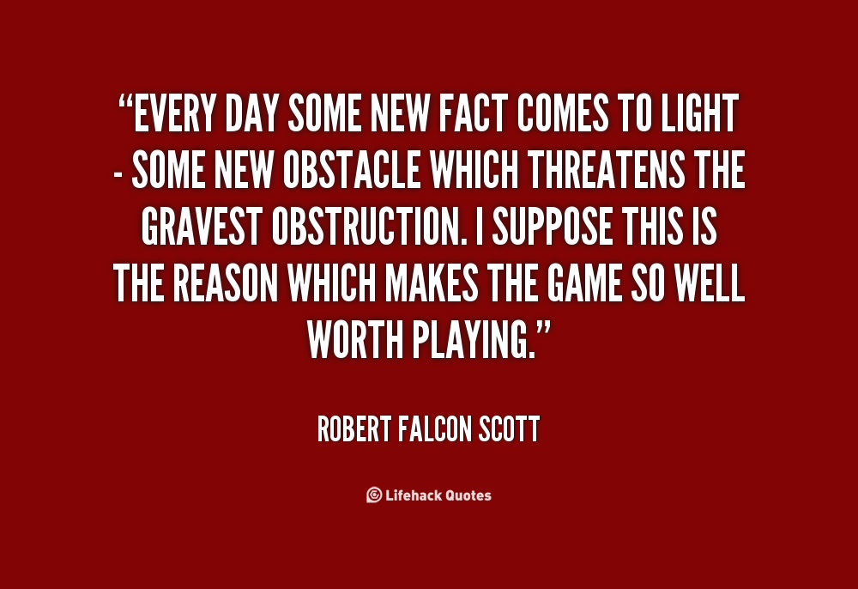
Notes:
Scot – Royal Navy – military tradition

Slide 30
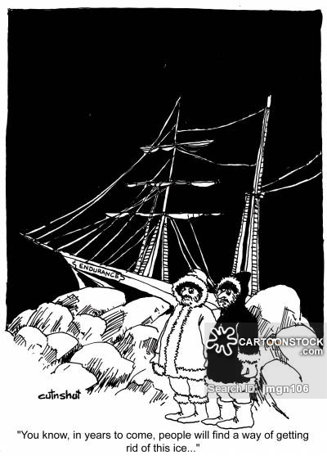
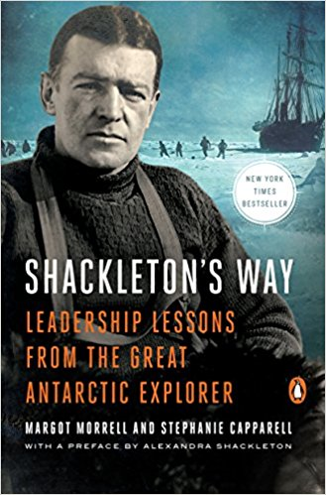
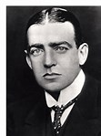

Slide 31
Sir Ernest Shackleton 1874-1922
“He has been called “The greatest leader that ever came on God’s earth, bar none,” yet he never lead a group larger that 27, he failed to reach nearly every goal he set, and, until recently, he had been little remembered after his death. But once you learn the story of Sir Ernest Shackleton and his remarkable Antarctic expedition of 1914-1916 you’ll come to agree with the effusive praise of those under his command. He is a model of great leadership and, in particular, a master of guidance in a crisis” – Margot Morell and Stephanie Capparell

Slide 32
Who was he?
One of the major figures in Antarctic Exploration in early 1900’s – grew up with 8 sisters
First served as a member of Scott’s Discovery Expedition 1901-1904
Did not get on well with Scott
Speculation Scott resented Shackleton’s popularity
Ended up being sent home with scurvy and blamed by Scott for failure of expedition
Knighted following Nimrod Expedition 1907-1909
Reached a record (for the time) farthest south latitude and found southern magnetic pole
Comment to wife on not reaching pole “A live donkey is better than a dead lion”
Notes:
He is not the first to reach the pole – Amundsen is…..in 1912

Slide 33
Imperial Trans-Antarctic Expedition 1914-1917
Shackleton’s goal then became to cross Antarctica travelling through the South Pole
Compare two expeditions
Stefanssson on Karluk set out to explore Arctic (Aug 1913)
Shackleton on Endurance set out to explore Antarctic (Dec 1914)
Both got trapped in pack ice
More than half of those on Karluk perished, those on Endurance survived
What is STEM equivalent of surviving a disaster?
No career ending injuries
No professional misconduct

Slide 34
Have you ever been cold and miserable?
Endurance sailed on Dec 5th, 1914
Knew ice further north than usual – took extra clothing
Should trip have been cancelled?
Jan 19th, 1915 – stuck in ice
Oct 27th, 1915 – ship is crushed and abandoned
Plan is to march across pack ice to open water but little progress made (two miles in two days)
April 9th, 1916 (day 491) – pack ice opens, boats launched, Reach Elephant island on April 15th
Day 506 – small group set sail for South Georgia Island reaching it 16 days later on May 10th – on wrong side of island
Shackleton and two others hiked overland for help
Four attempts made to rescue people on elephant island – finally successful on August 30th – 634 days after departure

Slide 35
Good Books/Video
Shackleton’s Way – Leadership Lessons from the Great Antarctic Explorer” Margo Morell and Stephanie Capparell
“Leading at the Edge – Leadership Lesons from the Extraordinary Saga of Shackleton’s Antarctic Expedition” by Dennis N.T. Perkins with Margaret P. Holtman, Paul R. Kessler, Catherine McCarthy
https://www.youtube.com/watch?v=e0wKmUUsnC4 (overview)

Slide 36
What did Shackleton get about leadership?
Notes:
Maybe not so different from Scott in appeal……get = understand

Slide 37
How do you recruit?
Be very clear about what you need and what is negotiable
Make a checklist to review candidates against
Think about
What basic skills should everyone have coming in
What skills can they learn easily if…
What skills would help us that we don’t currently have
Note – lots of ways to classify people by type/style/personality
MBTA, colors….
Interesting to reflect on, can talk more about
Type is not destiny though… you can “flex” (you may gravitate instinctually to some things under stress… awareness helps!)

Slide 38
Shackleton’s Way
Planning
Bought best equipment available
Hire top notch consultants
Leave details to experts, empower them to make their own decisions (did not micromanage)
Team Building
He did his share, assigned people by talent
Background Merchant Marine not Royal Navy
Identify “workhorses” for toughest tasks – but let them know you are aware that you are counting on their ability and good will

Slide 39
What did he do ? Examples
First officer fouled propeller early on when maneuvering – Shackleton helped him fix it without comments
Mistakes will be made; fix them and move on
When preparing for sledge march wanted everyone to travel light – 2lbs (about 1 kg) allowed per person for personal belongings
Threw away his gold cigarette case, gold sovereigns
Insisted that crew member brought along his banjo
Held a lottery to distribute warmer sleeping bags (had planned for only original group doing trek to have them) – exempted himself from participating
Argued about amount of ballast needed for boat – when journey over admitted he had been wrong

Slide 40
Flexible
Focus on present – not recriminations
Multiple plans for multiple contingencies
Not indecisive to change mind if get new information and can explain decision
“Often wrong, never in doubt” not good leadership!
Personally – I see effective leadership as “iterative” – do something and adjust

Slide 41
Managed Conflict/Modeled Key Behaviors
Managed Conflicts
People could vent but stepped in to avoid serious fights
Took people he considered biggest trouble makers with him on trip to South Georgia
Modeled key behaviors
Took on most challenging tasks
Stayed optimistic – “optimism is true moral courage” - Shackleton
Notes:
Class – strong preference for optimism

Slide 42
Communicated/Transparent/Respectful
Broke down social/occupational barriers
Allowed everyone a voice in discussion if not in decision
Small group meetings/divide team into subgroups
Show confidence in team members
Praise in public, criticize in private
When an individual needed help – offered a break/help to entire group rather than single someone out.

Slide 43
“Leading from the Edge” – Shackleton Model
Never lose sight of ultimate goal, and focus energy on short term objectives
Set a personal example with visible, memorable symbols and behaviors
Instill optimism and self-confidence, but stay grounded in reality
Take care of yourself: Maintain your stamina and let go of guilt
Reinforce the message constantly “We are one – we live or die together”
Minimize status differences and insist on courtesy and mutual respect
Master conflict – deal with anger in small doses, engage dissidents, and avoid needless power struggles
Find something to celebrate and something to laugh about.
Be willing to take the Big Risk
Never give up – there’s always another move

Slide 44
What about your leadership?
Get Feedback – especially 360⁰(people above, same level and below)
Avoid defensive reaction to criticism (easier said than done!)
Keep a decision journal
What did you decide, how did you decide, what do you expect to happen, maybe how you feel
Use it to look for patterns in what you do
Harder for you to deny what you yourself wrote…

Slide 45
Things to consider
Develop/Make a checklist (see “Checklist Manifesto”)
Easier in more stable environments
Look for ways to avoid previous failure modes
Keep short
Perform a “premortem”
Assume you are in the future and your decision failed
Provide plausible reasons for the failure
Know what can/cannot be known

Slide 46
Facilitative Leadership
http://www.schwartzassociates.com
I like this approach – core values are
Transparency
Curiosity
Accountability
Informed Choice
Compassion

Slide 47
Ground Rules (Facilitative Leadership)
State Views and ask genuine questions
Share all relevant information
Use specific examples and agree on what important words mean
Explain reasoning and intent
Test Assumptions and inferences
Jointly design next steps
Focus on interests not positions
Discuss un-discussable issues
Use a decision making rule that generate the right level of commitment

Slide 48
Mentor in the Moment
Looks for ways to mentor in daily interactions
Regular check-ins, less of a “big deal”
Where do your see yourself…what could I do to help….what I learned….why I do this….
Re-inforce good behaviors – say that you think they did good
Early intervention for bad behaviors…don’t wait for a formal review
Substance not style
HBR – “Real Mentorship Starts with Company Culture, Not Formal Programs” – Johnson and Smith

Slide 49
Good practices - feedback
Big picture Focus
What to people need to know to be maximally effective
Align to values/organization needs
Behavioral and specific
What is person doing/not doing
Factual not interpretive
Don’t guess what is going on / why someone is doing something
Positive and Negative
Look at Patterns
Look at impacts
Prioritized – few things at a time
HBR – “How to give feedback people can actually use” – Porter

Slide 50
Handle Problems
Focus on the Why
Prepare/Center yourself
Stand your Ground
“I need you to take a deep breath or we will need to reschedule”
Acknowledge
Your part in the problem
Grant them their perceptions (not same as agreeing with them – “This is what I heard you say” – check in, not affirm)
Consider doing at end of day so you both can leave afterwards
HBR – “How to give feedback to people who cry, yell, or get defensive” Jen Su, “Taking the Stress Out of Stressful Conversations” Weeks

Slide 51
Stress and Incentives
Stress response leads to a focus on short term and inhibits long term thinking
Incentives can also impact decision making
Bazerman study – asked 100 accountants to review five ambiguous accounting vignettes and judge the accounting by company x
Half told the company x had hired them, the other half that they had been hired by a different company y
People playing an accountant for x were 30% more likely to find account compliant with accounting principles

Slide 52
Stress Indicators
HBR – “Are you pushing yourself too hard at work?” – Zucker
Not taking time off
De-prioritizing personal relationships
Lack of social contact like smoking 15 cigarettes a day
Cannot leave work be hand/be fully present (checking work email…)
Neglecting sleep, meals, good diet….
Impairs critical thinking and decision making (night shift…not time to redesign exp)
Defined only by work
Note – talking about long term…not a few days to meet a deadline…..

Slide 53
Most Important Concept
Satisfice
Do only as much as you need to
Pareto Principle
Also known as 80/20 rule
Get 80% of the rewards from 20% of the effort
Rule of diminishing returns
Its not how much time you spend its how you spend the time

Slide 54
The 5 P’s (long term time management)
Purge: get rid of outdated information
Plan: map out your new system
Place: get everything set up
Put: file in the appropriate place
Purchase: hire out (or trade) what you can't do/don’t enjoy

Slide 55
The 4 D’s (short term time management)
Delete – do you need to do anything?
Delegate – do you have to do it?
Defer – is it important to do this now?
Diminish – make a start at least
Generally – learning a tool takes time but pays long term dividends…consider Return on Investment (ROI)

Slide 56
Think to yourselves for this exercise
List months of the year
Did you do in calendar order?
Can you list alphabetically ?

Slide 57
How hard is change?
Studies suggest only 1 in 7 heart patients will change behaviors when told it is a matter of life or death…
What people intend/what people do different
How do you surface the elephant?
IMMUNITY TO CHANGE: How to Overcome it and Unlock Potential in Yourself and your Organization. Robert Kegan and Lisa Lahey

Slide 58
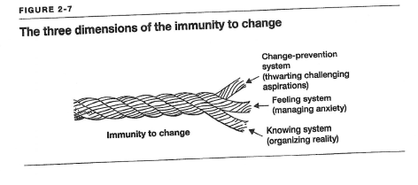

Slide 59
Immunity Steps
What change do you desire? (complaint)
What is implied by the need for this change? (what is underlying this – what is your want)
What is getting in the way/why isn’t this happening right now?
What do the behaviors prevent from happening that you don’t want to happen?

Slide 61
Example
I want people to bring me problems and they don’t
I want open communication
I get annoyed when people tell me about problems
If they bring me problems I cannot pretend things are ok/I need to fix problems and I may not be able to/if I cannot fix I will lose face

Slide 62
“You Learn Physics to Learn how to Think”
My favorite physics professor used to tell me that it didn’t matter what you studied as long as you learned how to study and how to solve problems and how to think
He also argued that physics was a particularly good subject to teach you how to think because the “right” answer was not a matter of interpretation, culture, history etc…..
Objective truth
My father “Don’t let the building burn down while you are thinking what to do”

Slide 63
Clearer Decision Making

Slide 64
Decision Making
Lots of interesting reads on this topic – these influenced me
“Think Better” – Tim Hurson
“On Being Certain – Believing you are right even when you are not” – Robert Burton
“Think Again” – Sydney Finkelstein, Jo Whitehead, Andrew Campbell
“Denialism” – Michael Specter
“Think Twice” Michael Mauboussin
“The Checklist Manifesto” – Atul Gawande
“Sway” – Ori Brafman and Rom Brafman
“Predictably Irrational” – Dan Ariely

Slide 65
Survival Mechanism
Length of neural fibres governs response rate
Emergency situation – hazard ahead while driving
Stem – slam on breaks
Limbic – react, shaking at near miss
Cortex – start to analyse what happens
Old ideas
Stem – absorb, no risk
New ideas
Stem – reacts first
Fight/flee/destroy
Cortex – rationalizes

Slide 66
Not always good
Difficult to break patterns (order of months)
Try switching your route across town…
Elephants – tether with a chain when young, they soon give up trying to get free, then can use a loop of rope… elephants don’t try to get away..

Slide 67
Trends
1,2,3… What comes next?
Scott Huettel put subjects into a fMRI and showed them random patterns of circles and squares
After seeing one symbol – no expectation of what second would be
If saw the same symbol twice in a row – expected to see it a third time
Predictive process is “automatic and obligatory”
Hear a crash behind you, move out of way
Extrapolations based on past results ignore what could have changed in environment

Slide 68
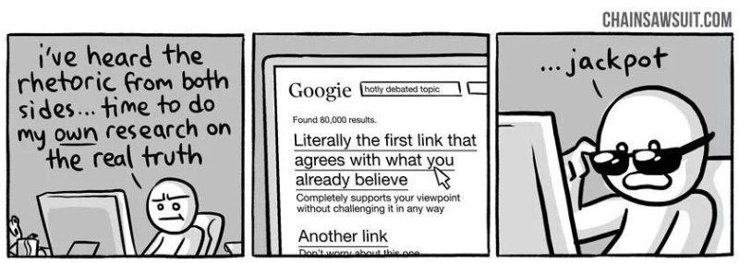
https://betterhumans.coach.me/cognitive-bias-cheat-sheet-55a472476b18
(Another important source for this lecture)

Slide 69
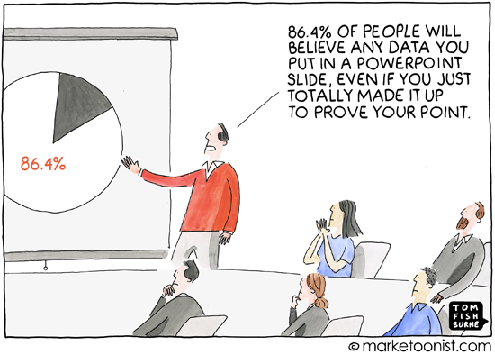

Slide 70
Reproductive Thinking
Mindless repetition / Conscious systematization/ incremental improvement
Repeating past behaviors, not challenging ideas, perceptions
Given stimulus, predictable response
“That’s the way we do things”
“Why change things that work”
Taking the same seat at the table…..
QWERTY keyboard

Slide 71
Incremental Change/ Kaizen
Kai = “change” zen = “good”
Monitor and refine
Take something good and make it better
“Continuous Quality Improvement”
“Six Sigma”
Can be a good way to improve health, diet – small incremental change may be easier to sustain than radical change
But – incremental change can improve upon the original – but not make something different

Slide 72
Productive Thinking
Breakthrough change
“Tenkaizen” ( “Think Better” - Tim Hurson www.thinkxic.com)
Ten = law, kai = change, zen=good
“good revolution”
Journal of Spurious Correlations, JSpurC
Forum for unpublishable results - i.e. for experiments and studies that failed
Failures can be studied for methodological errors and thus improve future studies
Can help others to avoid repeating mistakes

Slide 73
Risk/Failure
If consequences of failure high – favor reproductive thinking
Experience counts when doing things like landing a plane, valuable to fall back on trained responses
When consequences low – easier to do productive thinking
Prototyping
Looking for modes of failure
Edison – “I have not failed. I have merely found ten thousand ways that do not work”

Slide 74
S.M.A.R.T

Slide 75
Another S.M.A.R.T
Tests for big assumptions
Safe and Modest – what can you risk in testing even if you are wrong and assumption is correct?
Actionable – can try quickly, soon
Research/Test stance not a change stance – testing/rejecting assumption

Slide 76
Decisions
Think of a decision that you need to make
How do you plan to go about it?
Do you need information?
How do you get all the options on the table?
Do other people control some of the options?
What is your plan B?

Slide 77
Pair up to discuss your decision…..

Slide 78
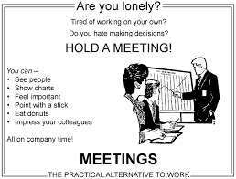
Meetings
Roles
Chair
Facilitator
Reporter
Meeting participant

Slide 79
Good Practices
Meetings should
Have a purpose
Have someone who has done a good job of identifying/selecting participants
Have an agenda
Start and end on time, not be too long
Start with introductions if people do not know each other well
Start with goals, ground rules
End with action items and/or decision summary
Have ground rules for interactions (set behavioral norms)
Active chair
Prepared and realistic
Not too dominant but clearly in control
Ensures feedback/follow up after meeting

Slide 80
Process is key
Making decisions
Should only have committees if they are to discuss/decide something
Minimise informational meetings and look for better ways to relay information
It is easier to decide how to decide before you have to decide!
Consensus or unanimity?
How much consensus?
Probably depends on importance of decision

Slide 81
Decision Model - overview
What is going on?
What is Success?
What is the Question?
Generate Answers
Forge the solution
Align resources

Slide 82
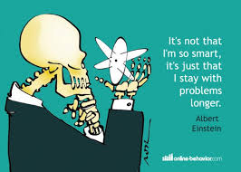
Explore Decision Space
What is going on?
What needs fixing/improving?
Why does it matter?
What information is available?
Who are stakeholders and what is at stake?
What is most compelling vision of a future where problem is solved?
What is success?
What would the future be like?
How would you measure/define success? What criteria will you apply?

Slide 83
Brainstorming Techniques
Timed period for ideas – no criticism/comment
Yellow stickies
Write on cards, collect randomly redistribute for comment
Group people and rotate
Generate ideas, critique ideas, come up with solutions
Perspective of target group
What could go wrong (switches perspective)

Slide 84
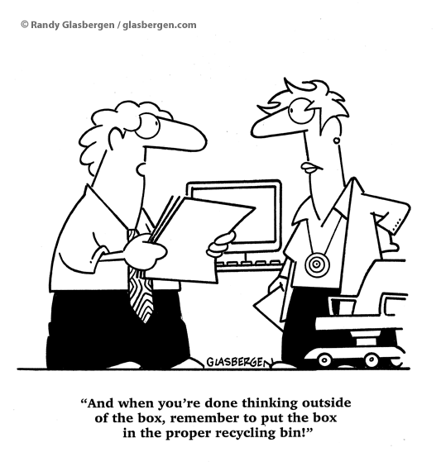
Effective Brainstorming
Alex Osborn, 1941
Criticism is ruled out
Freewheeling is welcomed
Easier to tone down
Quantity is wanted
More ideas lead to increased likelihood of success
Combination and Improvement are sought
Studies suggest rule of thirds
First third of ideas tend to be reproductive, next third begin to stretch boundaries, final third new ideas

Slide 85
Getting to third, third
Need to resist temptation to settle on first possible solution
Need to break past the tendency to stop when people think ideas are exhausted (usually after get old ideas/simple ideas on table)
ELSE
How ELSE might problem be solved?
Who ELSE might be involved?
Where ELSE might a solution come from?

Slide 86
Process is KEY
Transparency important
Information, decision making process
Are all issues raised?
Talk one on one
Talk in small groups
If chair, danger if you decide upon the desired outcome too early
Can you present all sides?
Are you willing to change your mind?

Slide 87
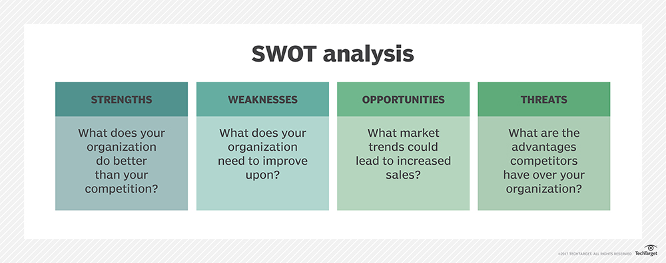
Acronyms
GEPO – Good Enough Push On
I³ - Influence, Importance, Imagination
POWER – Positives, Objectives, What Else, Enhancements, Remedies
SWOT – Strengths, Weaknesses, Opportunities, Threats

Slide 88
Explore Decision Space (Planning, Negotiating)
Look for ways to get ideas/interests on table before start detailed negotiation
Not everyone wants the same thing
Do you want more time / autonomy / flexibility / money / resources
Look at time frames – short/long term interests

Slide 89
Building Consensus
Understand the context
Biggest mistake can make is advocating for change before understand the culture you are working in
How do things get done?
When do things get done?
Why are things done that way?
Who are the key players?
Listen and observe
Understand the issue
Find out as much as you can in advance, analyze what you learn
Who benefits?
Easier if people benefit rather than an abstract entity “the group”

Slide 90
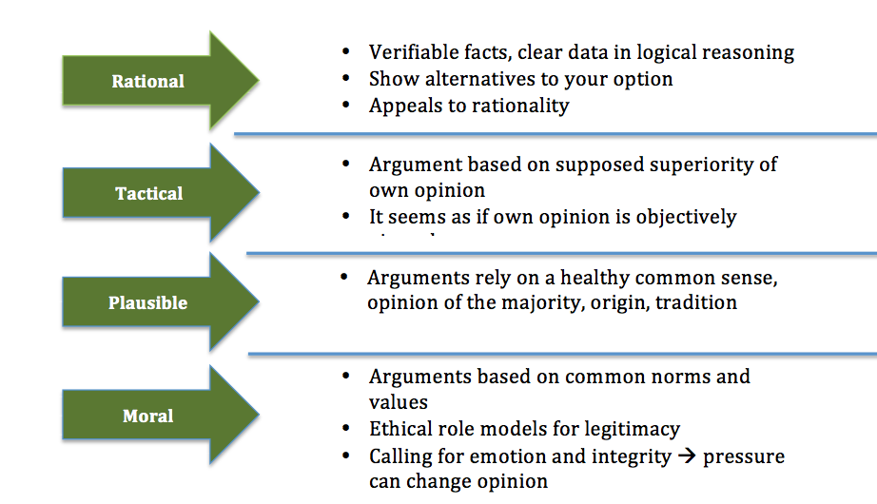
better

Slide 91
Testing Inferences …
One of biggest mistakes people can make is assuming that they know what someone means/intends/is implying
Often helps to test what you think you heard or if your deduction is correct
Tried out a good technique to help focus at start of workshop for introductions

Slide 92
Some other tactics
Connect to the organization or person’s goals, needs, or interests.
To be successful for the department, we will need…
Use relationship language
I’ve talked with several people who..
[Person] suggested that I talk with you…
Don’t take it personally! (Defensive Driving)
Know your purpose/goal
It’s not about you, but about you in a role
Go around, over, under bad behavior
Try to view it as a game

Slide 93
Thomas Kilmann Conflict Modes Negotiation ( is consensus building)
Group – Where do “Win-Win” and Win-Lose” map to?
Notes:
May be low assertive because just don’t care….

Slide 94
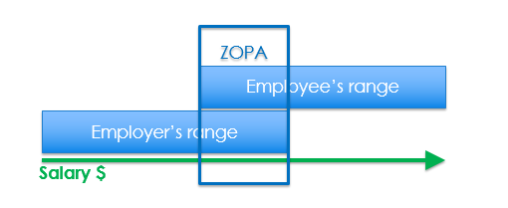
ZOPA – Zone of Possible Agreement
Understand the person you’ll be negotiating with. What are their interests? What is their style? What is your style?
Understand the full scope of what you can negotiate. What do other people get in similar situations? (ZOPA - Zone of Possible Agreement)

Slide 95
Information to gather
What are the norms here?
At your institution/In your industry?
Elsewhere?
Information is key
Talk to peers/Use your network
See if any national/regional/local data is available
What do you do if data/research does not support your position?
Acknowledge, explain why data may not be applicable or why the norm should be changed

Slide 96
Reservation Price/BATNA (Best Alternative to a Negotiated Agreement)
Ask your self
What do I have now
What must I have in future
What can I live without
What can I ask for instead
At what point do I walk away
Use these to set your “Reservation Price” and BATNA
May be same if have a limited negotiation – eg salary only
Maybe status quo (Not so much BATNA as “Only alternative to a negotiated solution”

Slide 97
Consider Compromise
Are you asking for minimum you want or more than you want?
What you would like or what you need?
What is your fall back position?
Needs balance
Don’t give in too easily
Don’t argue too hard

Slide 98
Beware of Anchoring….
Be aware of “Anchoring”
First number laid out in a discussion has an “anchoring effect”
Too low – hard to raise offer
Too High – seen as unrealistic
May/May not be good to go first

Slide 99
Distributive to Integrative
A distributive negotiation is one where only one thing is on the table
E.g. the price of a house
If the reservation price the seller has in mind (lowest they will sell for) and reservation price of buyer (most they will pay) overlap – have a zone of possible agreement
If not – no room for negotiation
If do – goal of buyer is to get lowest price, goal of seller highest, likely both will be somewhat disappointed

Slide 100
Integrative
The purpose of exploring needs not positions is to open up the possibility of a more integrative approach (win-win)
If increase the options on the table
Provide some funds for decorating house
Leave some furniture behind
Rent to own
Help Seller move…
Then may convert to a situation everyone happy with end result

Slide 101
Avoid
Assuming in advance how someone will act – people are rarely always wrong
Appeasement
Cannot please everyone, every time
Trading votes
Focus on specifics of the issue
Making things personal
Single options
If there is no time for a choice or no freedom do not pretend

Slide 102
Success Strategies
Practice conversation/role play
Helps to try out arguments in advance on someone who will be a constructive critic
Think about other person’s interests
How will what you propose help them?
Easier to recruit future graduate students/better graduate students?
Establishing a fair policy?
Helping you be more effective in helping them get their research done or publicized?

Slide 103
Keep the tone polite and positive
Try to frame statements as “I” not “you”
“I believe I deserve “x” because I have achieved “y”” not “You are being unfair if you don’t give me “x”
Be as factual as possible
Avoid exaggeration
Be as clear as possible
Context and Interpretation are key in communication.
Are you listening to responses you are being given?
Can help if you repeat back to people what you think they said “I think what you are telling me is….. did I understand you correctly? And then respond

Slide 104
What next?
Thank you for your attention !
Happy to follow up on these conversations
What will you try?

Slide 105
Additional Slides – teams and types of team members

Slide 106
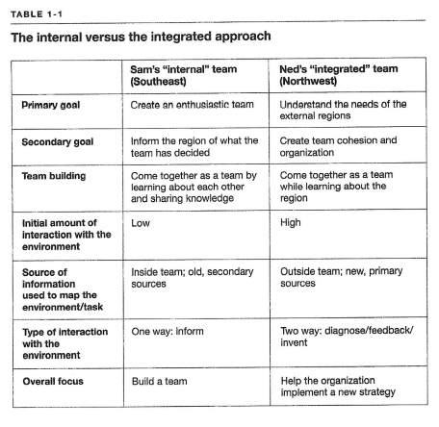

Slide 109
If you are
Green
Look for challenges, chance to innovate
Expect intelligence and competence
Be careful - Can sulk, be highly critical
Orange
Want independence, lack of structure, good with tasks requiring physical co-ordination
Assumes flexibility, works in here and now
Be careful - Can become aggressive, rude, intentionally break rules

Slide 110
If you are
Blue
Look for ways to influence, chance to help
Expects “team spirit”, democratic approach, wants opinions
Be Careful -Can withdraw, lie to save face, passively resist
Gold
Great at details, organization, provide stability
Detailed and thorough approach, loyal
Be careful - Complain, prone to self pity, herd mentality

Slide 111
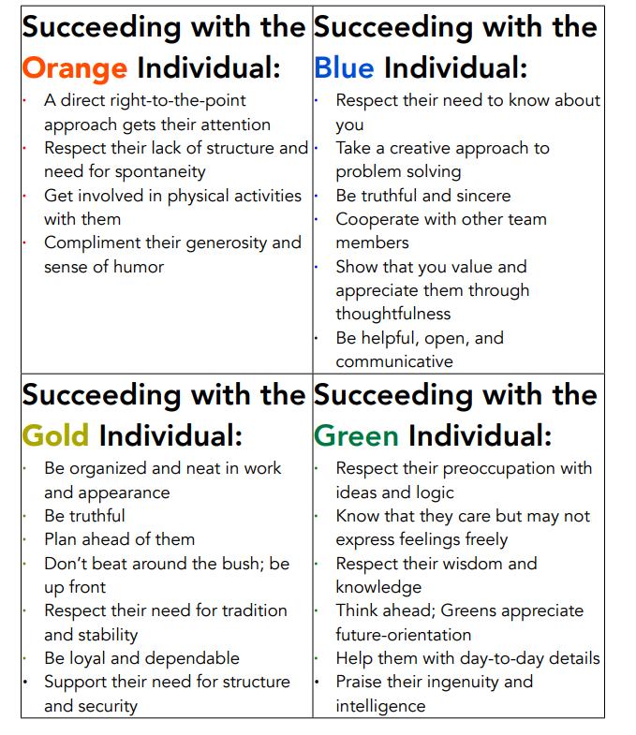

Slide 112
Additional Slides – levels of understanding

Slide 113
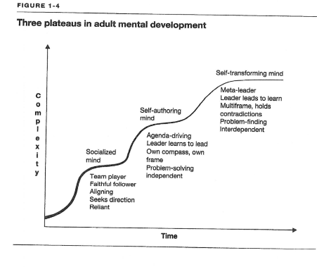

Slide 114
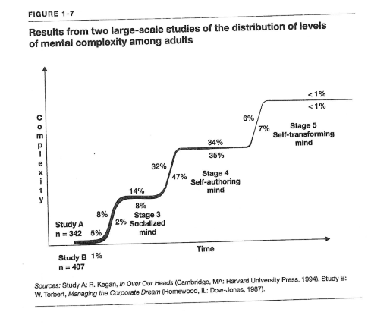

Slide 115
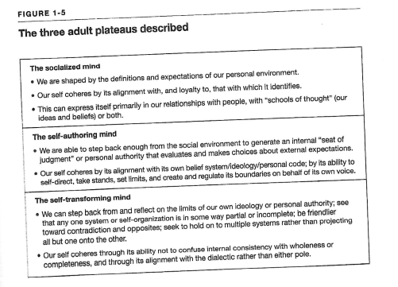
How do we learn these skills? How do we teach them?

Slide 116
Additional Slides – Decision Making

Slide 117
AHA experience / Unexpected Connections
Heracletus 6th century BCE “ The unexpected connection is more powerful than one which is obvious”
Also know as Eureka Moments after Archimedes
Many examples in Science
John Snow – London Cholera outbreak in 1854 – connected many victims to a water pump that was contaminated
Farnsworth – developed TV after wondering when looked at straight lines of plowed field if could build up picture line by line
Fleming – Penicillin
Dean Langler at Oberlin College – if could move pianos – could improve access for people with disabilities – first US campus to have a policy of access

Slide 118
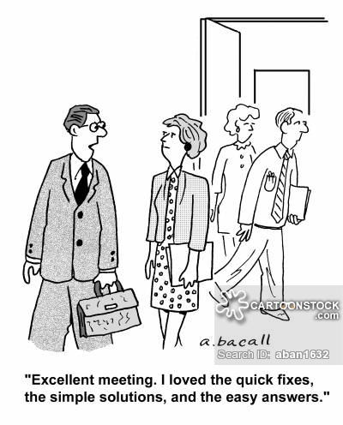
Problem solving 101
Perceive a problem
Pick a solution
Do something/anything

Slide 119
Creative and Critical Thinking
Critical Thinking
Analytic, Judgmental, Selective
Productive thinking is most likely when these are separate steps
Creative Thinking
Generative – blue-skying, what-iffing, ephemeral
Non-judgemental
Expansive
If let ideas live by deferring judgment tend to get more ideas…

Slide 120
So…
What is the Question?
Change problems into questions
We cannot do this because…. What would we have to to to be able to….
What is most compelling question?
What question could drive a brainstorming session?
Generate Answers
Forge Solution
Evaluate most promising ideas, compare to success criteria, make robust
Align Resources

Slide 121
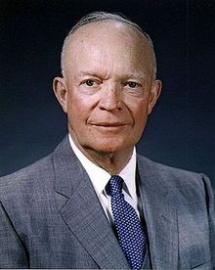
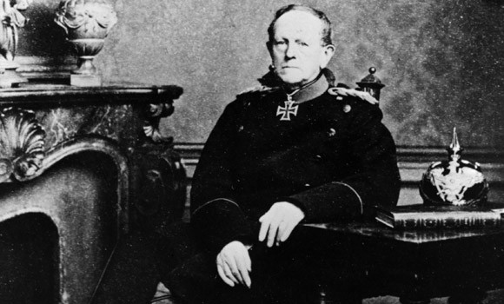
Quotes
Eisenhower – “Plans are useless but planning is indispensable”
Moltke - “No battle plan survives contact with the enemy

Slide 122
Class Discussion - Tunnel Vision
Why can it be hard to make sure you spend enough time/effort on considering alternatives?
Why do we tend to rapidly narrow focus?
Phillip Johnson-Laird model
People reason from a set of premises and only look for compatible possibilities
Influenced by how problem is presented
Use mental models that are incomplete
Survival depended on fast/efficient techniques

Slide 123
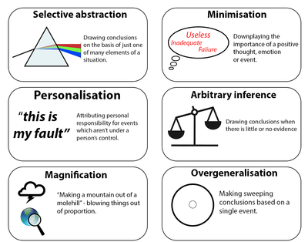
Cognitive Dissonance/Confirmation Bias
Cognitive dissonance wants internal consistency
Confirmation Bias wants external consistency
Robert Cialdini – consistency offers two benefits
Permits us to stop thinking about something – allows a mental break
Allows us to avoid changing our behavior – no need to act

Slide 124
Problems “Biases” Address
Too much information coming in
Don’t get all the information we need
Need to do something (cannot be paralyzed)
Cannot remember everything

Slide 125
“Think Better” - Maubousin
Avoid tunnel vision by
Explicitly considering alternatives
Negotiation – know best alternatives to a negotiated settlement for both sides
Seek Dissent
Lincoln Cabinet
Keep track of previous decisions
Kierkegaard “Life must be understood backwards… But it must be lived forwards”
Tendency for us to believe we knew more about an outcome beforehand than we actually did
Hindsight bias – people unreliable in saying how uncertain they were before seeing results

Slide 126
.. “Think Twice” - Mauboussin
Avoid making decisions at emotional extremes
Stress, anger, fear, anxiety, greed, euphoria
Understand what incentives may be operating
Financial
Reputation
Benefits to individual rather than group
How much work put in should depend on importance/impact of decision
Car insurance ad – time choosing car v insurance

Slide 127
“Think Twice” – general recommendations
Raise your awareness
Study other peoples poor decisions – easier then to catch your own
Put Yourself in the shoes of others
Consider other perspectives, have empathy
Recognize role of skill and luck
If commenting on someone's performance – look only at what skill could impact

