Slide 1
Communication skills leave a big impression
One-on-one, in a meeting, or for a seminar. People will remember very little of what you say and a lot about how you say it!
Stick to a few take-aways (1-2 for a meeting, no more than 3 for a seminar)
Speak clearly
Make eye contact
No upspeak
Don’t touch your hair or face
Rehearse to see if you have any verbal tics
ahs, ums, likes – to excess
Land your points
Shorten your sentences
BREATHE!
Articulate your words
Use silence
Eliminate qualifiers
Notes:
Upspeak – rising intonation at end of sentence – like asking a question

Slide 2
S.M.A.R.T

Slide 3
S.M.A.R.T Goals/New Habits
Specific
Measurable
Achievable
Relevant
Timely
Can make SMARTER – add Evaluate/Exciting, Re-assess/Redo

Slide 4
E can be ecological or… R can be Rewarding …..

Slide 5
Mentor in the Moment
Looks for ways to mentor in daily interactions
Regular check-ins, less of a “big deal”
Where do your see yourself…what could I do to help….what I learned….why I do this….
Re-inforce good behaviors – say that you think they did good
Early intervention for bad behaviors…don’t wait for a formal review
Substance not style
HBR – “Real Mentorship Starts with Company Culture, Not Formal Programs” – Johnson and Smith

Slide 6
Good practices - feedback
Big picture Focus
What to people need to know to be maximally effective
Align to values/organization needs
Behavioral and specific
What is person doing/not doing
Factual not interpretive
Don’t guess what is going on / why someone is doing something
Positive and Negative
Look at Patterns
Look at impacts
Prioritized – few things at a time
HBR – “How to give feedback people can actually use” – Porter

Slide 7
Handle Problems
Focus on the Why
Prepare/Center yourself
Stand your Ground
“I need you to take a deep breath or we will need to reschedule”
Acknowledge
Your part in the problem
Grant them their perceptions (not same as agreeing with them – “This is what I heard you say” – check in, not affirm)
Consider doing at end of day so you both can leave afterwards
HBR – “How to give feedback to people who cry, yell, or get defensive” Jen Su, “Taking the Stress Out of Stressful Conversations” Weeks

Slide 8
Most Important Concept
Satisfice
Do only as much as you need to
Pareto Principle
Also known as 80/20 rule
Get 80% of the rewards from 20% of the effort
Rule of diminishing returns
Its not how much time you spend its how you spend the time

Slide 9
The 5 P’s (long term time management)
Purge: get rid of outdated information
Plan: map out your new system
Place: get everything set up
Put: file in the appropriate place
Purchase: hire out (or trade) what you can't do/don’t enjoy

Slide 10
The 4 D’s (short term time management)
Delete – do you need to do anything?
Delegate – do you have to do it?
Defer – is it important to do this now?
Diminish – make a start at least
Generally – learning a tool takes time but pays long term dividends…consider Return on Investment (ROI)

Slide 11
Immunity Steps
What change do you desire? (complaint)
What is implied by the need for this change? (what is underlying this – what is your want)
What is getting in the way/why isn’t this happening right now?
What do the behaviors prevent from happening that you don’t want to happen?

Slide 13
Example
I want people to bring me problems and they don’t
I want open communication
I get annoyed when people tell me about problems
If they bring me problems I cannot pretend things are ok/I need to fix problems and I may not be able to/if I cannot fix I will lose face

Slide 14
Decision Making
Lots of interesting reads on this topic – these influenced me
“Think Better” – Tim Hurson
“On Being Certain – Believing you are right even when you are not” – Robert Burton
“Think Again” – Sydney Finkelstein, Jo Whitehead, Andrew Campbell
“Denialism” – Michael Specter
“Think Twice” Michael Mauboussin
“The Checklist Manifesto” – Atul Gawande
“Sway” – Ori Brafman and Rom Brafman
“Predictably Irrational” – Dan Ariely

Slide 15
Risk/Failure
If consequences of failure high – favor reproductive thinking
Experience counts when doing things like landing a plane, valuable to fall back on trained responses
When consequences low – easier to do productive thinking
Prototyping
Looking for modes of failure
Edison – “I have not failed. I have merely found ten thousand ways that do not work”

Slide 16
Another S.M.A.R.T
Tests for big assumptions
Safe and Modest – what can you risk in testing even if you are wrong and assumption is correct?
Actionable – can try quickly, soon
Research/Test stance not a change stance – testing/rejecting assumption

Slide 17
Good Practices - Meetings
Meetings should
Have a purpose
Have someone who has done a good job of identifying/selecting participants
Have an agenda
Start and end on time, not be too long
Start with introductions if people do not know each other well
Start with goals, ground rules
End with action items and/or decision summary
Have ground rules for interactions (set behavioral norms)
Active chair
Prepared and realistic
Not too dominant but clearly in control
Ensures feedback/follow up after meeting

Slide 18
Decision Model - overview
What is going on?
What is Success?
What is the Question?
Generate Answers
Forge the solution
Align resources

Slide 19
Brainstorming Techniques
Timed period for ideas – no criticism/comment
Yellow stickies
Write on cards, collect randomly redistribute for comment
Group people and rotate
Generate ideas, critique ideas, come up with solutions
Perspective of target group
What could go wrong (switches perspective)

Slide 20
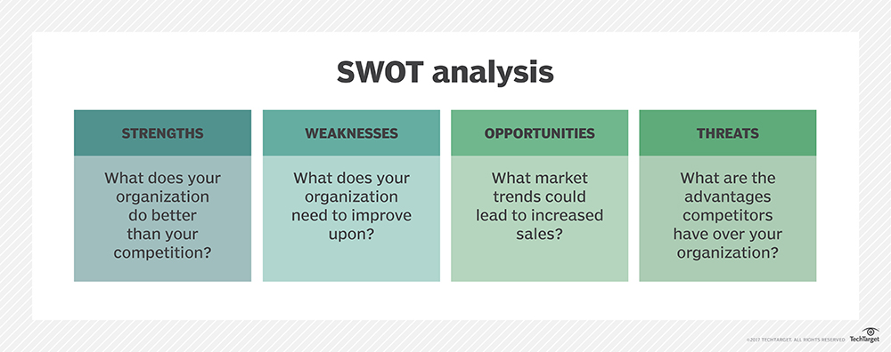
Acronyms
GEPO – Good Enough Push On
I³ - Influence, Importance, Imagination
POWER – Positives, Objectives, What Else, Enhancements, Remedies
SWOT – Strengths, Weaknesses, Opportunities, Threats

Slide 21
Some other tactics – consensus building
Connect to the organization or person’s goals, needs, or interests.
To be successful for the department, we will need…
Use relationship language
I’ve talked with several people who..
[Person] suggested that I talk with you…
Don’t take it personally! (Defensive Driving)
Know your purpose/goal
It’s not about you, but about you in a role
Go around, over, under bad behavior
Try to view it as a game

Slide 22
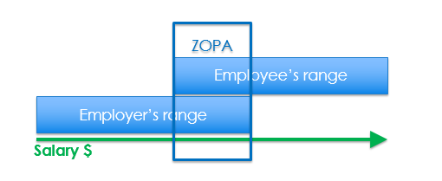
ZOPA – Zone of Possible Agreement
Understand the person you’ll be negotiating with. What are their interests? What is their style? What is your style?
Understand the full scope of what you can negotiate. What do other people get in similar situations? (ZOPA - Zone of Possible Agreement)

Slide 23
Reservation Price/BATNA (Best Alternative to a Negotiated Agreement)
Ask your self
What do I have now
What must I have in future
What can I live without
What can I ask for instead
At what point do I walk away
Use these to set your “Reservation Price” and BATNA
May be same if have a limited negotiation – eg salary only
Maybe status quo (Not so much BATNA as “Only alternative to a negotiated solution”

Slide 24
Avoid
Assuming in advance how someone will act – people are rarely always wrong
Appeasement
Cannot please everyone, every time
Trading votes
Focus on specifics of the issue
Making things personal
Single options
If there is no time for a choice or no freedom do not pretend

